Slide 1

Low-resolution FTIR spectrometers for the validation of S5P CH4 and CO products
Mahesh Kumar Sha, Martine De Mazière, Justus Notholt, Thomas Blumenstock, Huilin Chen, Angelika Dehn, David W T Griffith, Frank Hase, Pauli Heikkinen, Christian Hermans, Marco Huebner, Nicholas Jones, Rigel Kivi, Bavo Langerock, Christof Petri, Qiansi Tu and Damien Weidmann
http://frm4ghg.aeronomie.be/

Slide 2
Campaign description
Fiducial Reference Measurements for Ground-Based Infrared Greenhouse Gas Observations (FRM4GHG) is a European Space Agency (ESA) funded project focusing on the intercomparison of instruments and harmonization of retrievals and products from collocated new and established GHG observation ground based Infrared instrumentations to get Fiducial Reference Measurements (FRMs) for Greenhouse Gases (GHGs). These dataset will also be used for the validation of satellite missions targeting:
carbon dioxide (CO2); methane (CH4); carbon monoxide (CO); other climate relevant trace gases (e.g. formaldehyde (HCHO))
Lead by: Justus Notholt (University of Bremen) and Martine De Mazière (BIRA-IASB)
http://frm4ghg.aeronomie.be/
Sha, M. K., De Mazière, M., Notholt, J., Blumenstock, T., Chen, H., Dehn, A., Griffith, D. W. T., Hase, F., Heikkinen, P., Hermans, C., Hoffmann, A., Huebner, M., Jones, N., Kivi, R., Langerock, B., Petri, C., Scolas, F., Tu, Q., and Weidmann, D.: Intercomparison of low and high resolution infrared spectrometers for ground-based solar remote sensing measurements of total column concentrations of CO₂, CH₄ and CO, Atmos. Meas. Tech. Discuss., https://doi.org/10.5194/amt-2019-371, in review, 2019.

Slide 3
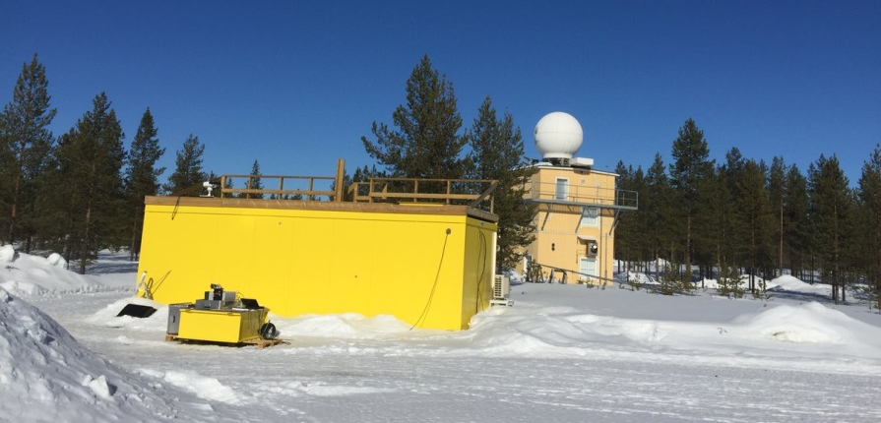
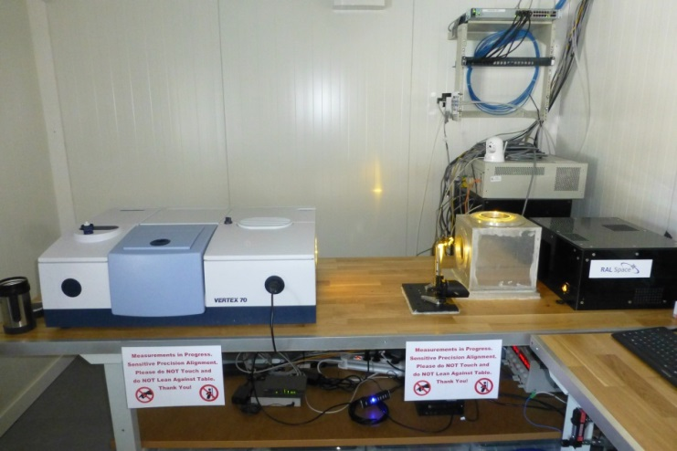
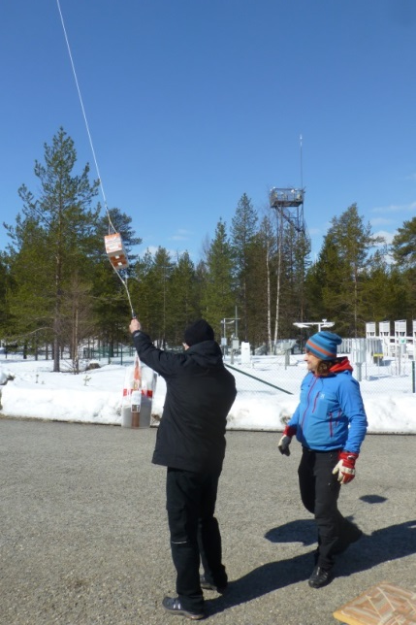
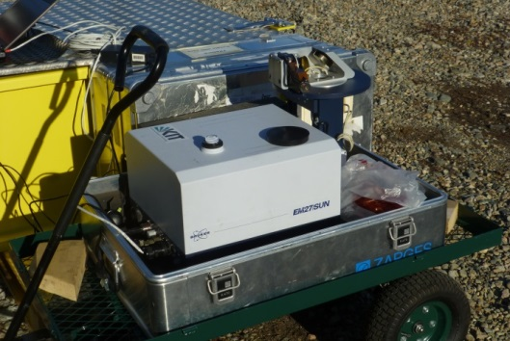
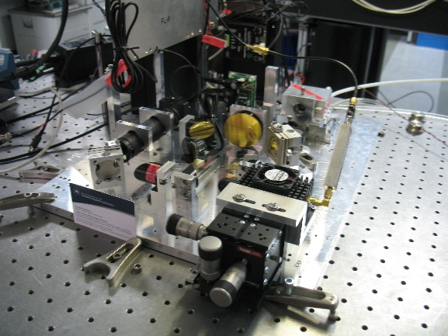
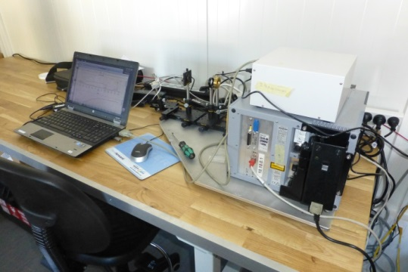
Participating instruments
TCCON
Vertex 70
AirCore
LHR optical breadboard
IRcube
EM27/SUN

Slide 4
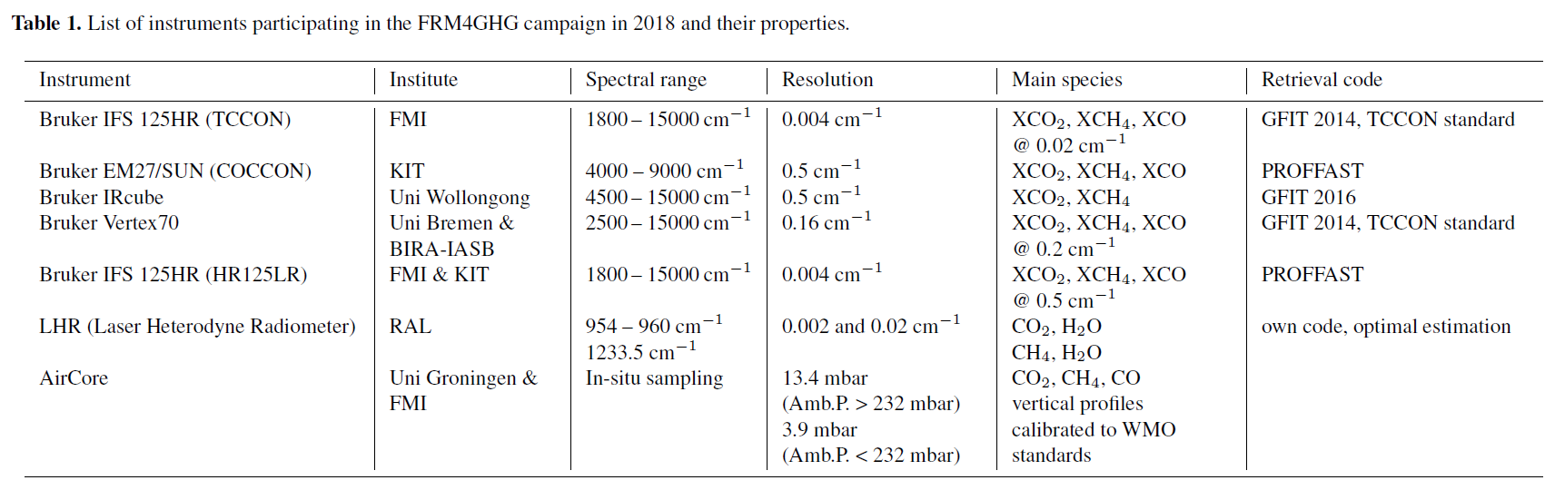
FMR4GHG campaign
Location – TCCON site at Sodankylä, Finland (67.37 N, 26.63 E, 188 m.a.s.l); possibility for AirCore launches at the site

Slide 5
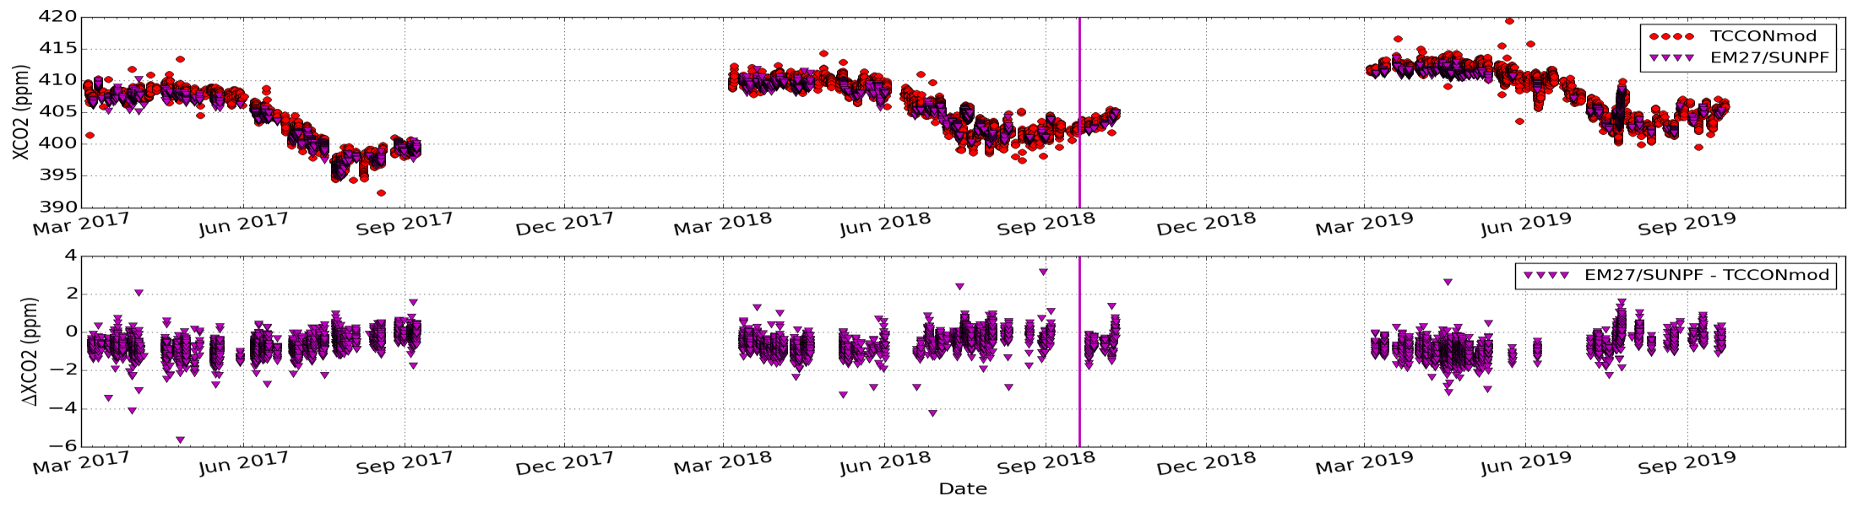
EM27/SUN vs TCCON – XCO2
Nonlinearity correction for TCCON data in 2017; seasonal bias can be seen
Species | Bias (%) | STD (%) | R
EM27/SUN vs TCCON | -0.72 | 0.51 | 0.995

Slide 6
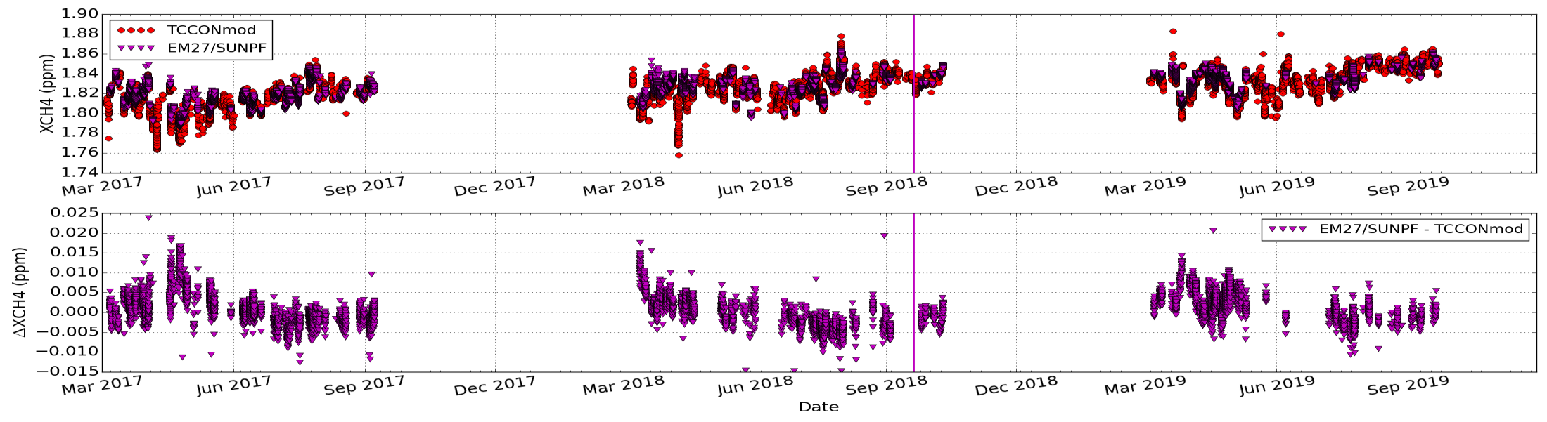
EM27/SUN vs TCCON – XCH4
High bias during the spring time measurements
Weather proof cover installed – towards the end of 2018

Slide 7
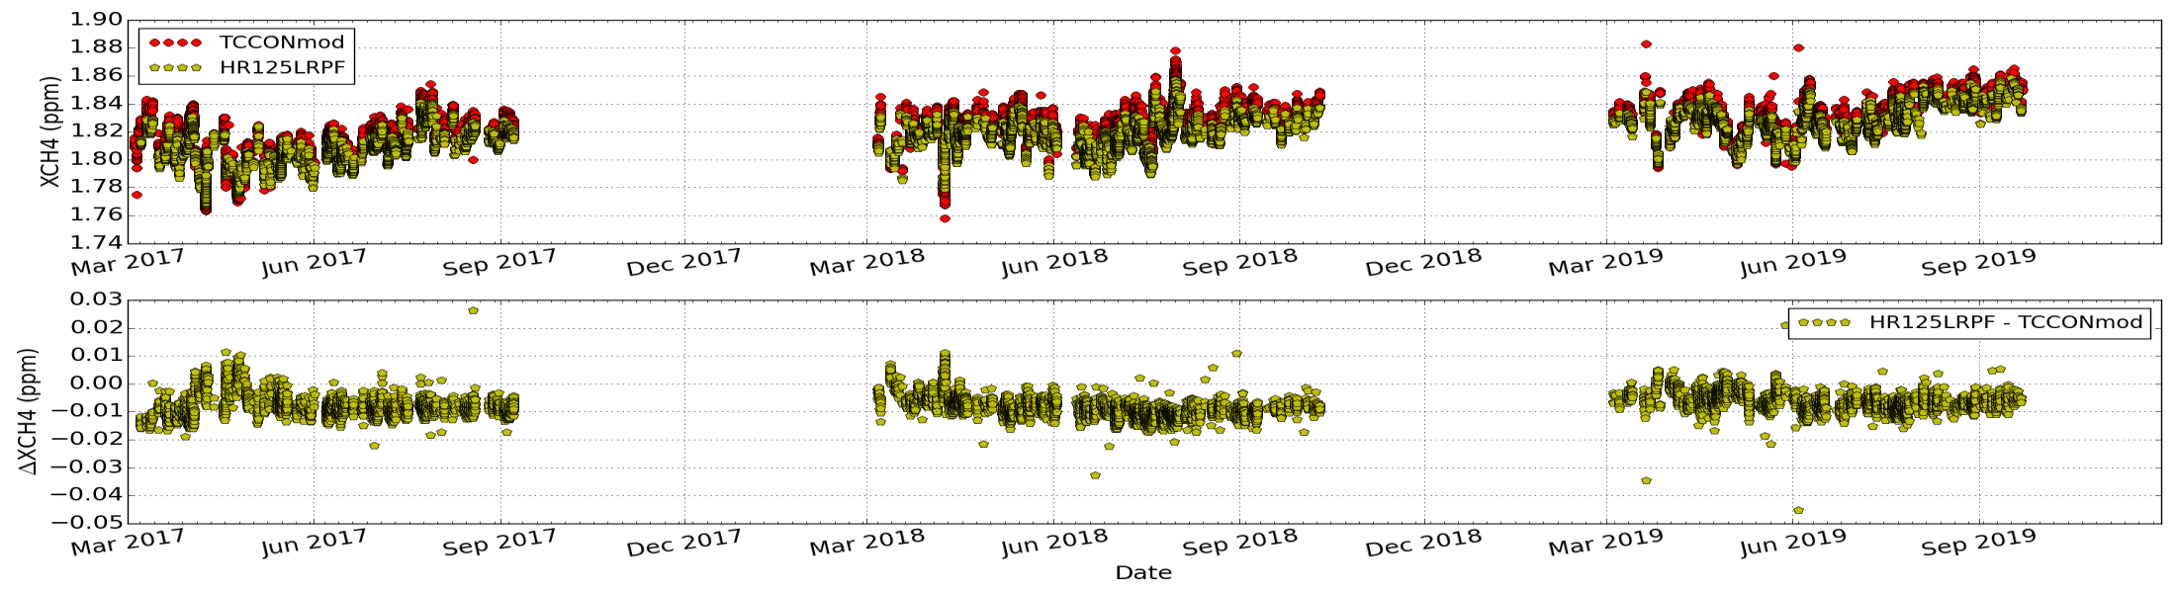
HR125LR vs TCCON – XCH4

Slide 8
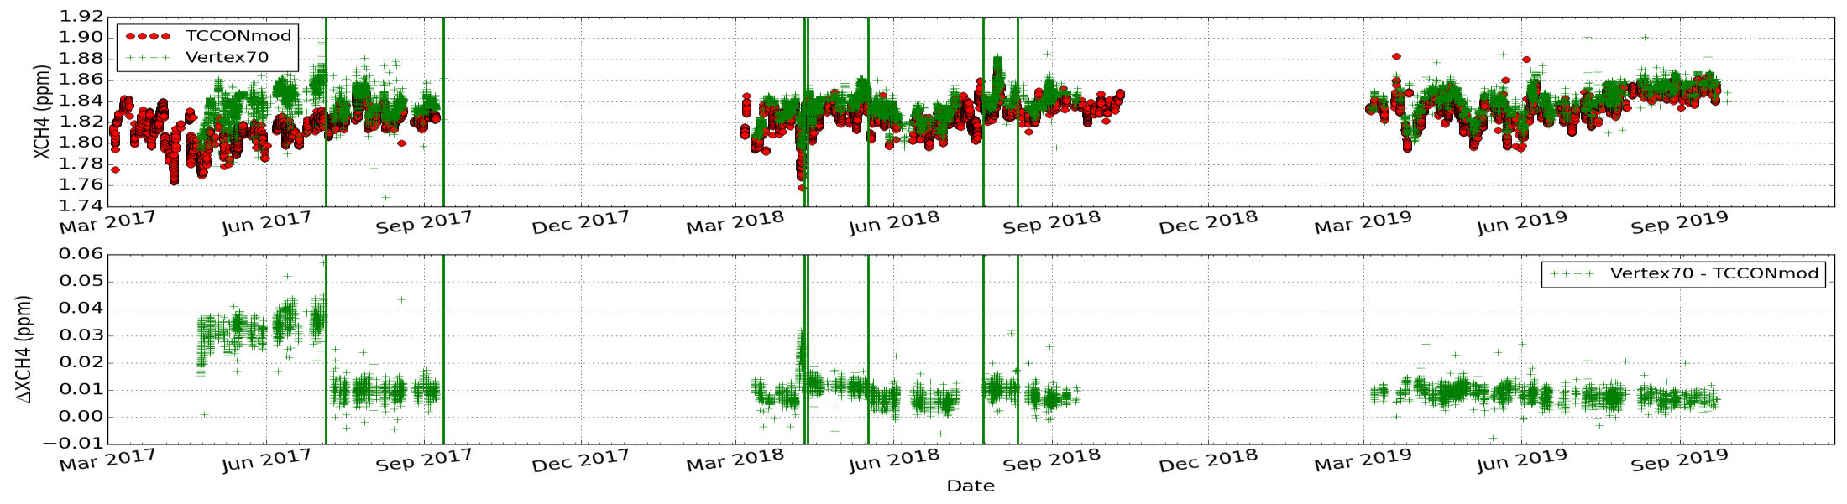
VERTEX70 vs TCCON – XCH4
Several modifications in 2017 & 2018 to find the best configuration
Instrument operated in 2019 under stable condition

Slide 9
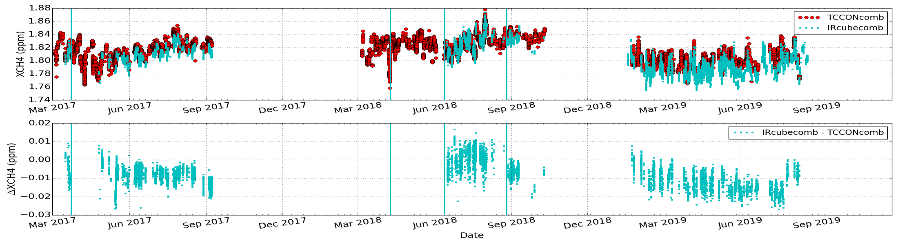
IRcube vs TCCON – XCH4
2017 – broken optical fibre cable; 2018 - modifications to find best configuration (Sodankylä)
Instrument operated in 2019 under stable condition (Wollongong)

Slide 10
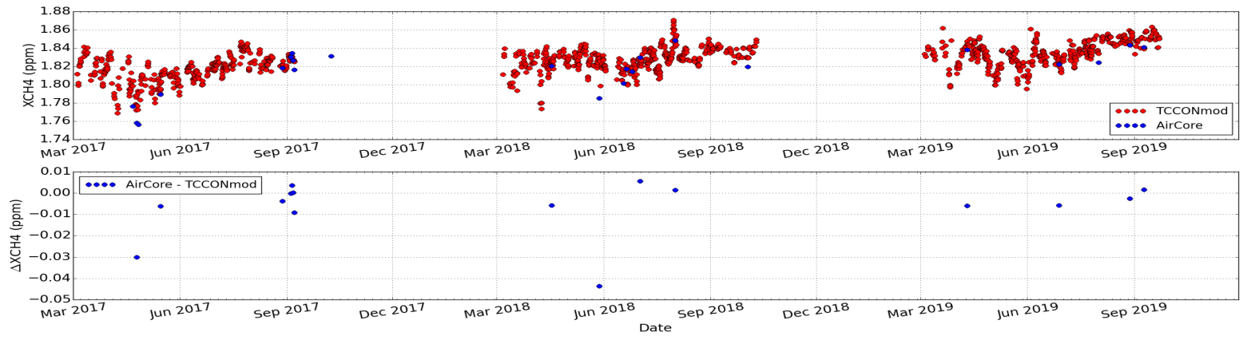
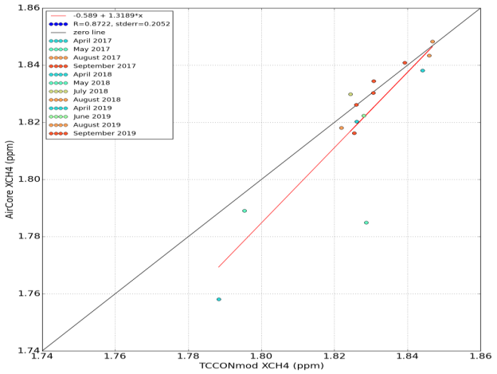
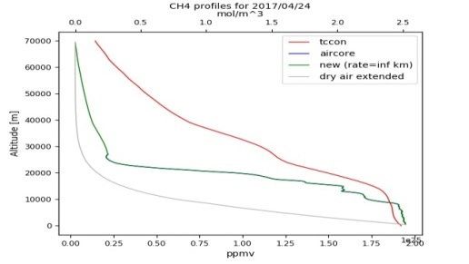
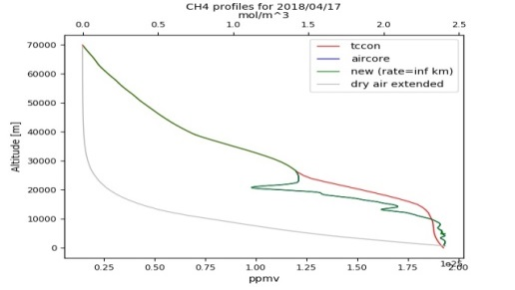
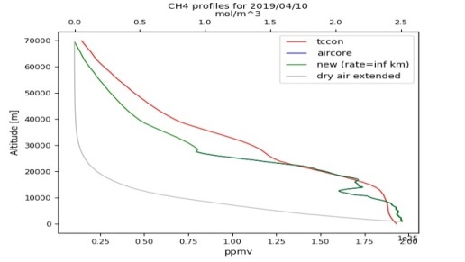
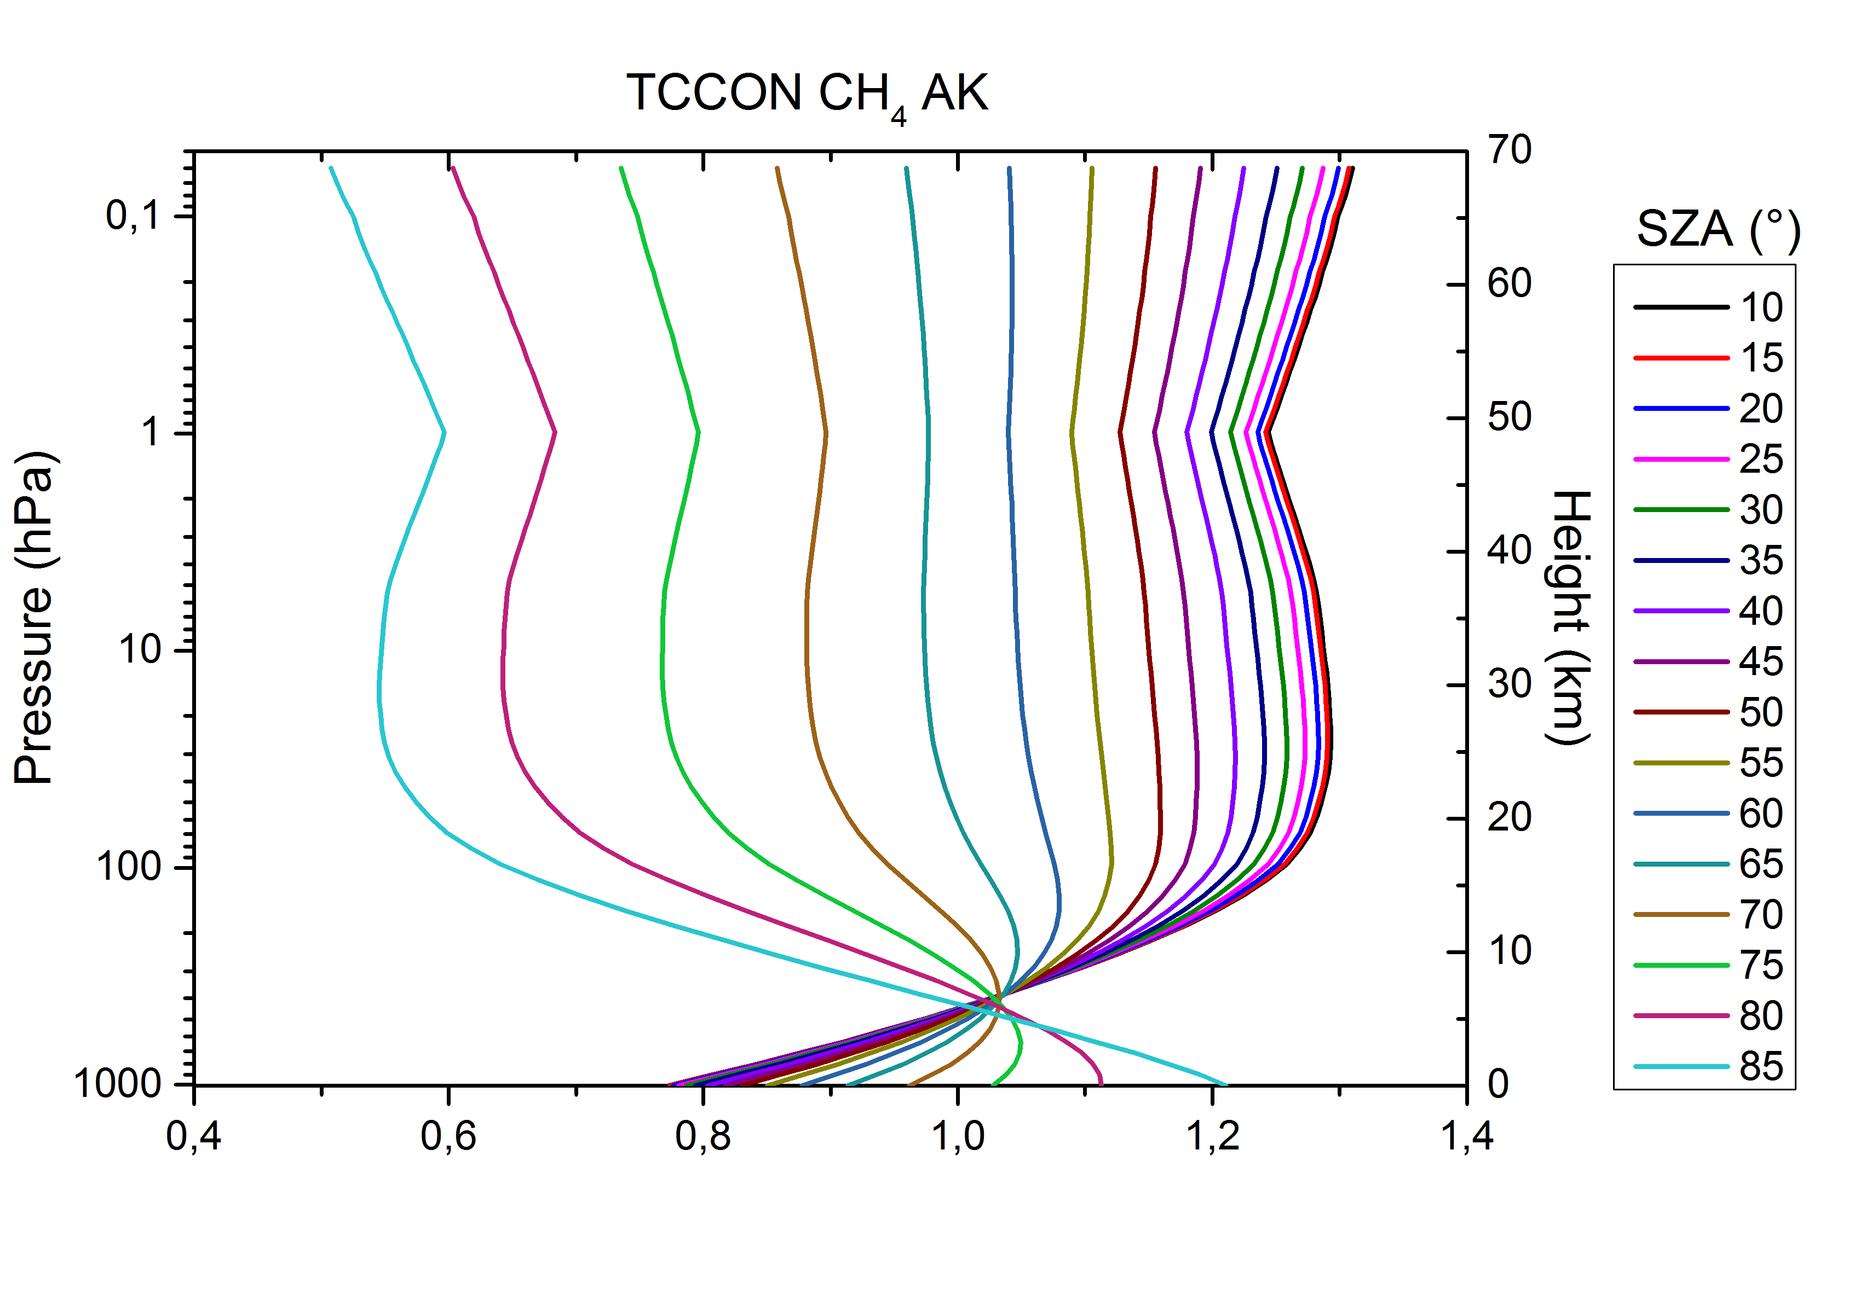
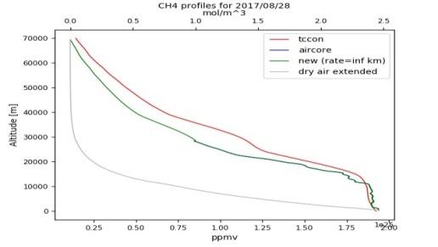
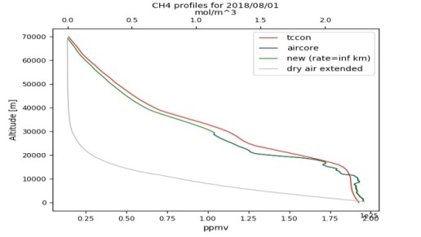
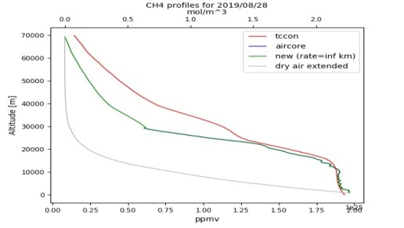
AirCore vs TCCON – XCH4

Slide 11
Coincidence criteria for S5P validation study
Period of study: 01 March 2018 – 1 October 2019.
S-5P data from Mission Performance Centre (MPC) provided by the Payload Data Ground Segment (PDGS) at DLR.
Coincidence criteria for CH4: Time delta = 1 hours; Geo-distance delta = 100 km radius. QA filtering: qa_value > 0.5; bias corrected S5P-CH4 product used for the study. From the coincident and filtered satellite measurements an average of all pixels is taken for each ground-based reference measurements.
S-5P requirements for CH4 total column: target bias = 1.5 %; target precision : < 1 %

Slide 12
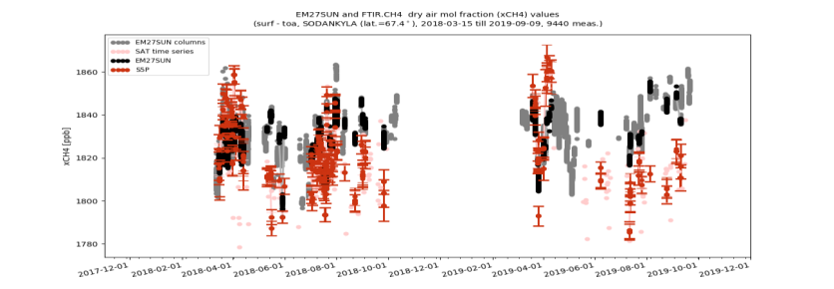
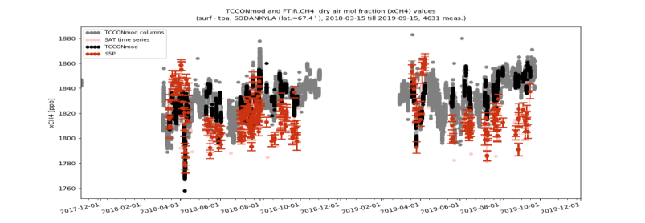
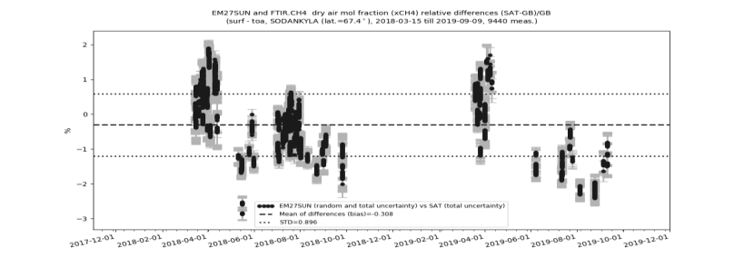
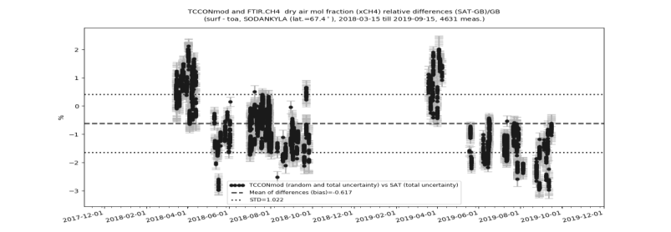
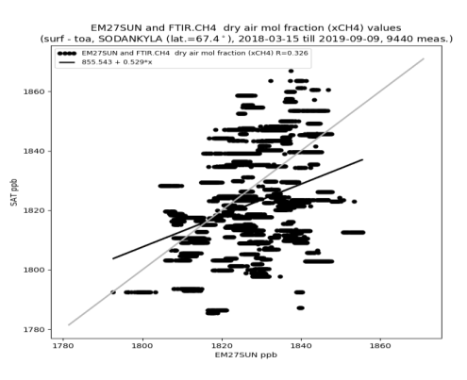
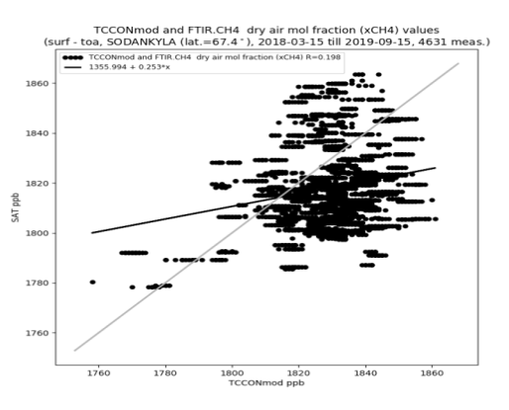
S5P validation results using EM27/SUN – XCH4
EM27/SUN
TCCON
Note: different number of measurements
EM27/SUN data scaled to WMO via TCCON
Validation type | Bias % | STD % | R
EM27/SUN vs TCCONmod | 0.05 (1 ppb) | 0.22 (4 ppb) | 0.942
S-5P vs EM27/SUN | -0.31 | 0.9 | 0.326
S-5P vs TCCONmod | -0.62 | 1.02 | 0.198

Slide 13
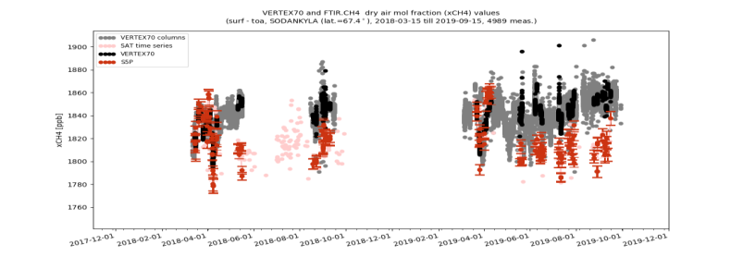
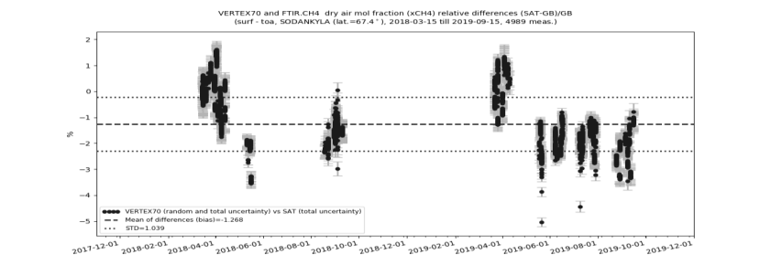
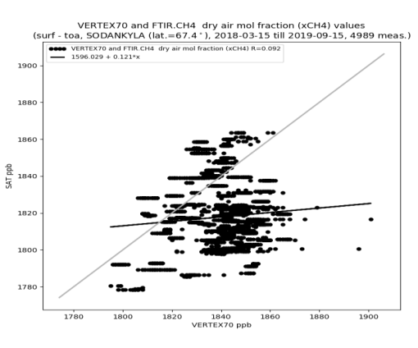
S5P validation results using VERTEX70 – XCH4
VERTEX70
TCCON
VERTEX70 data not yet scaled to WMO
Validation type | Bias % | STD % | R
VERTEX70 vs TCCONmod | 0.5 (9 ppb) | 0.22 (4 ppb) | 0.969
S-5P vs VERTEX70 | -1.27 | 1.04 | 0.092
S-5P vs TCCONmod | -0.62 | 1.02 | 0.198

Slide 14
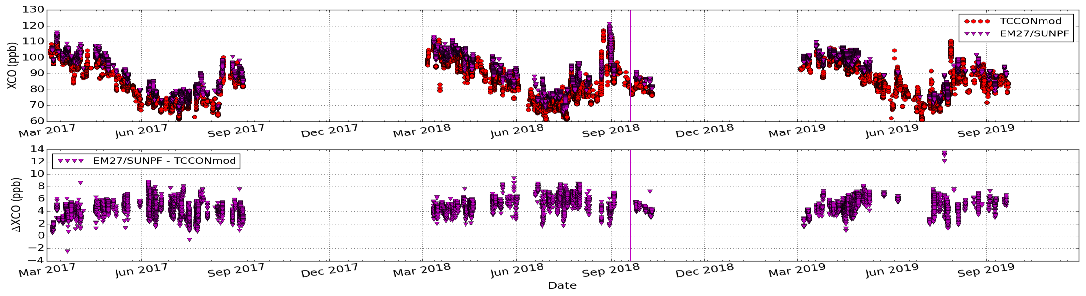
EM27/SUN vs TCCON – XCO

Slide 15
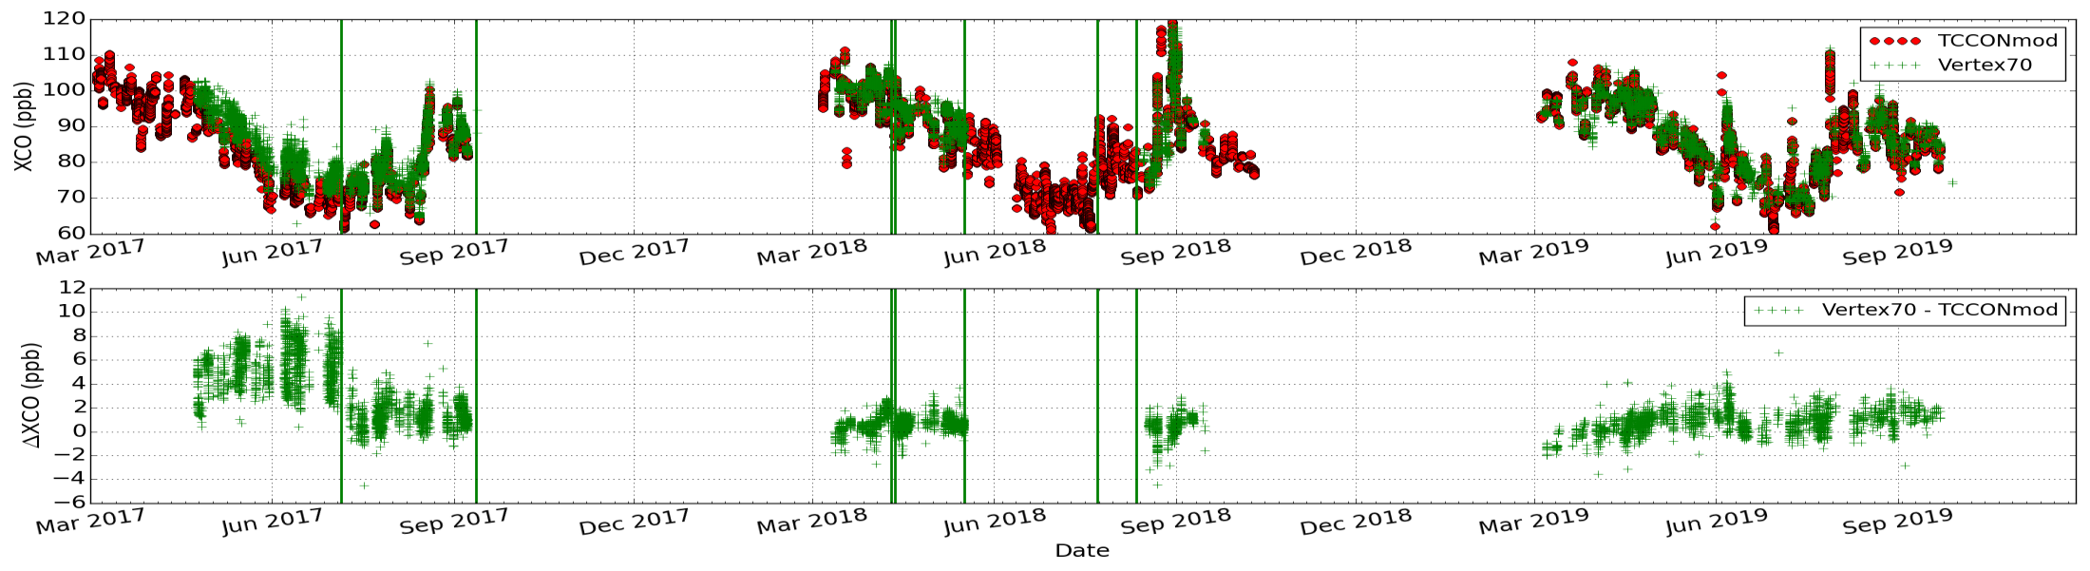
VERTEX70 vs TCCON – XCO

Slide 16
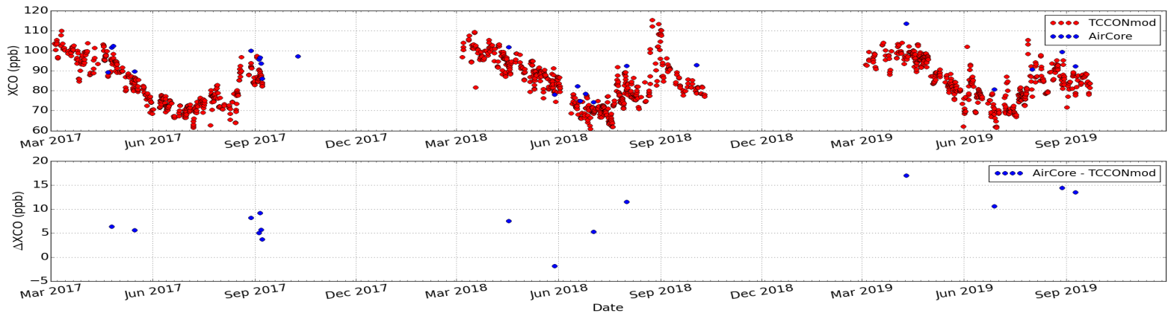
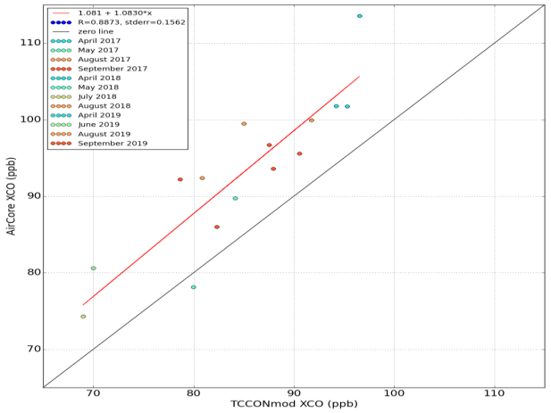
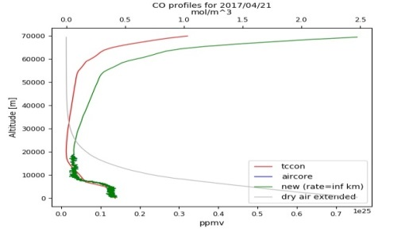
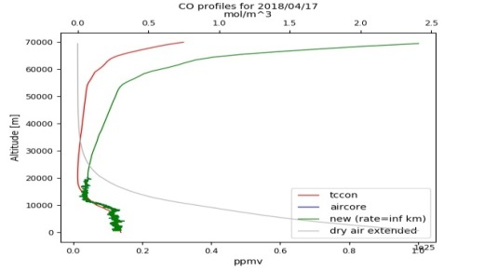
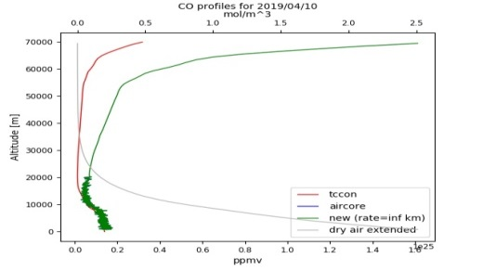
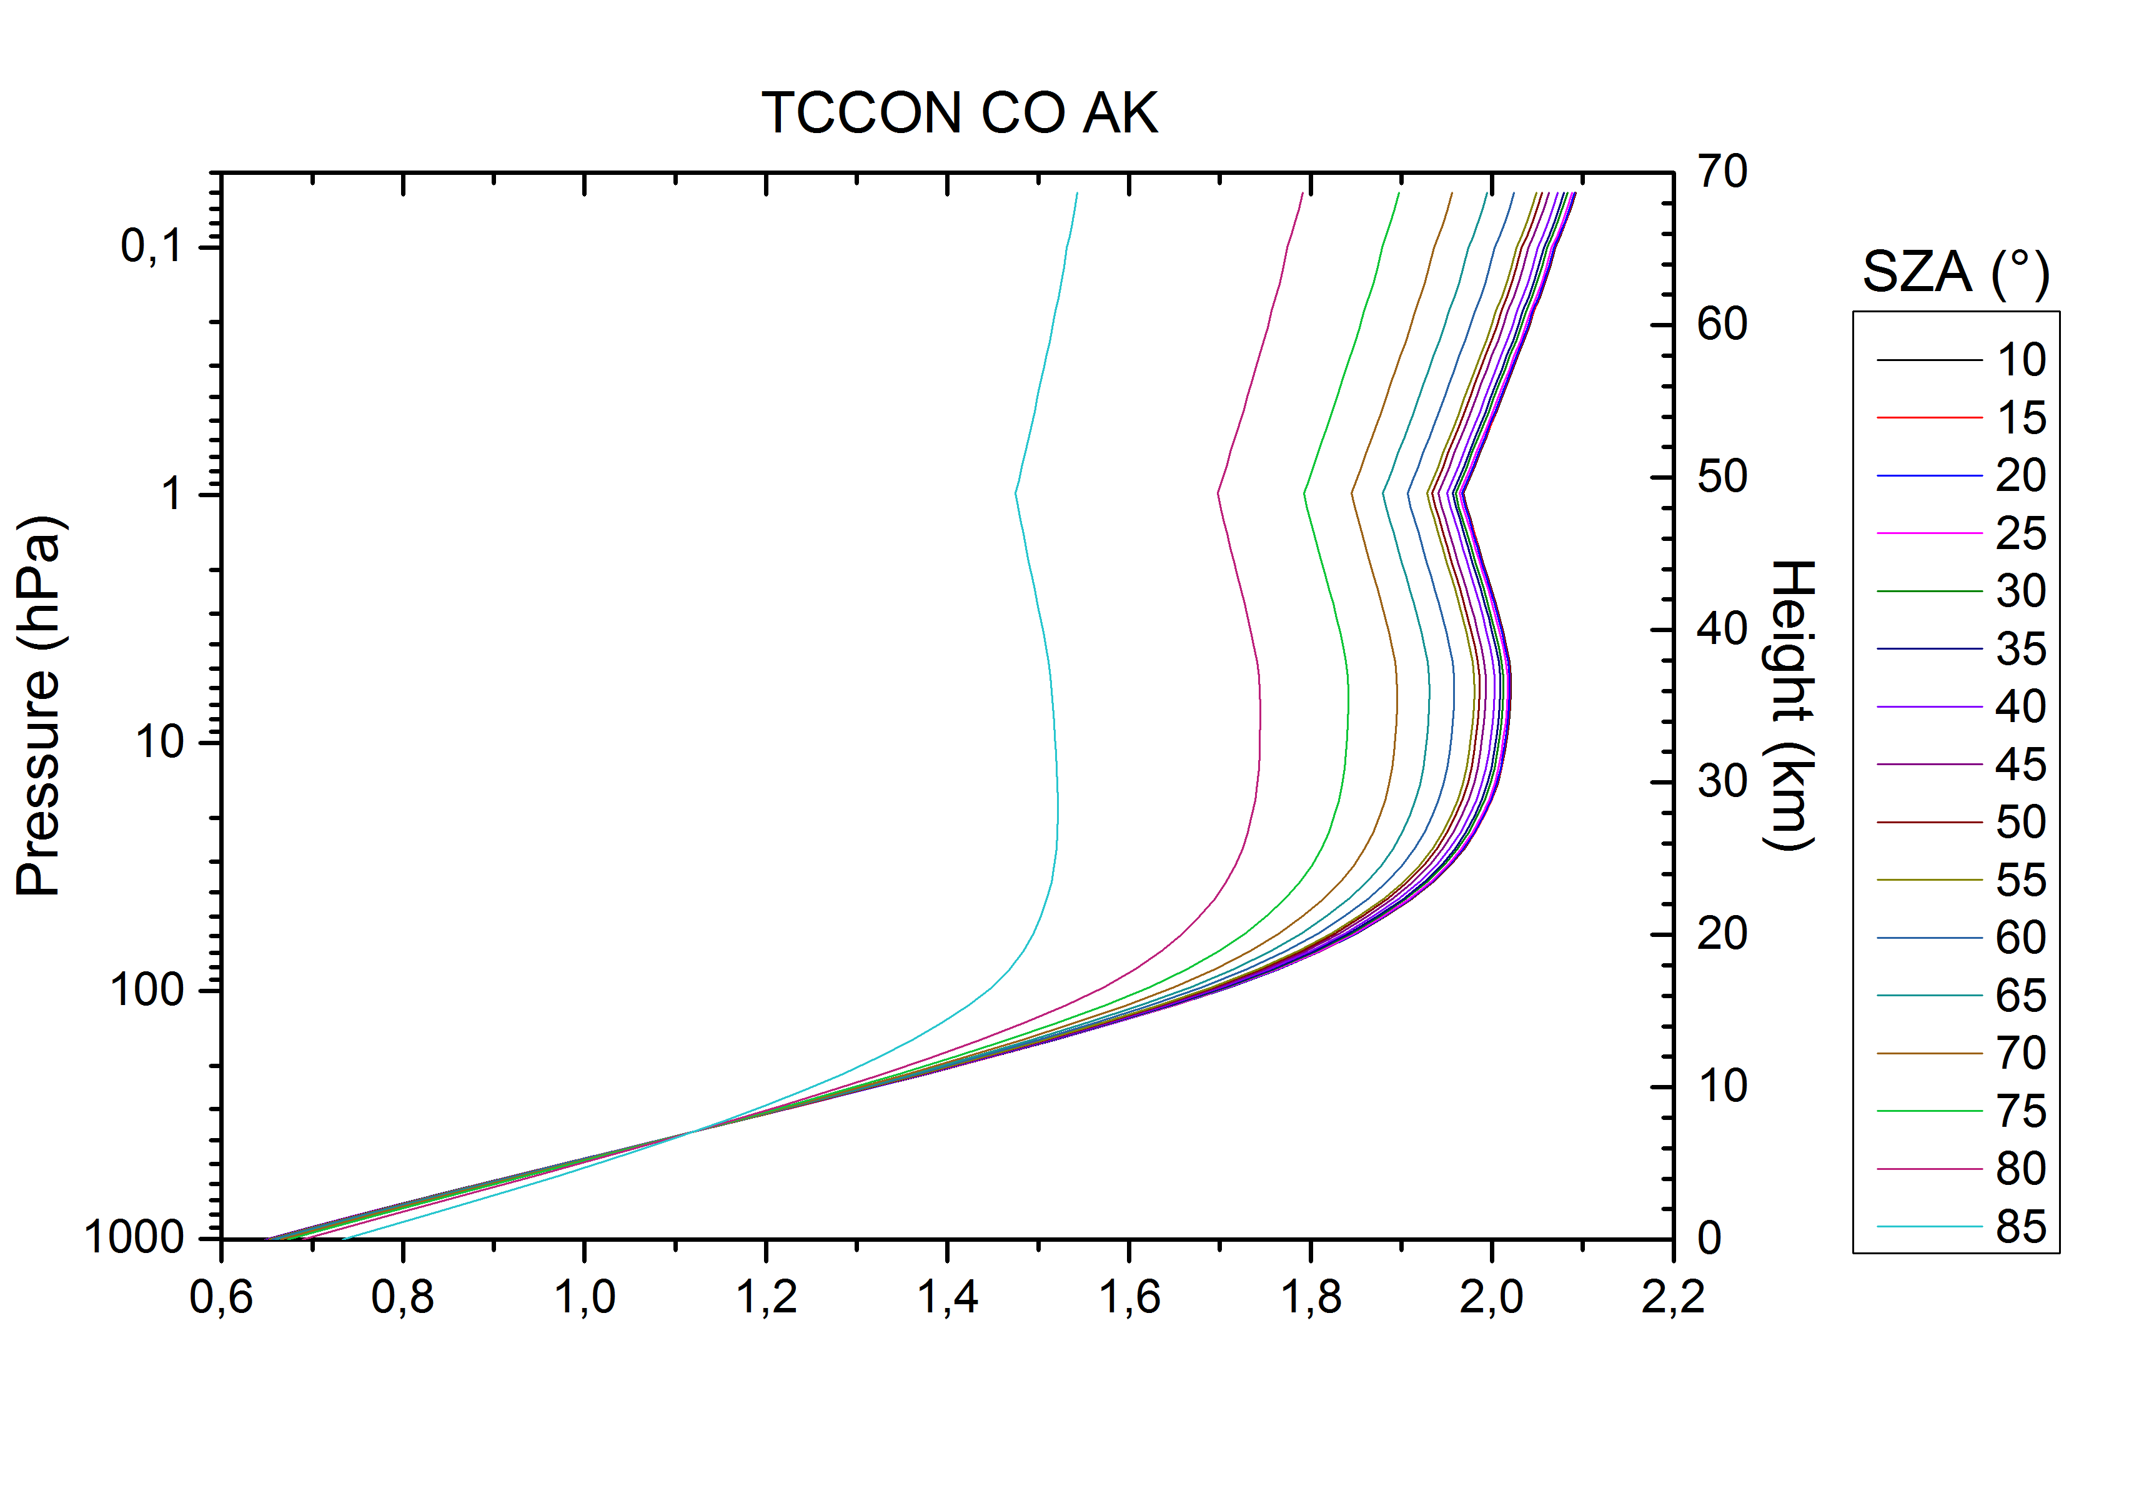
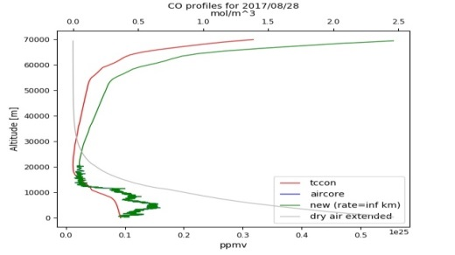
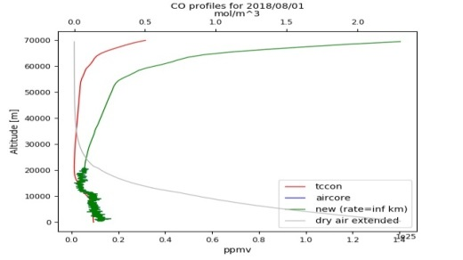
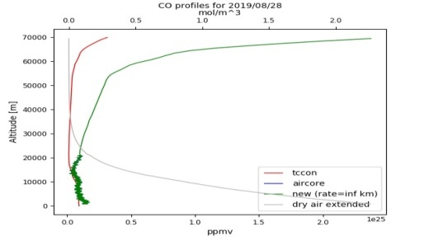
AirCore vs TCCON – XCO

Slide 17
Coincidence criteria for S5P validation study
Period of study: 01 March 2018 – 1 October 2019.
S-5P data from Mission Performance Centre (MPC) provided by the Payload Data Ground Segment (PDGS) at DLR.
Coincidence criteria for CO: Time delta = 1 hours; Geo-distance delta = 50 km radius. QA filtering: qa_value > 0.5;. From the coincident and filtered satellite measurements an average of all pixels is taken for each ground-based reference measurements.
S-5P requirements for CO total column: target bias = 15 %; target precision : < 10 %

Slide 18
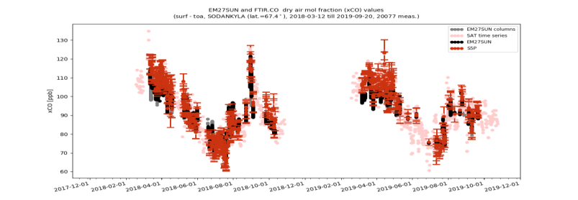
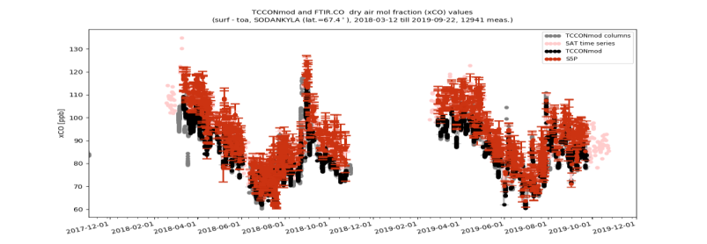
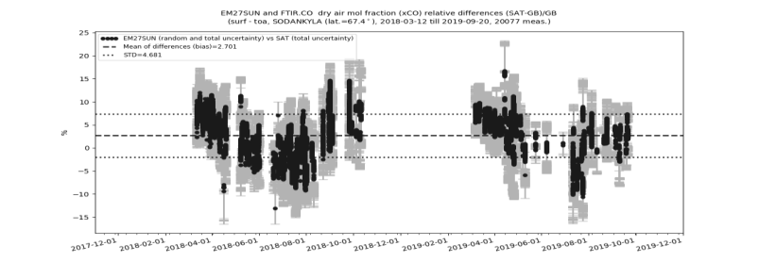
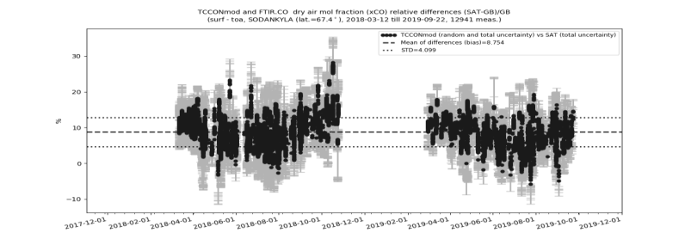
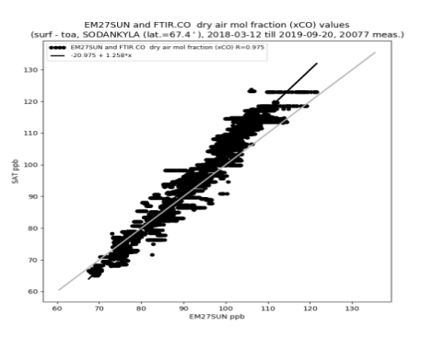
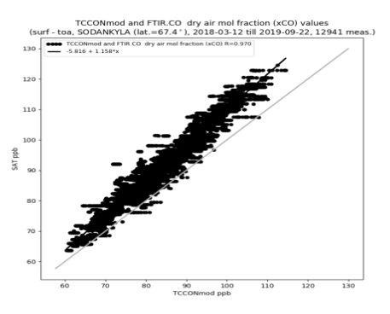
S5P validation results using EM27/SUN – XCO
EM27/SUN
TCCON
Note:
EM27SUN data not yet corrected for spectroscopic errors
Validation type | Bias % | STD % | R
EM27/SUN vs TCCONmod | 5.55 (5.0 ppb) | 1.37 (1.23 ppb) | 0.995
S-5P vs EM27/SUN | 2.7 | 4.68 | 0.975
S-5P vs TCCONmod | 8.75 | 4.1 | 0.97

Slide 19
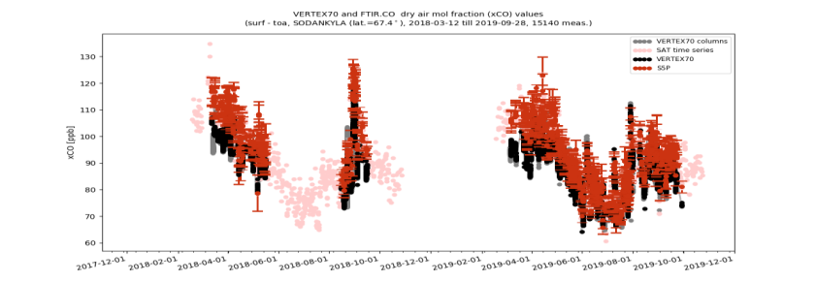
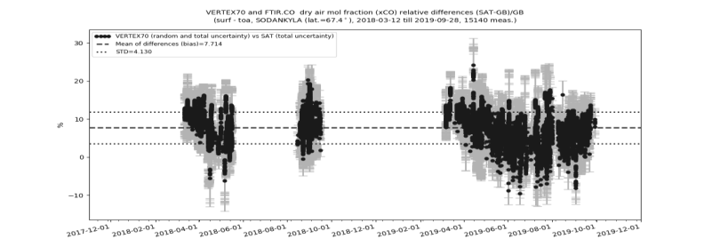
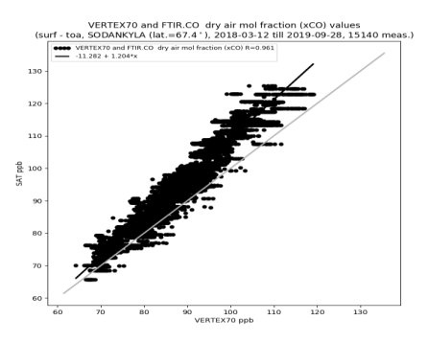
S5P validation results using VERTEX70 – XCO
VERTEX70
TCCON
Note: shorter time period only during summer season
VERTEX70 data not yet scaled to WMO
Validation type | Bias % | STD % | R
VERTEX70 vs TCCONmod | 0.78 (0.7 ppb) | 0.99 (0.89 ppb) | 0.996
S-5P vs VERTEX70 | 7.71 | 4.13 | 0.961
S-5P vs TCCONmod | 8.75 | 4.1 | 0.97

Slide 20
Summary and conclusions
Assessment of low-resolution TCCON-complementing instruments for CO2, CH4, CO
  Nonlinearity feature detected and corrected for the TCCON. Small seasonal cycle in CO2 is seen between TCCON and other low-resolution datasets as well as with the AirCore measurements.
  We see a small bias in CH4 during spring due to the difference between the prior relative to the true atmospheric state, the column averaging kernel at high solar zenith angles and the retrieval sensitivities.
  The differences seen in the CH4 intercomparisons including the HR125LR data with respect to the standard TCCON data highlight the impact of the different spectral resolutions.
  The low-resolution instruments (except EM27/SUN) are not yet scaled to the WMO reference which is the reason for the bias for CO2 and CH4. We see a seasonal dependent bias in CO comparison as the low-resolution measurements are not scaled to the WMO reference.
Results of S5P validation using low-resolution instruments
  The validation results for S5P CH4 and CO show a scatter and correlation comparable to the results obtained with TCCON.
➔ EM27/SUN (COCCON network instrument), Vertex70 and IRcube can complement the TCCON network, and can be considered suitable reference networks / instruments for the validation of S5P CH4 and CO products (as shown in this presentation) and for OCO-2 CO2 product (as shown in earlier presentation).

Slide 21

Thank you for your attention!

