Slide 1


Low resolution FTIRs
Presenter: Mahesh Kumar Sha
Group: Infrared Observations & lab experiments
Royal Belgian Institute for Space Aeronomy (BIRA-IASB)
Ringlaan 3, 1180 Brussels, Belgium
Tel. +32-(2)-37-30-389
Email: mahesh.sha@aeronomie.be
http://aeronomie.be/
ICOS Atmospheric MSA Meeting, Groningen, Nov 21 – 23, 2017

Slide 2
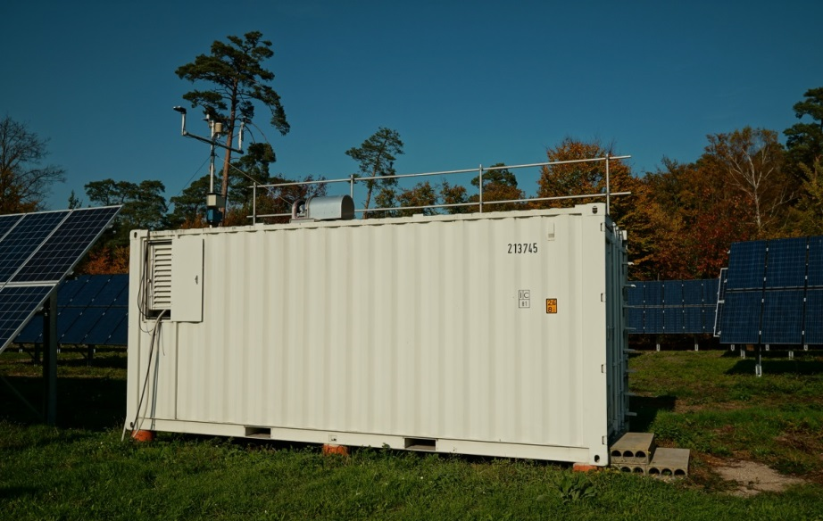
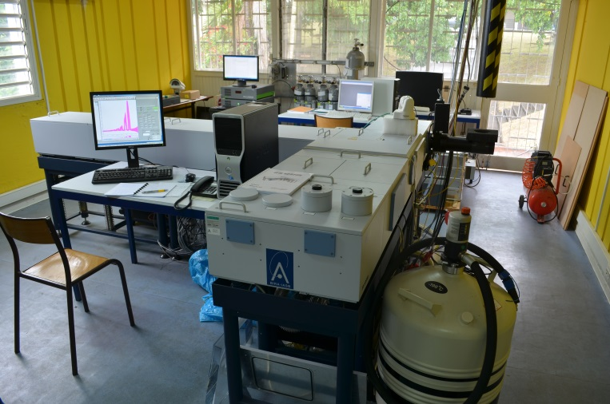
Motivation for low resolution FTIRs
Greenhouse gas (GHG) and climate relevant gases measuring satellites require ground-based measurements for validation of temporal and spatial trends and/or dependencies on satellite observational characteristics.
Total Carbon Column Observing Network (TCCON) provides accurate and precise measurements of GHGs and is the current standard for validation of GHG measuring satellites (e.g. SCIAMACHY, GOSAT, OCO-2 and S5P).
TCCON network has limited geographic coverage, especially in remote locations and locations with high/low albedo.
Limitations for TCCON – very expensive, requires good infrastructure (container, Bruker IFS 125HR as spectrometer, solar tracker) – no easy to relocate, requires special operating conditions, requires trained personnel for both operation and maintenance
  expensive if further expansion of the network is desired.
FTIR container at in Karlsruhe
FTIR spectrometer – Bruker IFS 125HR

Slide 3
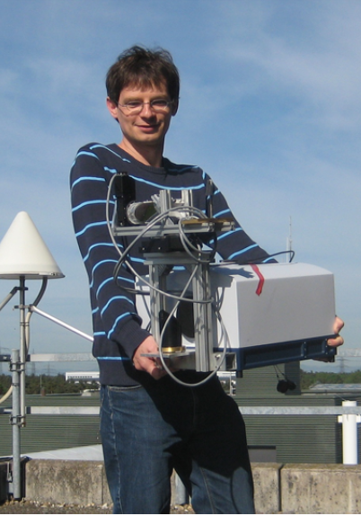
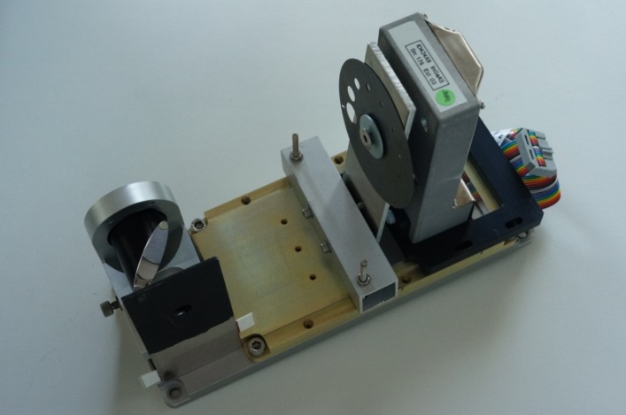


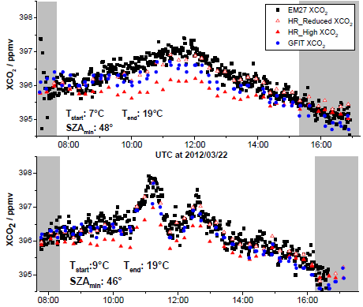
A tabletop spectrometer for XCO2 and XCH4
Karlsruhe Institute of Technology (KIT) started in 2011 the development of a novel compact NIR-FTIR spectrometer for carbon cycle research. This venture was started in collaboration with Bruker Optik GmbH. EM27 spectrometer was chosen as a starting point.
M. Gisi, F. Hase, S. Dohe, T. Blumenstock, A. Simon, and A. Keens: “XCO2-measurements with a tabletop FTS …“, AMT 2012

Slide 4
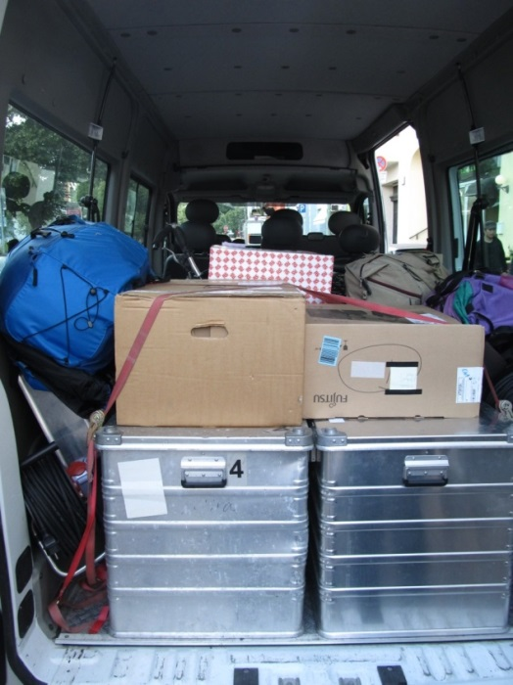
Performance of the EM27/SUN
Side-by-side measurements of EM27/SUNs at Karlsruhe
XCO2 calibration factors
(M. Frey et al.: “Calibration and instrumental line shape characterization of a set of portable FTIR spectrometers…“, AMT, 2015)
spectrometer | Before campaign | After campaign
1 | 1.00000 | 1.00000
2 | 0.99924 | 0.99921
3 | 1.00015 | 1.00016
4 | 0.99987 | 0.99987
5 | 0.99960 | 0.99962
XCO2 calibration stable
within 0.003% !! (#2)
(TCCON site-to-site consistency: 0.1%)

Slide 5
Long-term stability of EM27/SUN
Courtesy: M. Frey, KIT, publication in preparation

Slide 6


COCCON – coordinated by Frank Hase (KIT)
COCCON offers a framework for the EM27/SUN to ensure operation of coherent and reliable spectrometers, and finally highly consistent and calibrated trace gas datasets and to foster the distribution of the EM27/SUN via international collaborations.
All EM27/SUN spectrometers are checked and calibrated at KIT before delivery to customers
Recalibration can be performed if required (problem detection XAIR drifts away ...)
The recipe for the instrumental lineshape characterization including software is published by KIT
Tools for spectra preprocessing and atmospheric retrievals is provided by KIT
CPDHF construction under construction at KIT (ESA-funded COCCON PROCEEDS project)
Contact Frank Hase – frank.hase@kit.edu

Slide 7
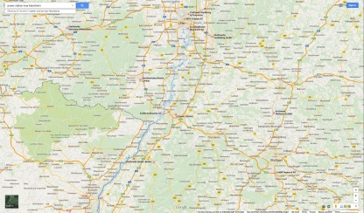
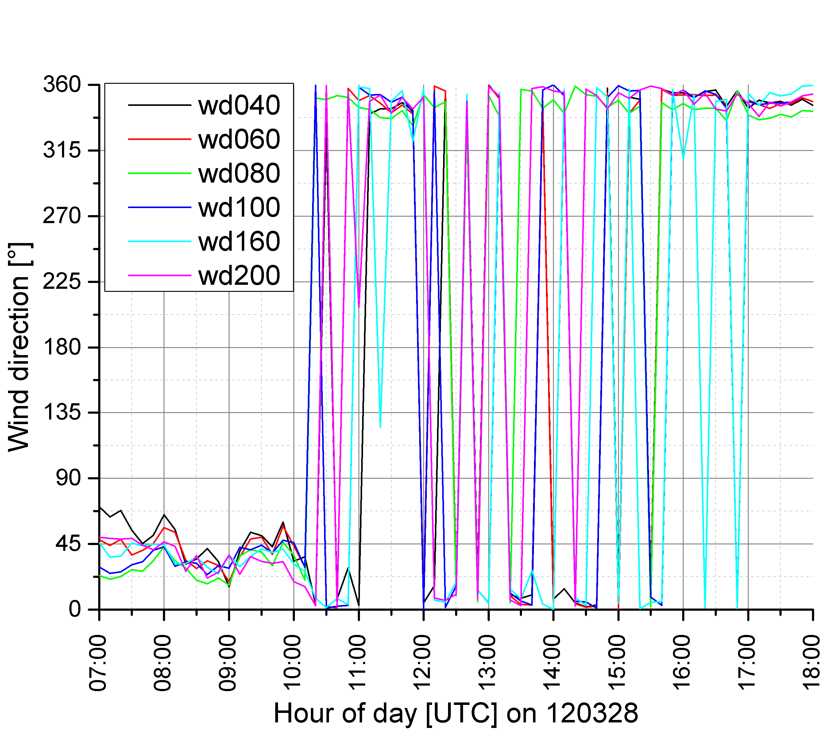
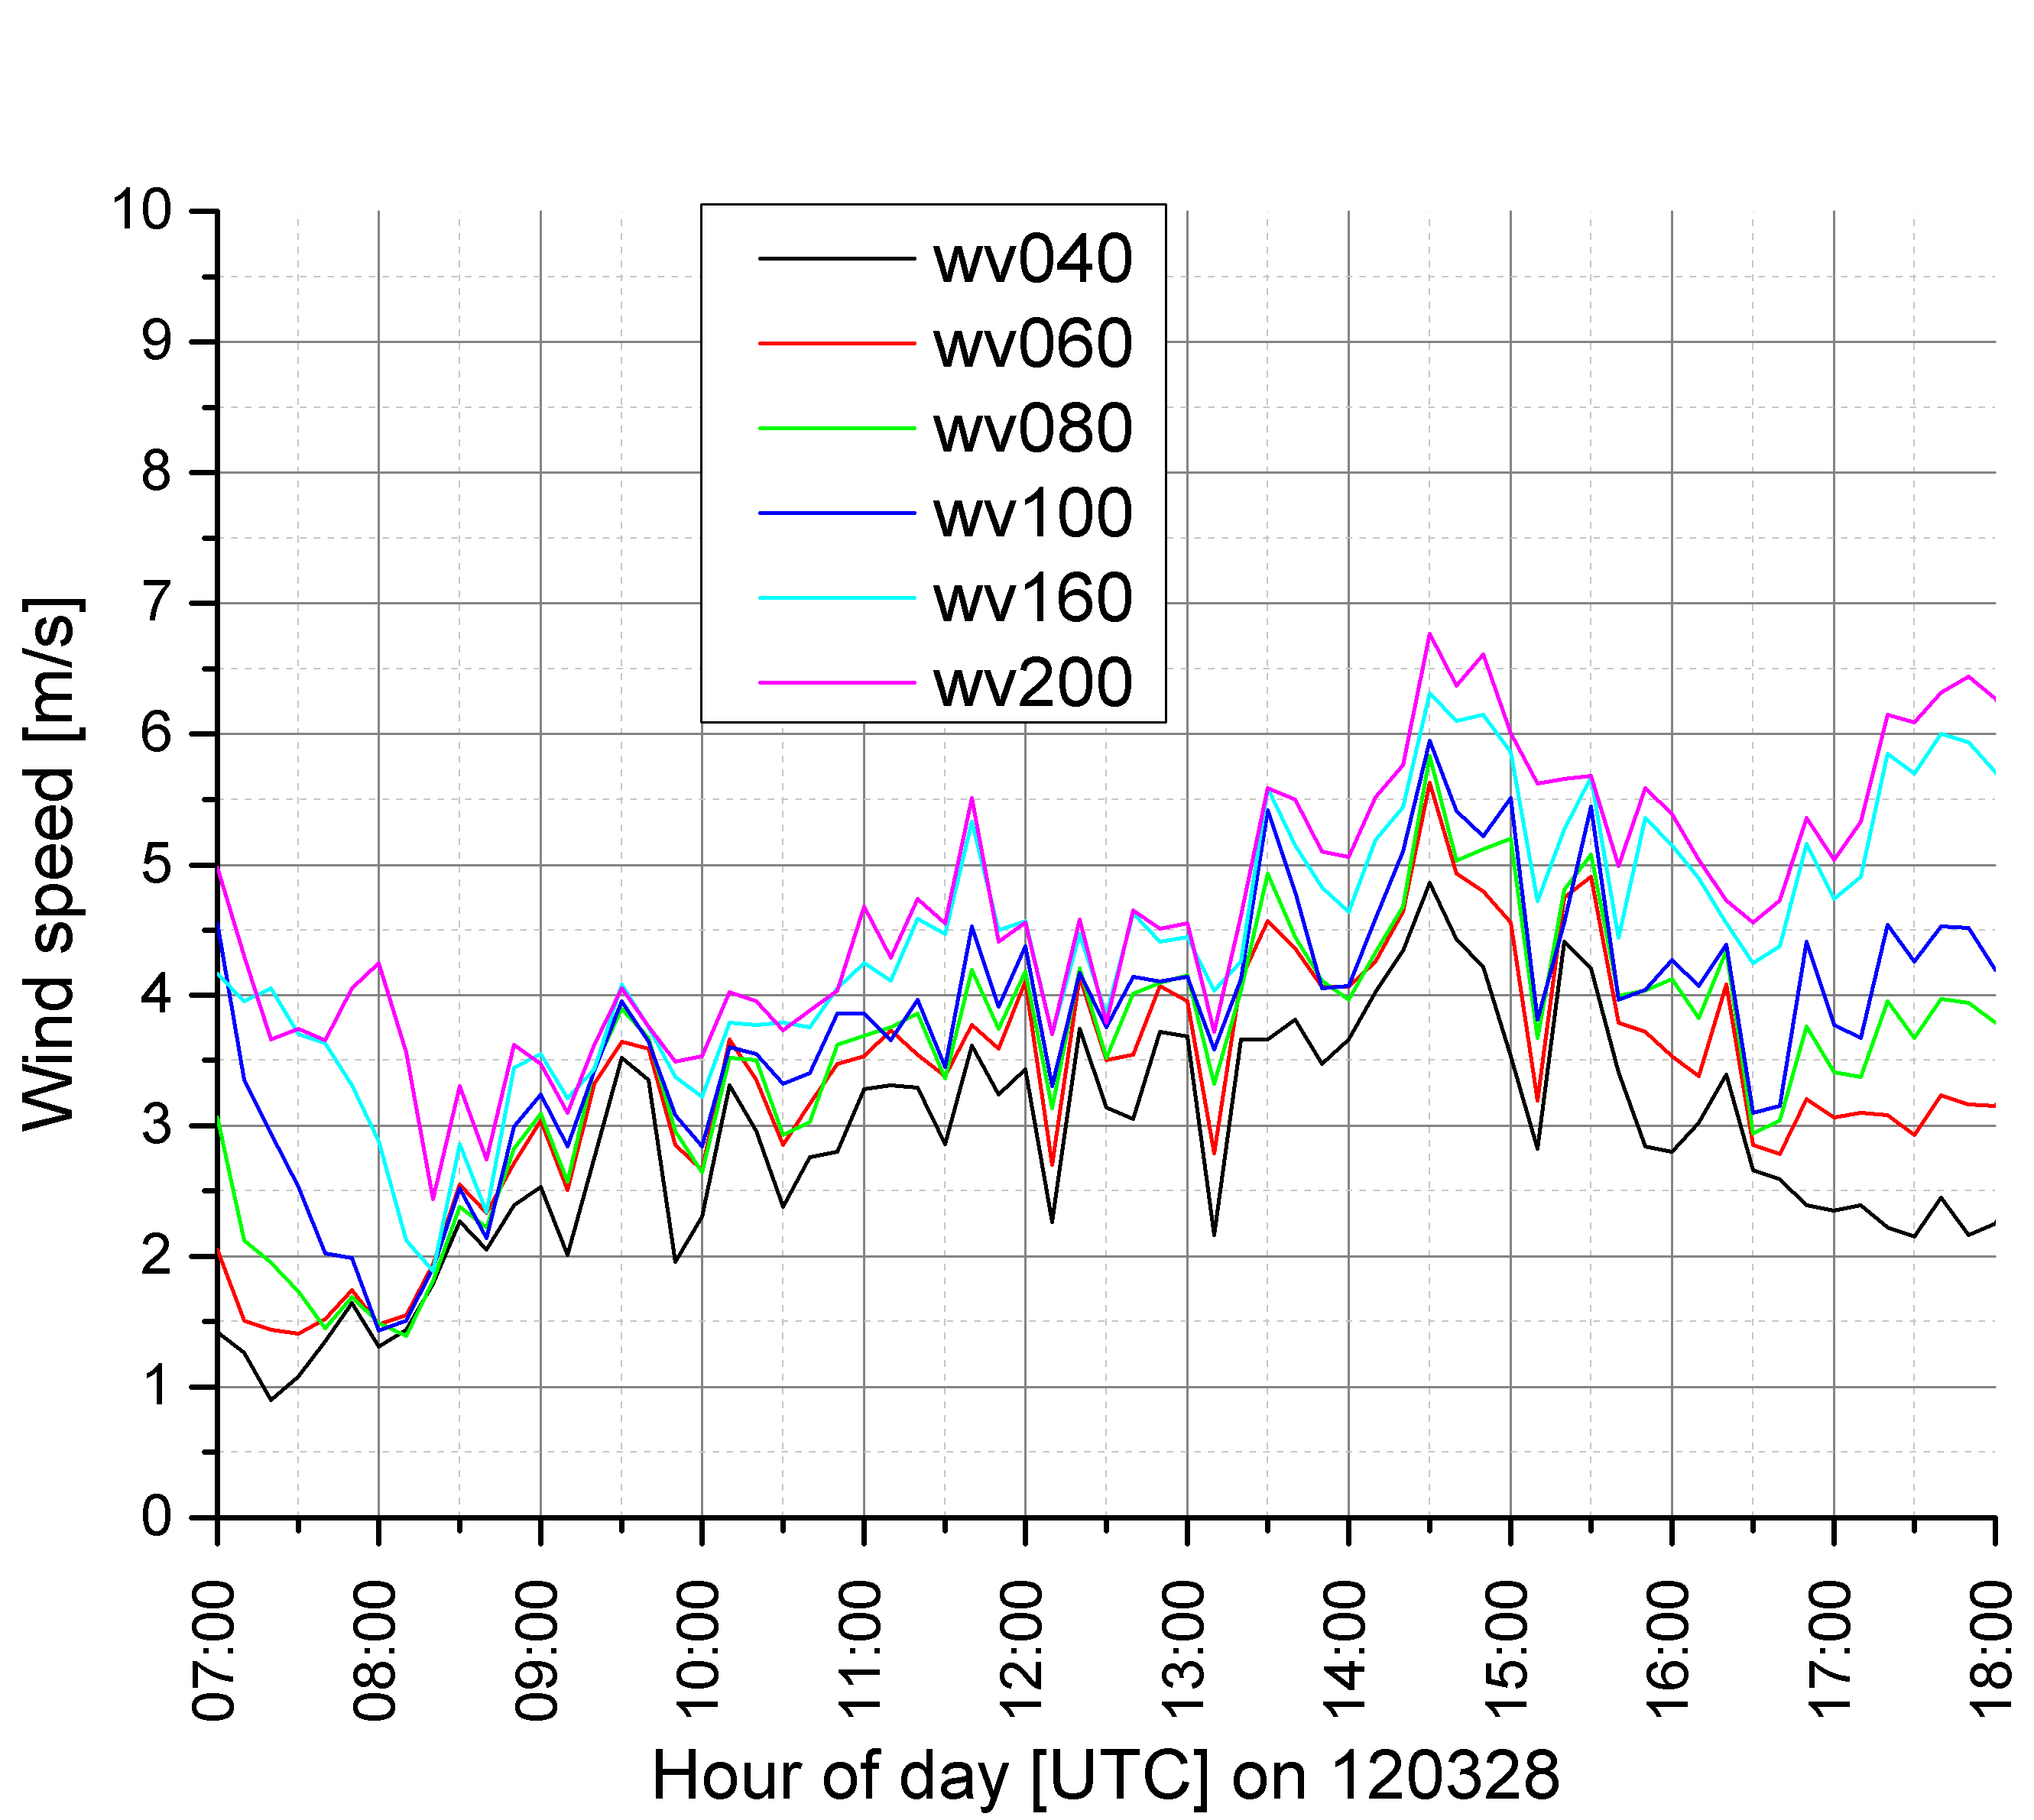
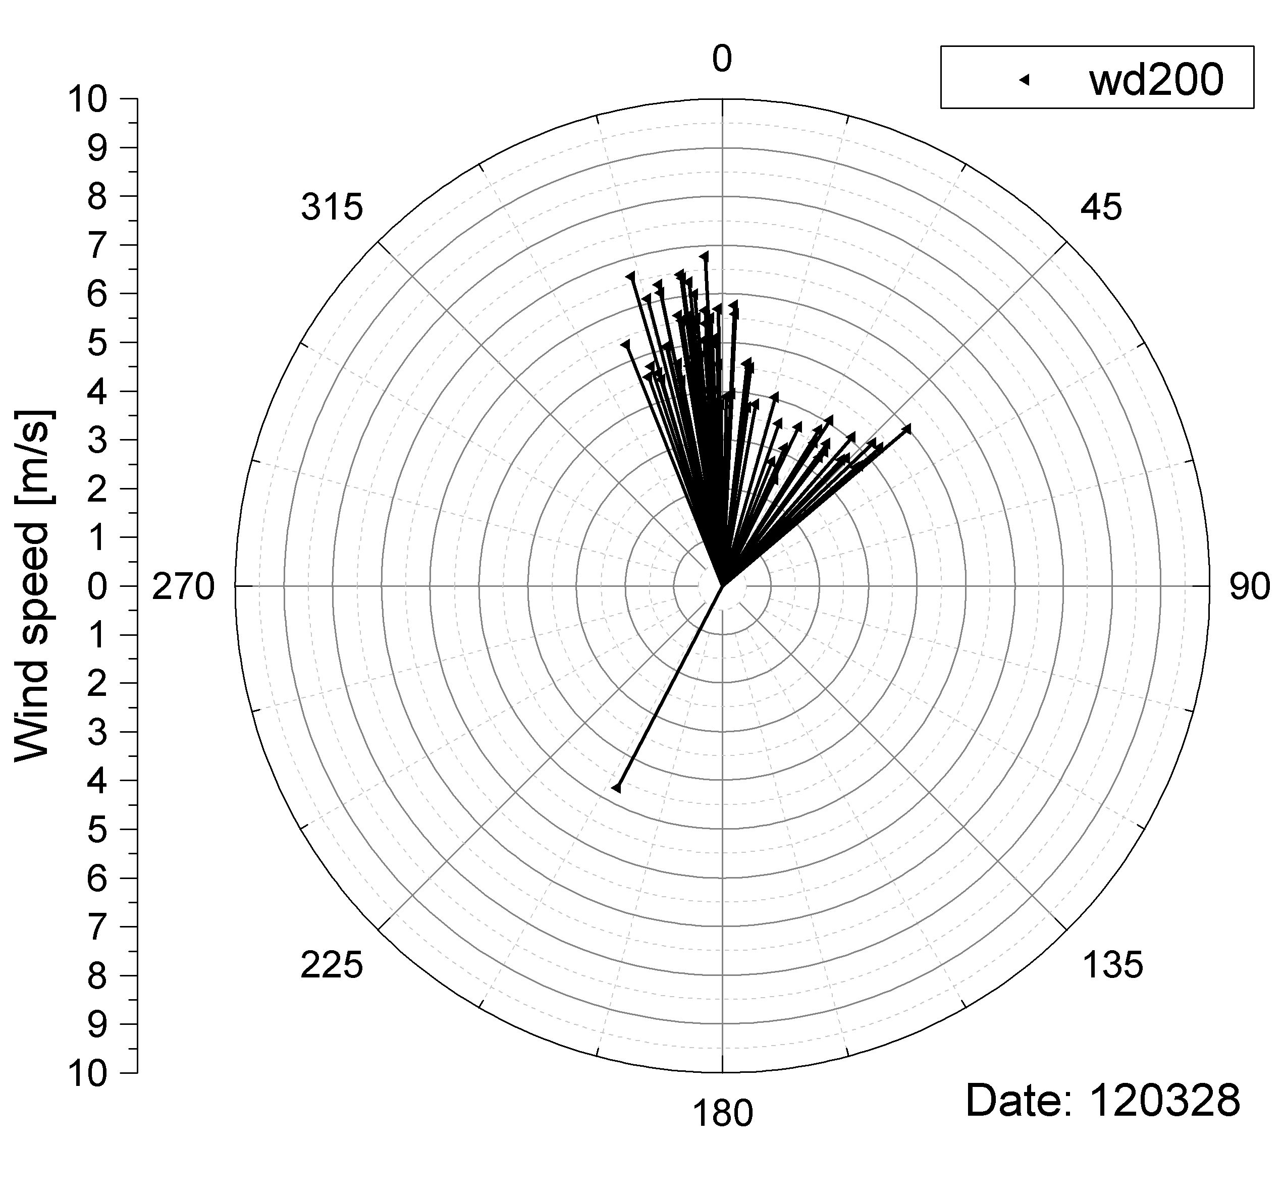
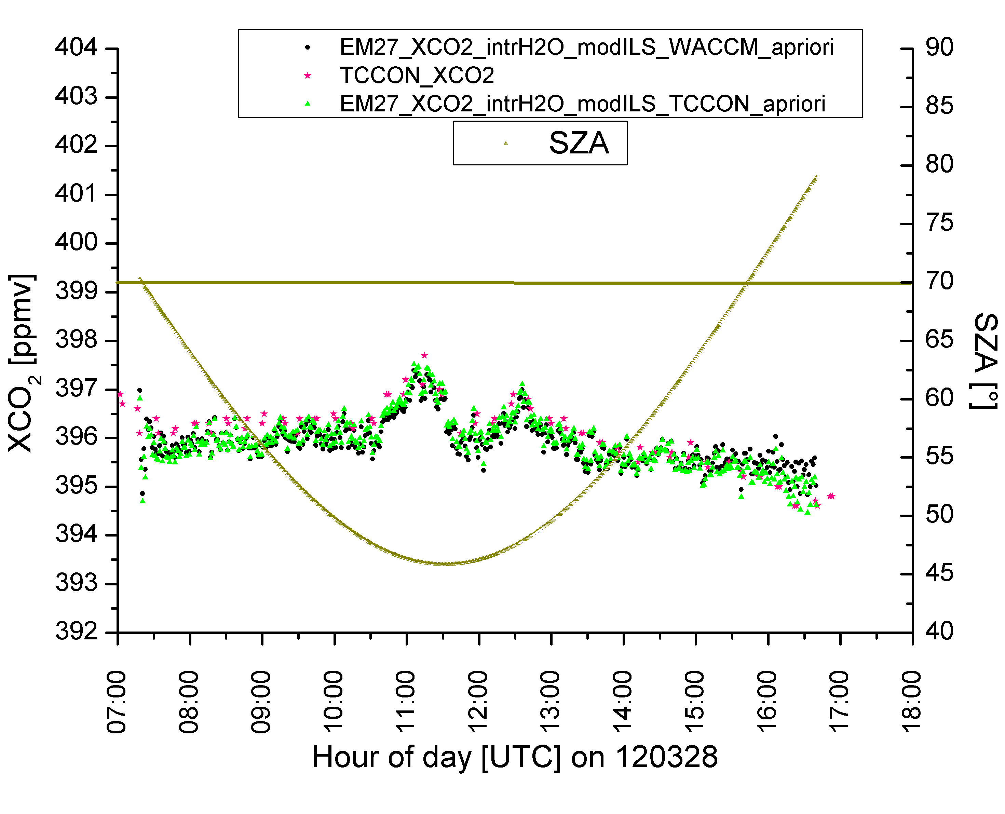
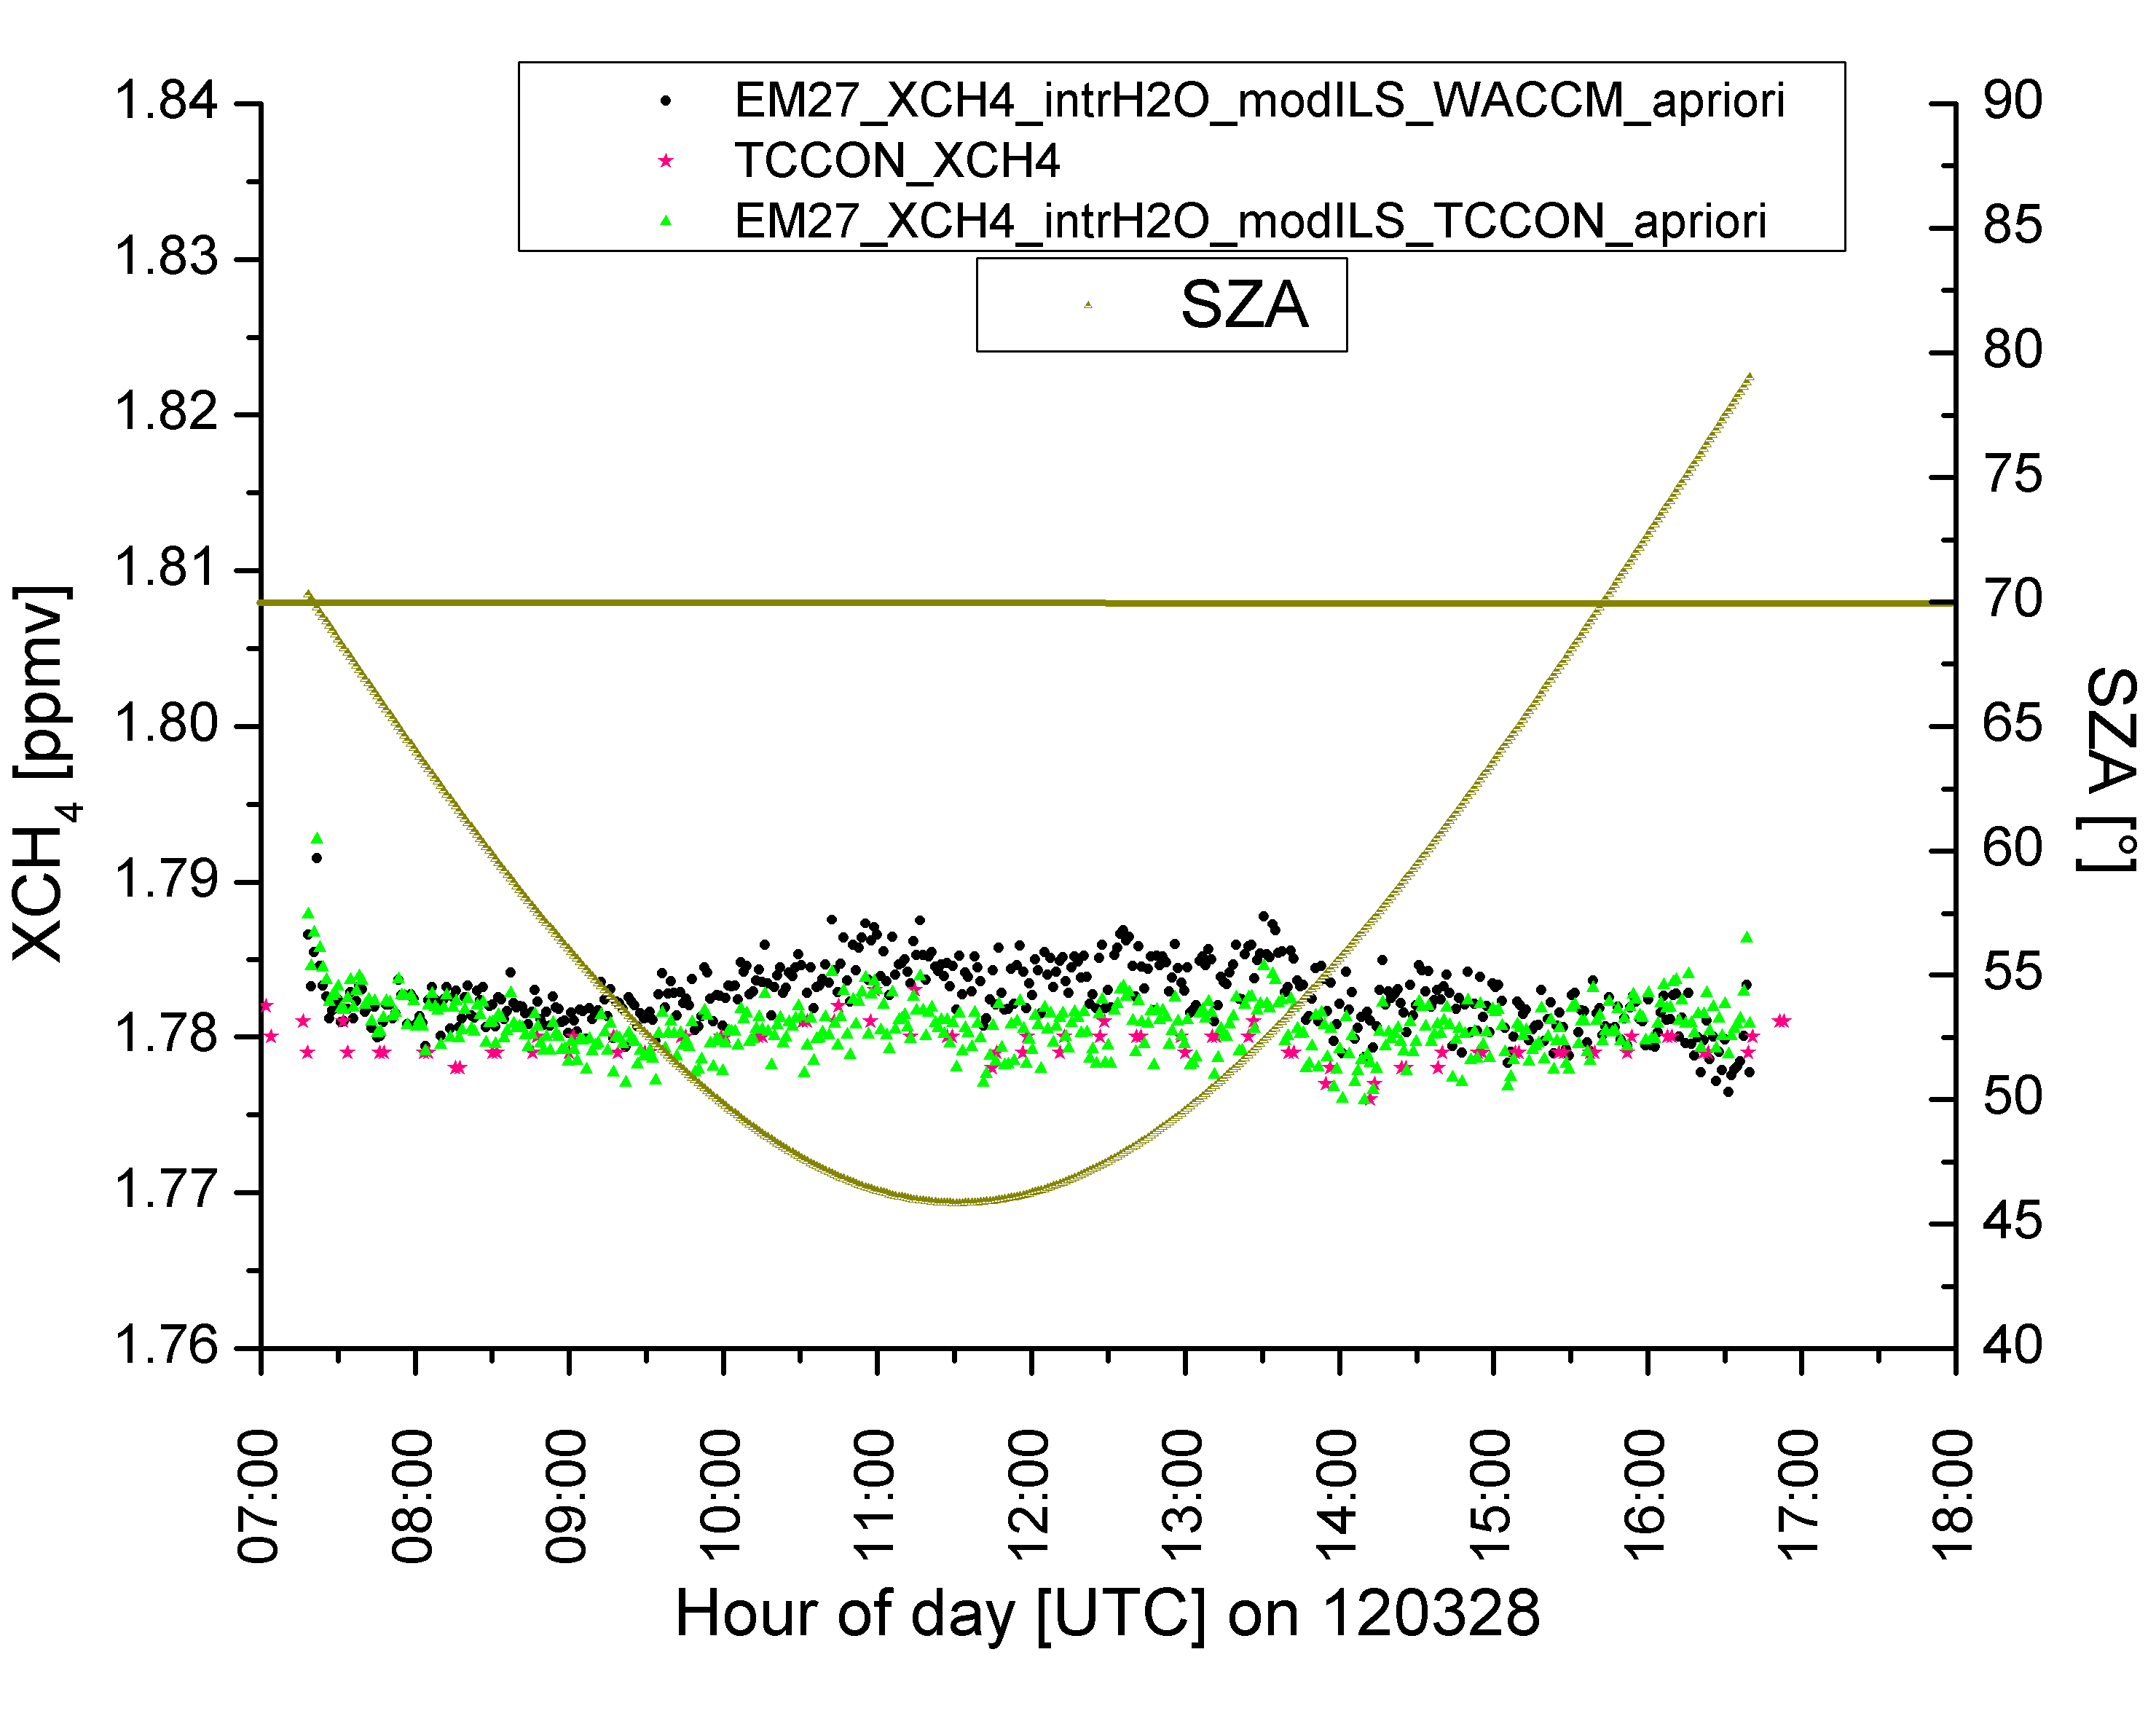
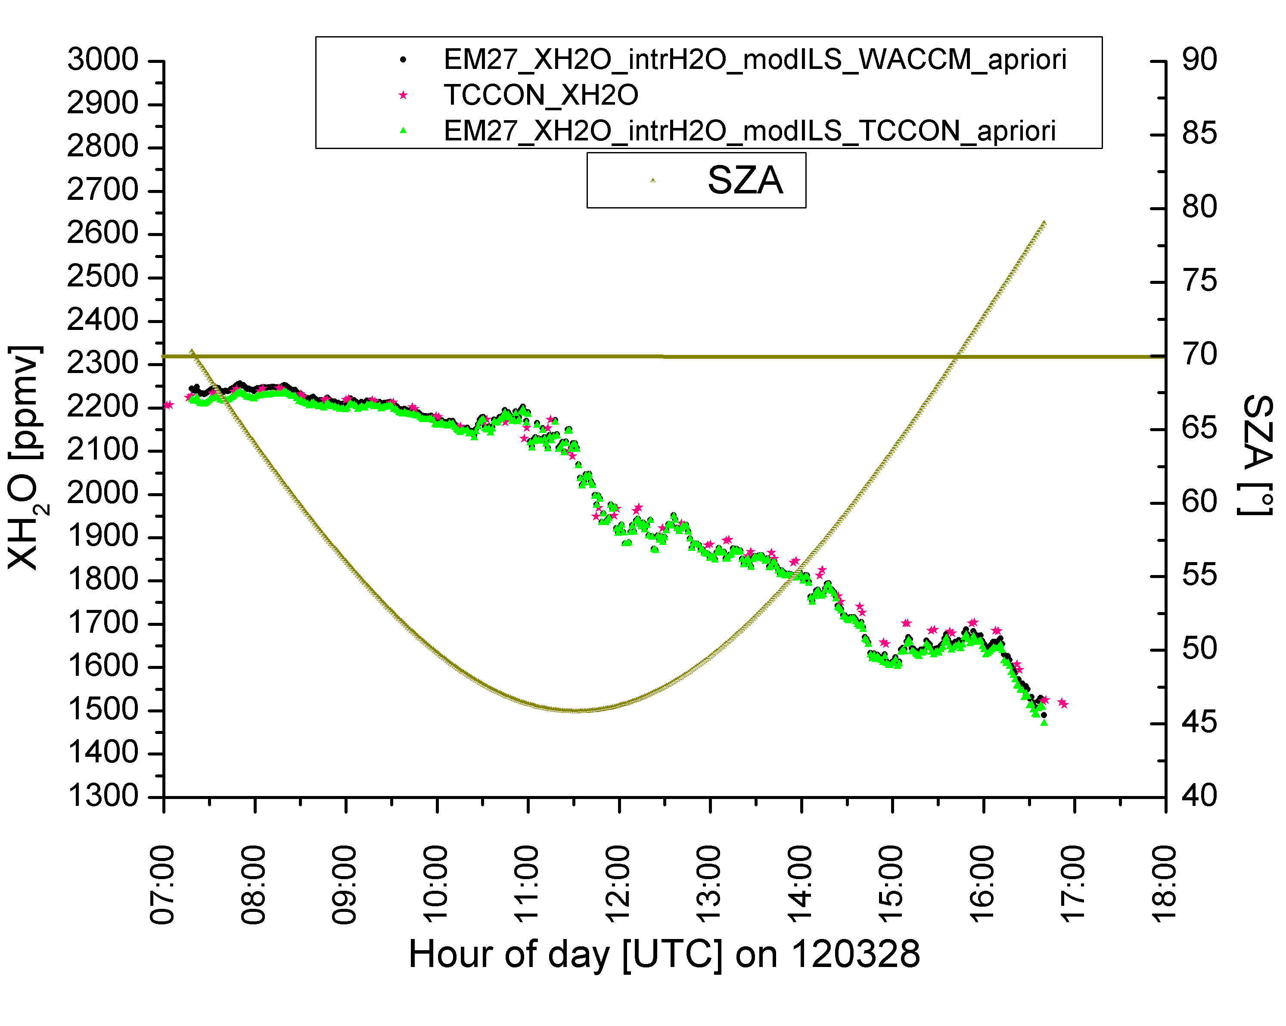
COCCON application
CO2 source from industrial region
  Retrieval results from Karlsruhe on 28.03.2012

Slide 8
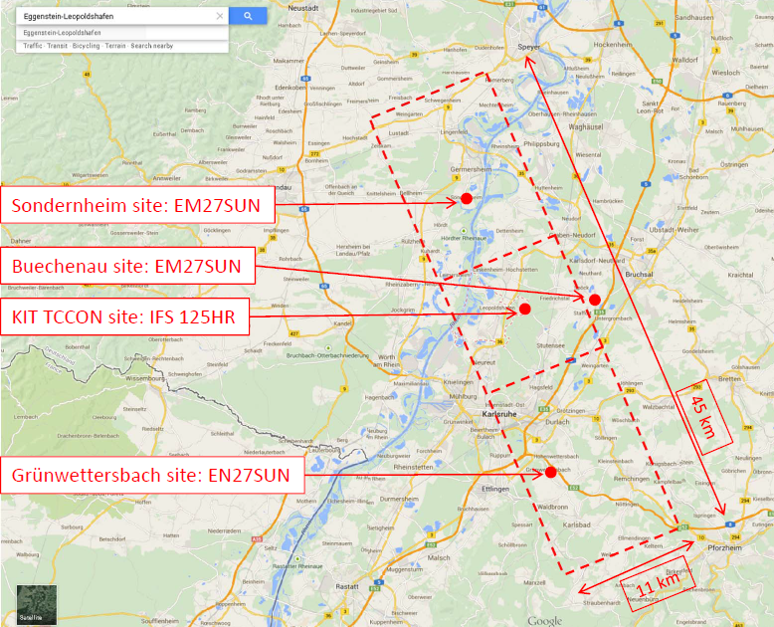
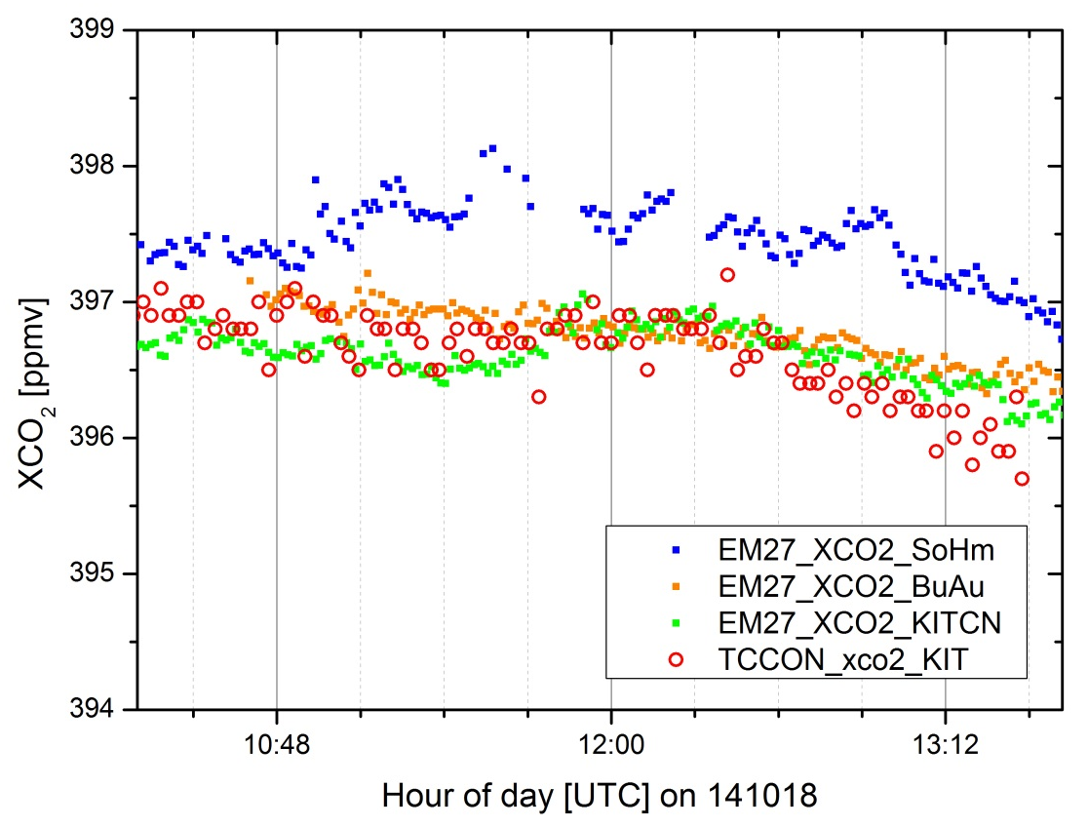
COCCON application
Extended ground-based network for satellite validation
  TCCON measurements at KIT + 3 EM27/SUN spectrometers
Note: XCO2 gradient along OCO-II track
of about 1 ppmv / 10 km
analysis TCCON spectra: S. Dohe
analysis COCCON spectra: M. Kumar Sha

Slide 9
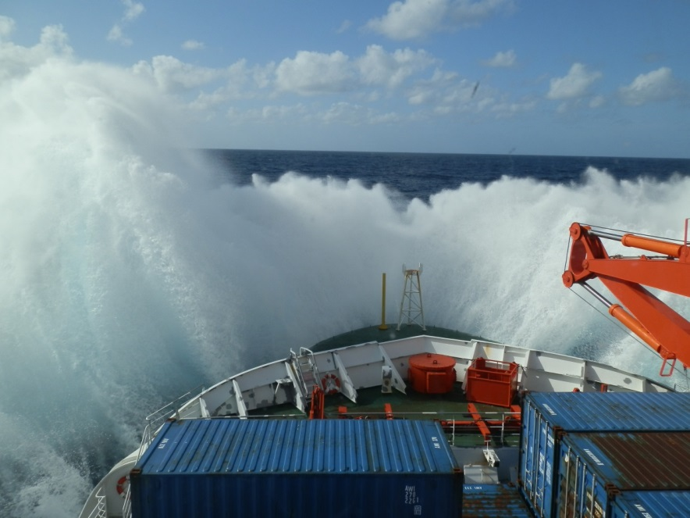


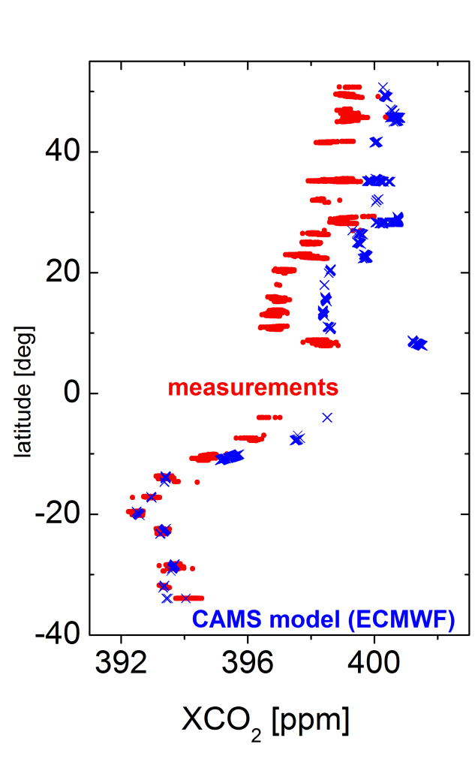
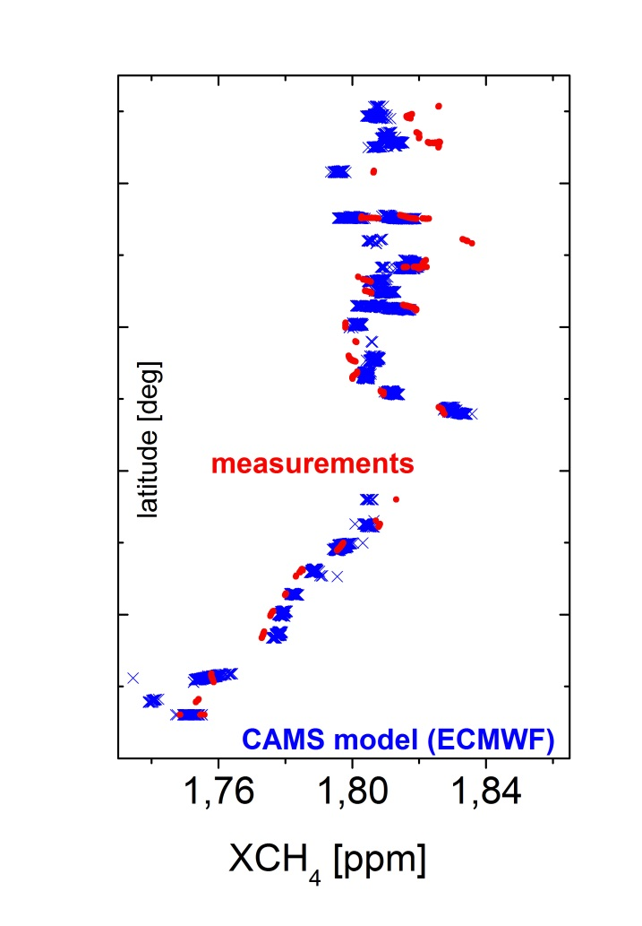
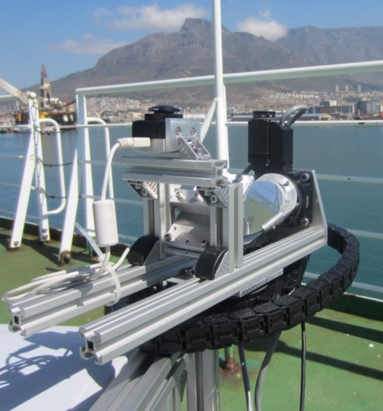
COCCON application
Polarstern cruise (March/April 2014)
  Fast sun-tracker for ship measurements development in the group of Andre Butz
F. Klappenbach et al.: “Accurate mobile remote sensing … aboard a research vessel“ , AMT, 2015

Slide 10
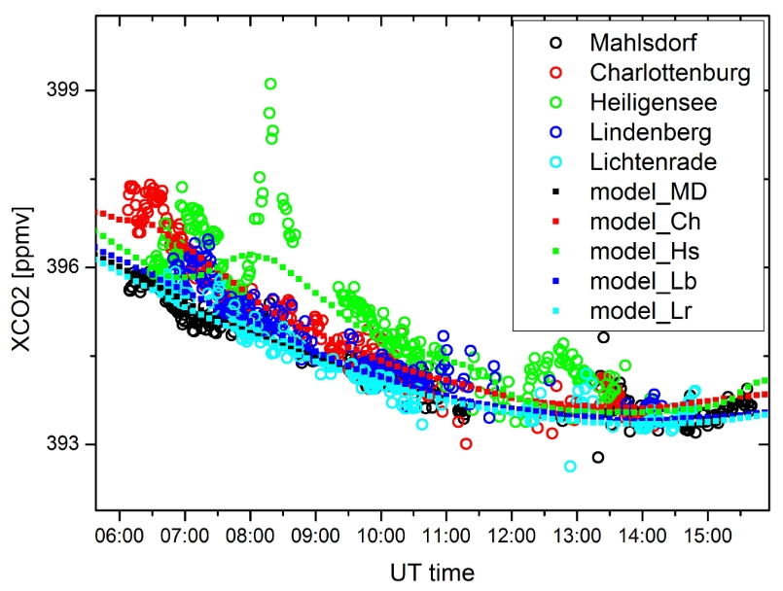
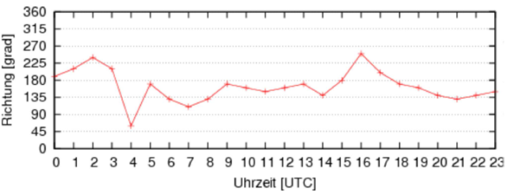
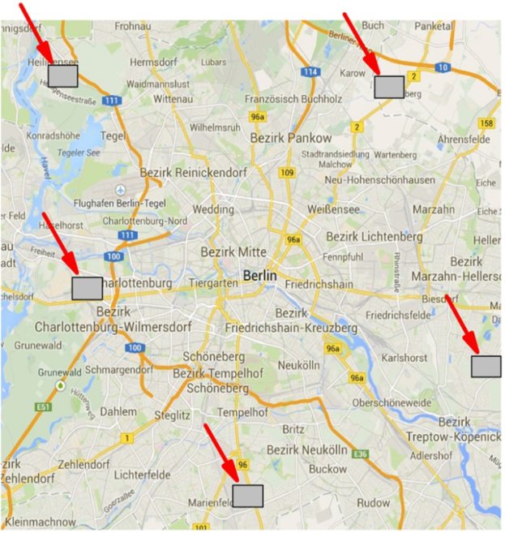
COCCON application
Berlin city campaign (June/July 2014)
  CO2 outflow; comparison with simplified model
F. Hase et al., “Detecting greenhouse gas emissions of Berlin – part 2 ...“, AMT 2015

Slide 11
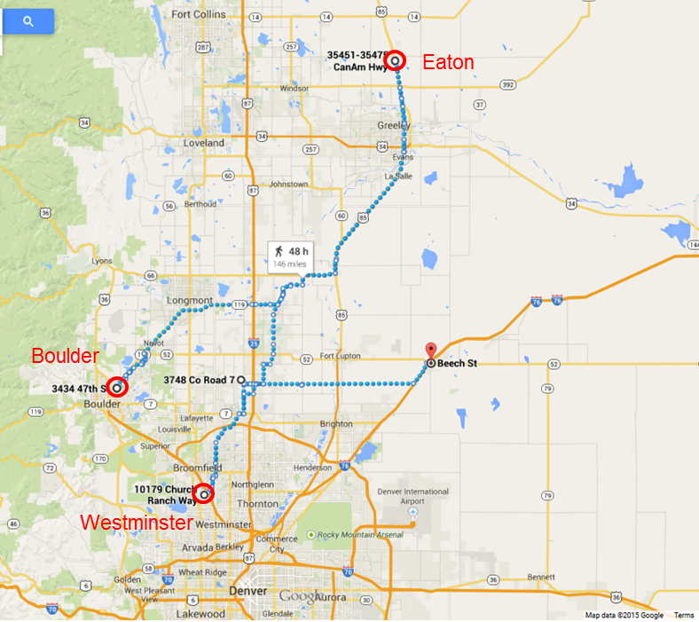
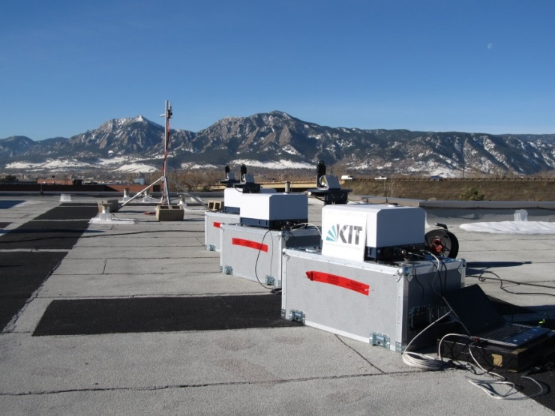
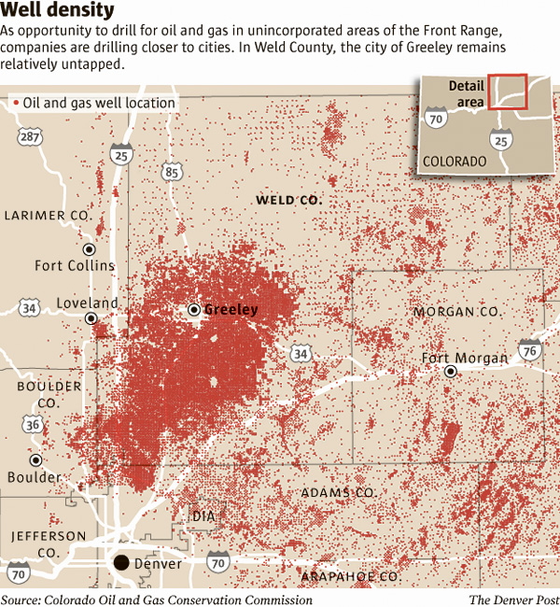
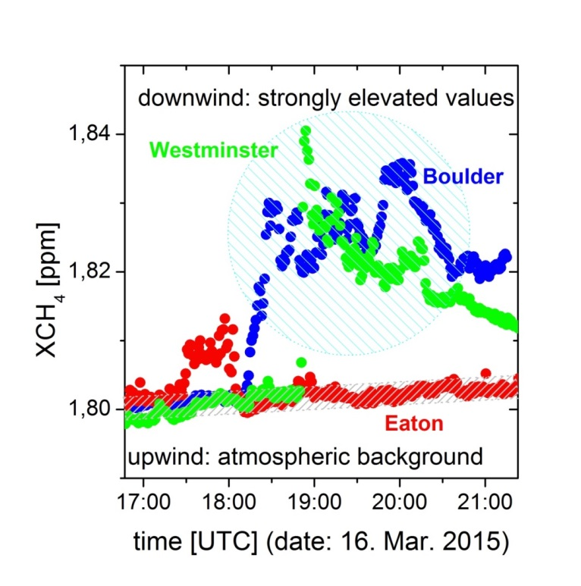


COCCON application
Colorado campaign (March 2015)
  CH4 from Fracking

Slide 12
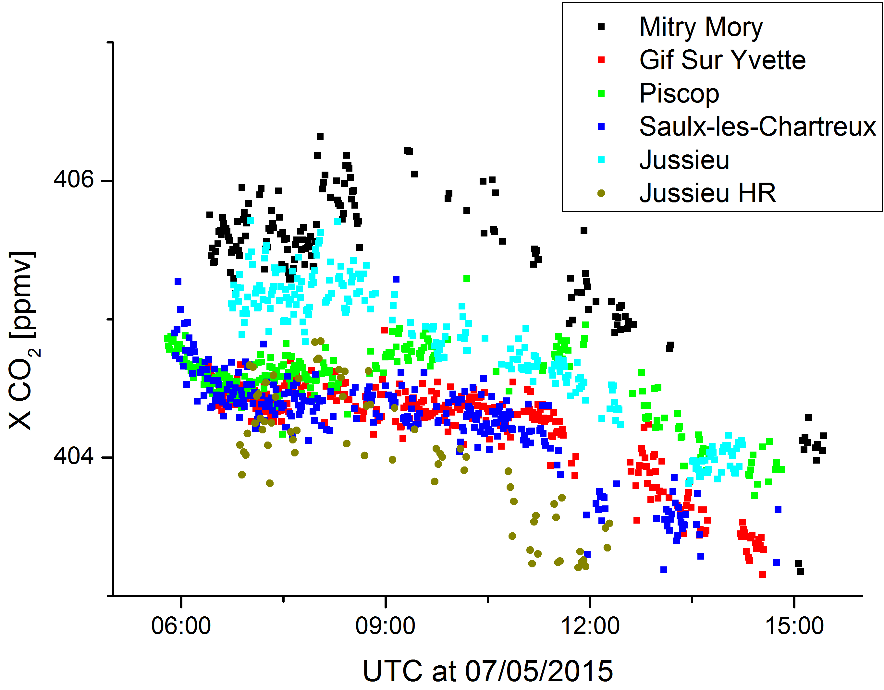
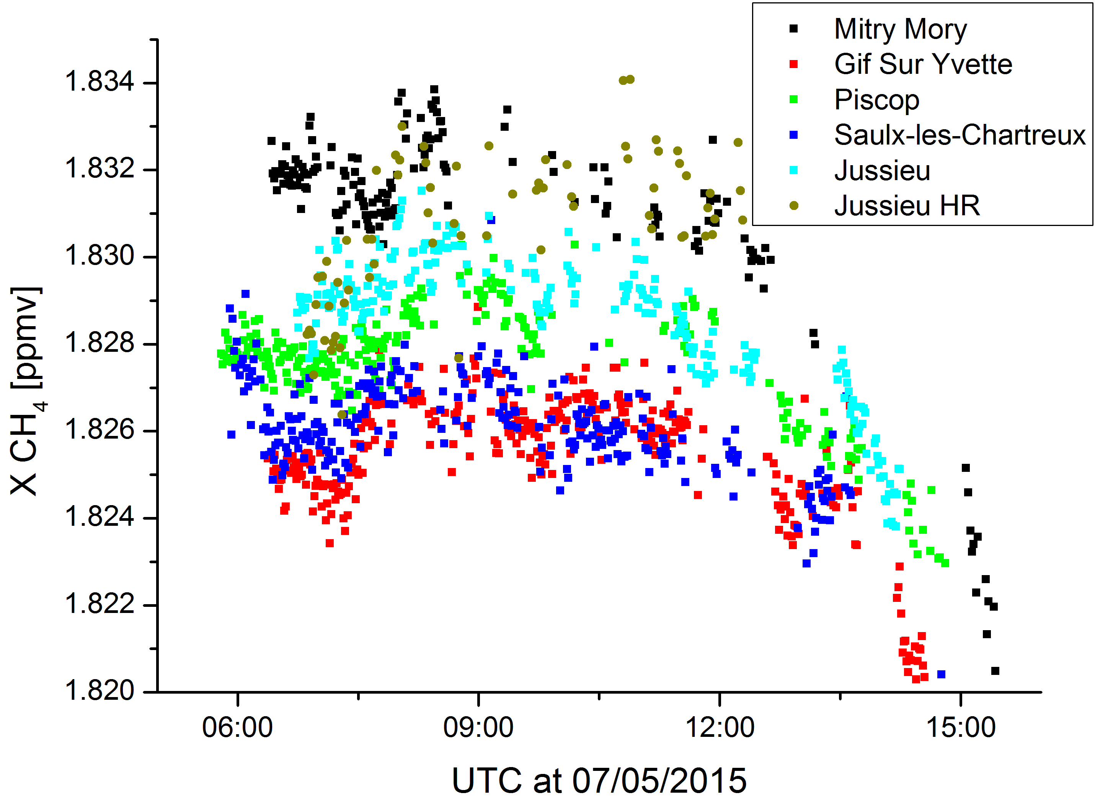
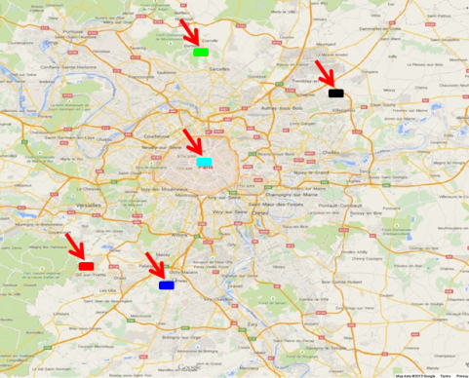
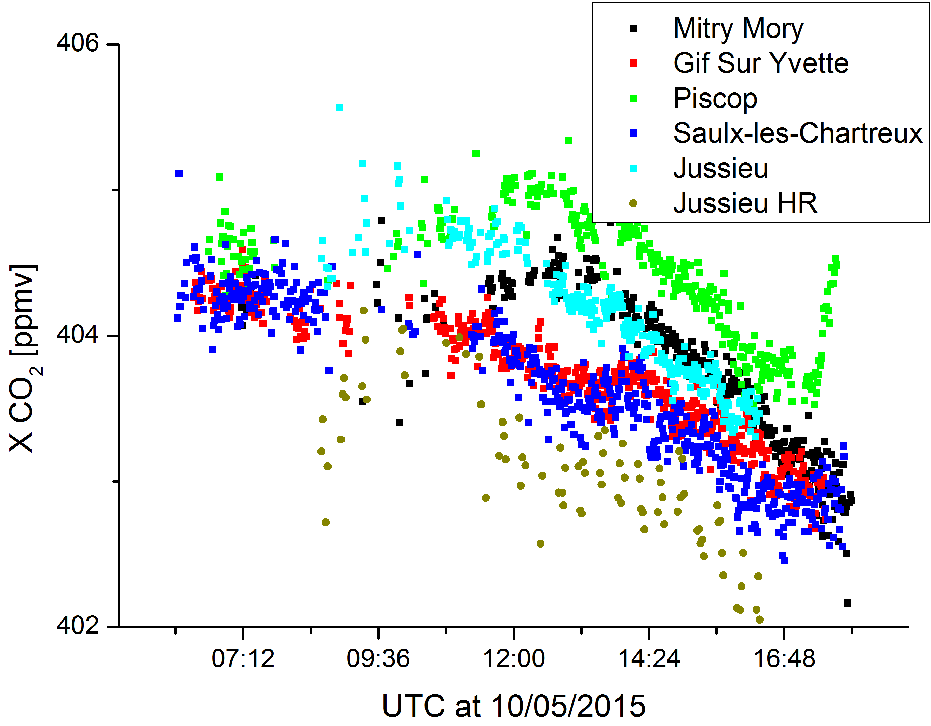
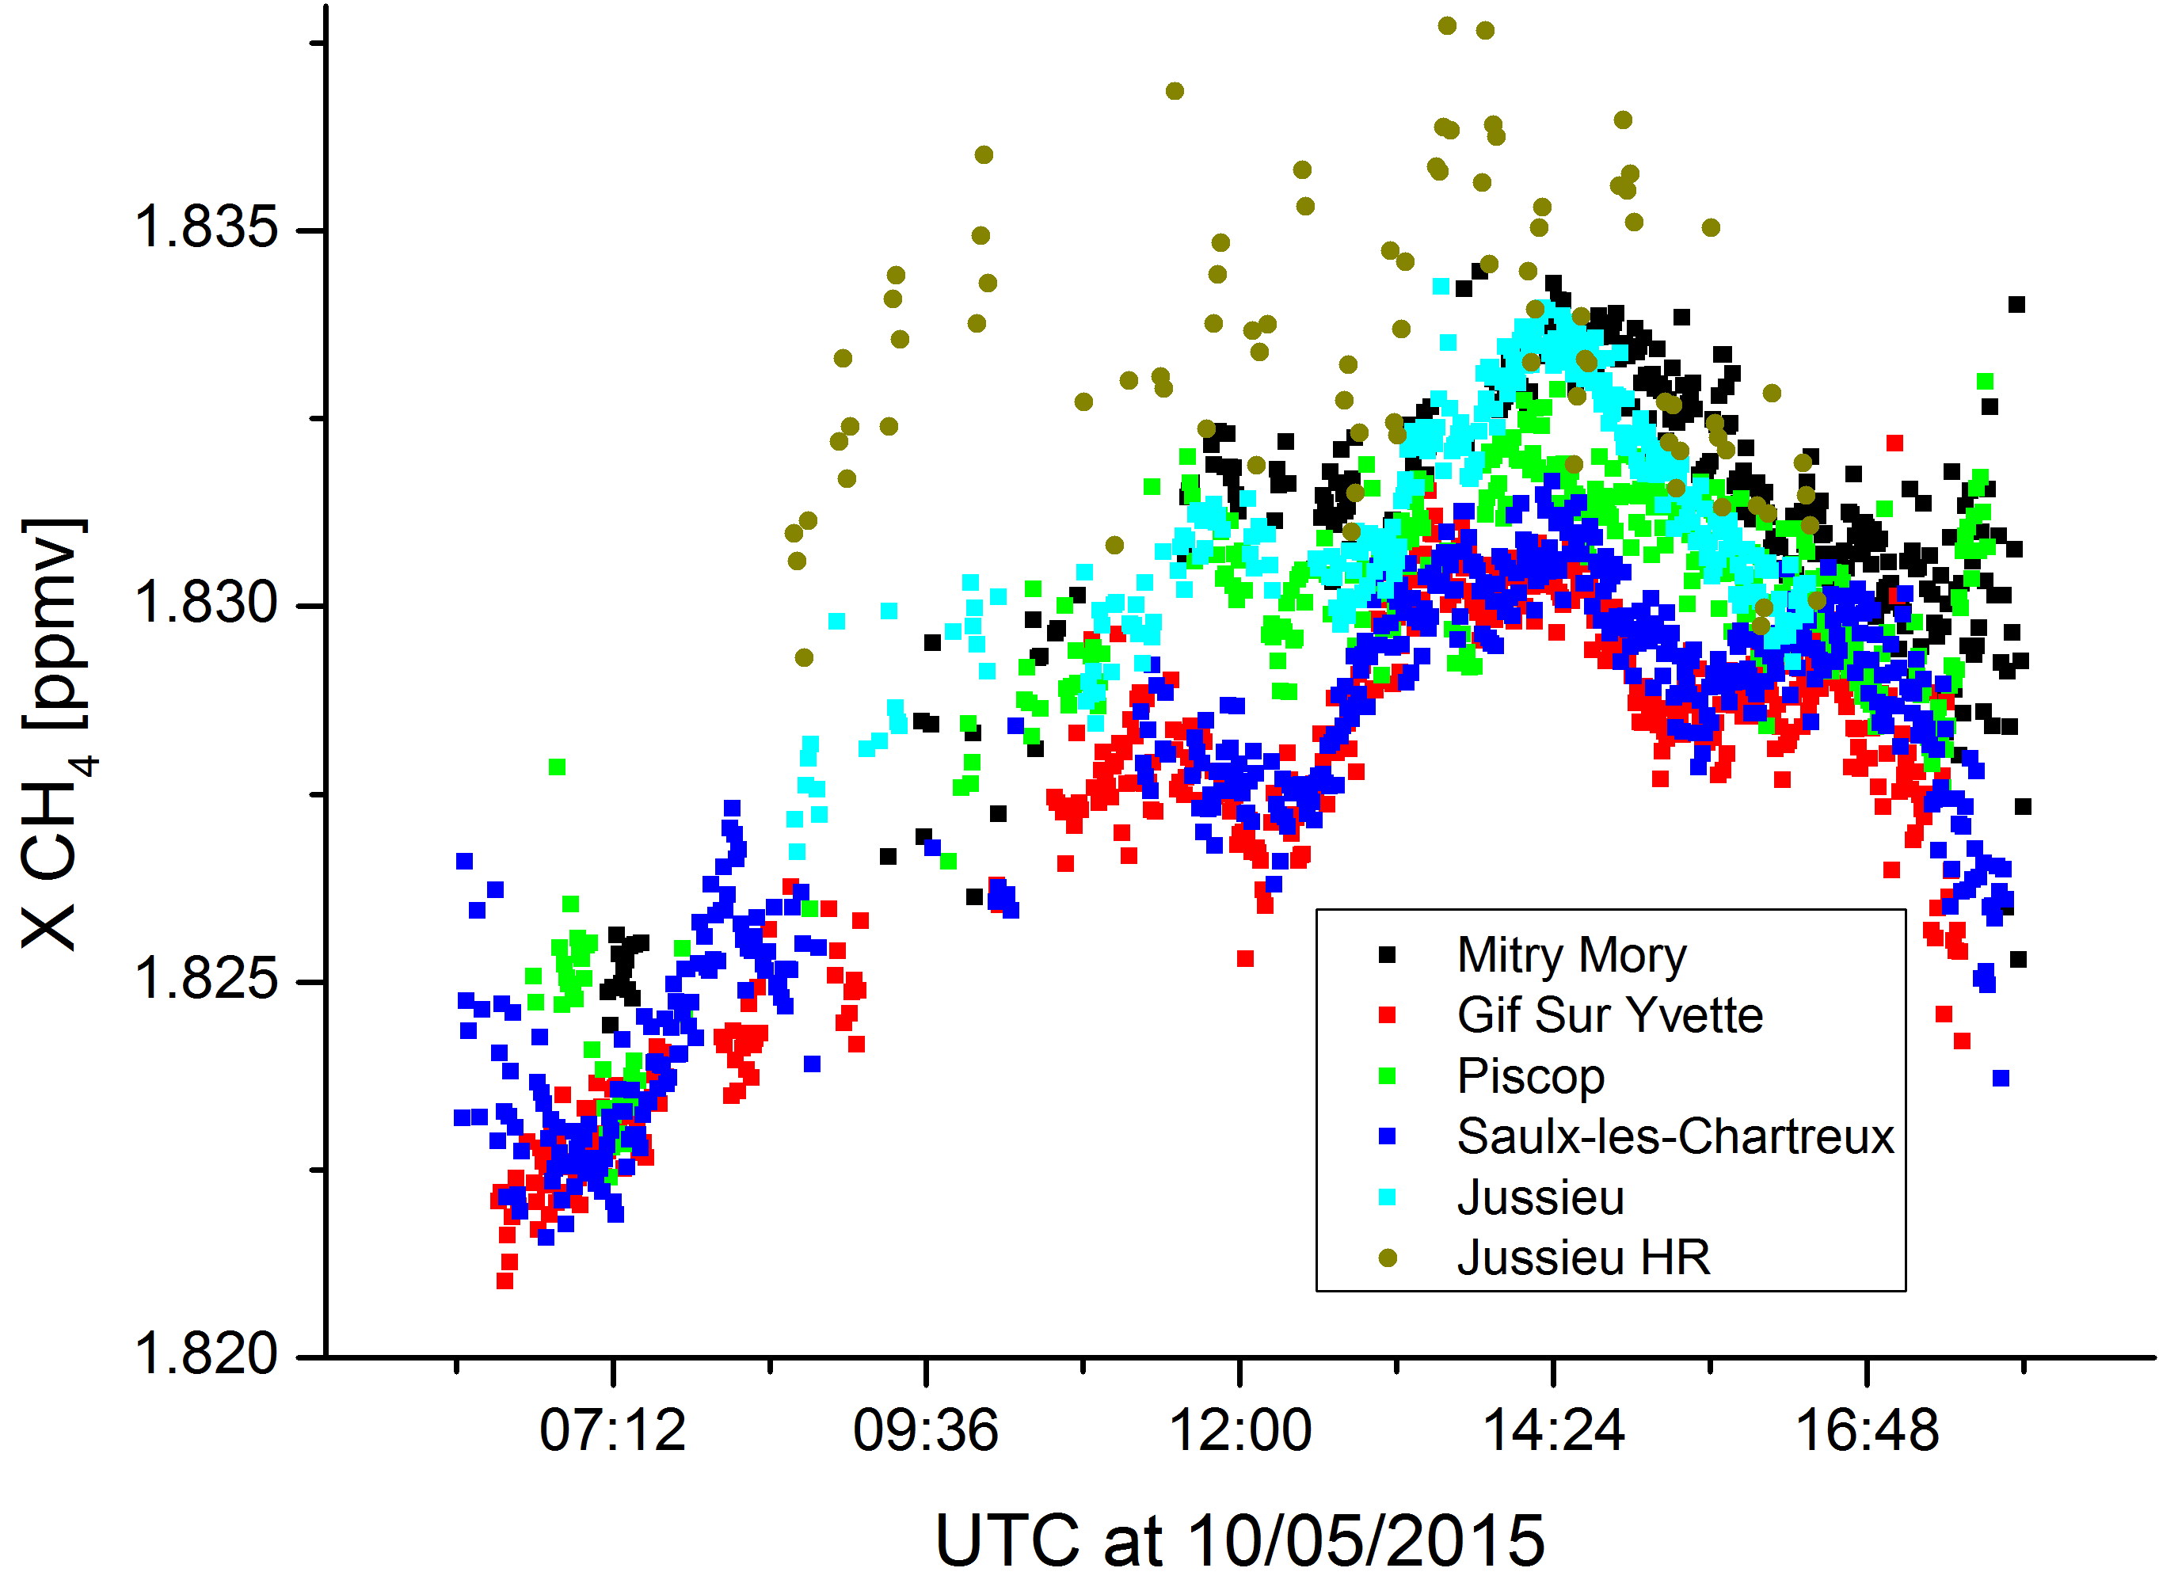
COCCON application
+ collaborators from France
Paris city campaign (May 2015)
  CO2 outflow
Courtesy of M. Frey, F. Hase, publication in preparation

Slide 13
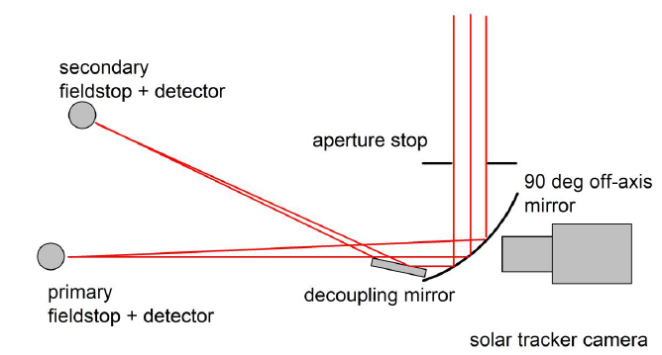
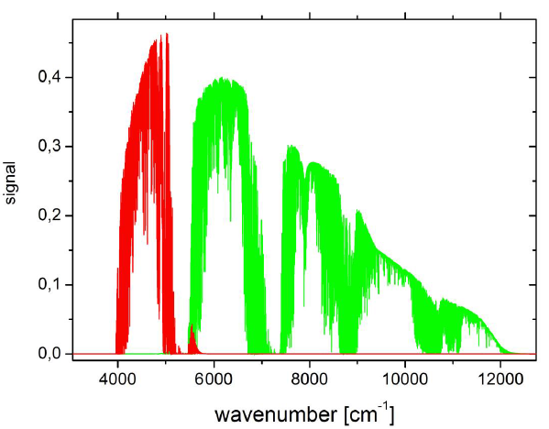
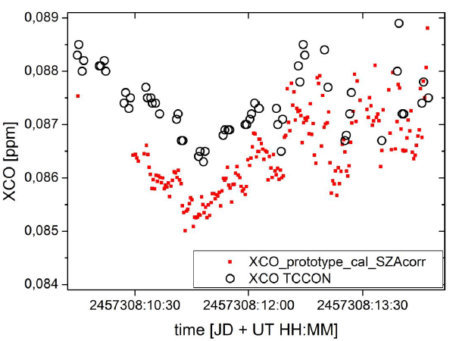
COCCON – CO Channel extension (new)
F. Hase et al."Enhancing the capabilities of a portable FTIR spectrometer for greenhouse gas measurements…“ , AMTD, 2016

Slide 14
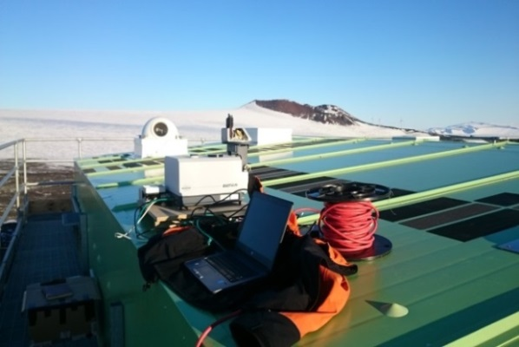
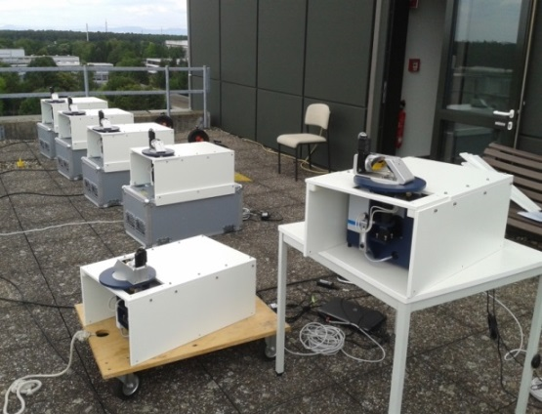
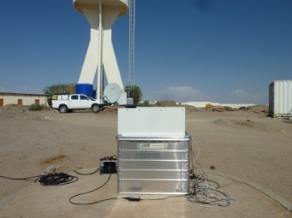
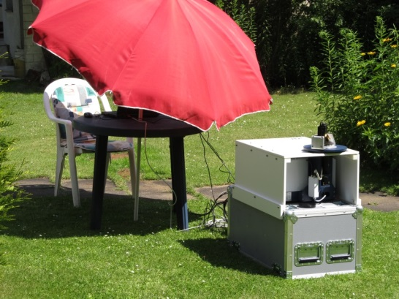
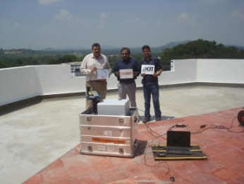
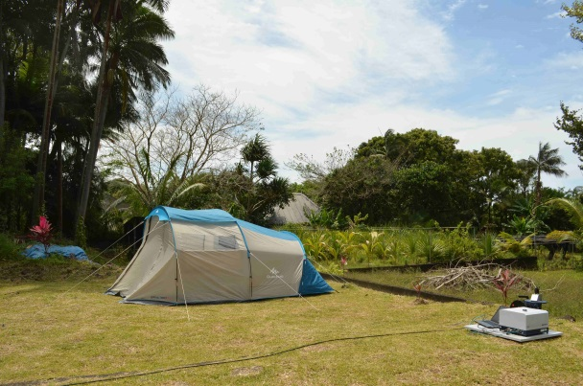
The growing EM27/SUN community
KIT (Hase): 10+*
Harvard Univ (Wofsy): 2
Univ of Wollongong (Griffith): 1
LANL (Dubey): 1
Jaxa (Shiomi): 1
NIES (Morino): 1
Caltech (Wennberg): 1
Univ of Leicester (Boesch): 1
BIUST (Mengistu Tsidu): 1
TUM (Chen): 1
Key Lab Env. Optics & Tech (Wang): 1
INOE (Ene): 1
DLR (Butz): 1
UNAM (Grutter): 1
Univ of Toronto (Wunch): 2
AEMET (Garciar): 1
Currently: ~27
Arrival Heights
Karlsruhe, Germany
Gobabeb, Namibia
Berlin, Germany
Gadanki, India
Ile de La Réunion, France

Slide 15
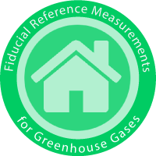

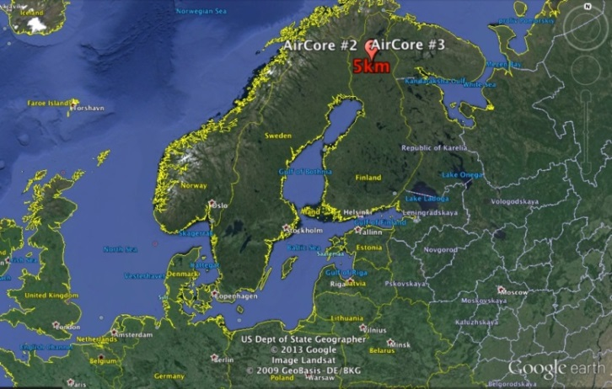







Fiducial Reference Measurements for Greenhouse Gases
FRM4GHG: project objectives and implementation
Assess characteristics of instruments in their capability to provide precise GHG column measurements, and that are cheaper and more mobile than the standard TCCON instrument
Perform an intercomparison of simultaneously measured total column concentrations of a few GHG (CO₂, CH₄, CO) using several different infrared spectrometric instruments colocated at a TCCON site, covering all seasons
Chosen TCCON site = Sodankylä, Finland
@ 67.37°N, 26.63°E, 188 m a.s.l
In-situ vertical profiles of GHG are
provided by regular AirCore launches

Slide 16

Project partners and funding
J. Notholt (coordinator), C. Petri (University of Bremen, IUP)
M. De Mazière (deputy-coordinator), M. K. Sha, C. Hermans, F. Scolas (Royal Belgian Institute for Space Aeronomy)
R. Kivi, P. Heikkinen (Finnish Meteorological Institute)
T. Blumenstock, F. Hase, Q. Tu (Karlsruhe Institute of Technology)
N. Jones, D. Griffith (University of Wollongong)
D. Weidmann, A. Hoffmann, M. Huebner (Rutherford Appleton Lab)
H. Chen, Joram Hooghiem (University of Groningen)
Project duration: August 2016 → end January 2018
Funded by ESA, Technical Officer : A. Dehn
assisted by P. Castracane
Project website: http://frm4ghg.aeronomie.be/

Slide 17
FRM4GHG campaign: Instruments overview
Instrument | Institute | Spectral range | Resolution | Main GHGs
Bruker IFS 125HR | FMI | 1800 — 15000 cm⁻¹ | 0.004 cm⁻¹ | XCO₂, XCH₄, XCO @ 0.02 cm⁻¹
Bruker Vertex 70 | Uni Bremen BIRA-IASB | 2500 — 15000 cm⁻¹ | 0.16 cm⁻¹ | XCO₂, XCH₄, XCO
Bruker EM27/SUN | KIT | 4000 — 9000 cm⁻¹ | 0.5 cm⁻¹ | XCO₂, XCH₄, XCO
Bruker IR Cube | Uni Wollongong | 4500—15000 cm⁻¹ | 0.5 cm⁻¹ | XCO₂, XCH₄
LHR (Laser Heterodyne Radiometer) | RAL | 954—960 cm⁻¹ | 0.002 and 0.02 cm⁻¹ | CO₂, H₂O
AirCore | Uni Groningen FMI | In-situ sampling | 13.4 mbar (Amb.P. > 232 mbar)3.9 mbar (Amb.P. < 232 mbar) | CO₂, CH₄, CO vertical profiles, calibrated to WMO standards

Slide 18
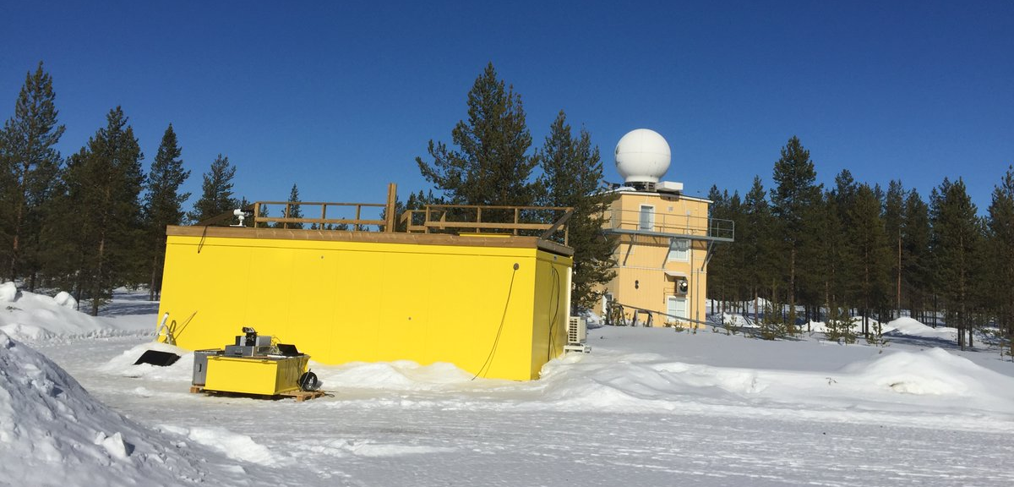
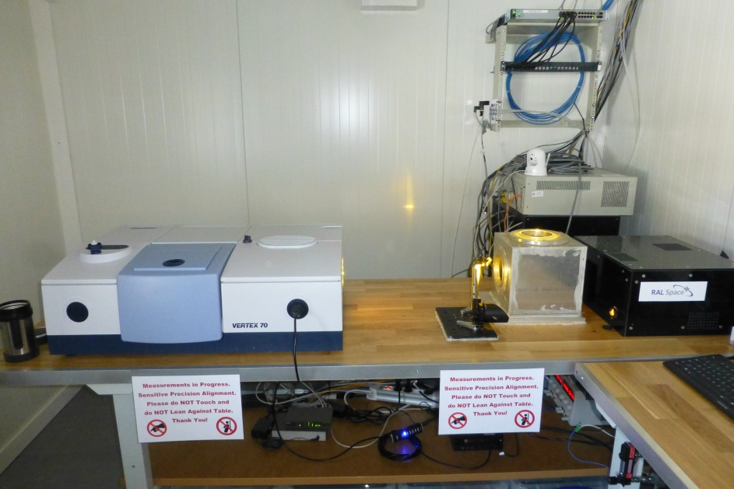
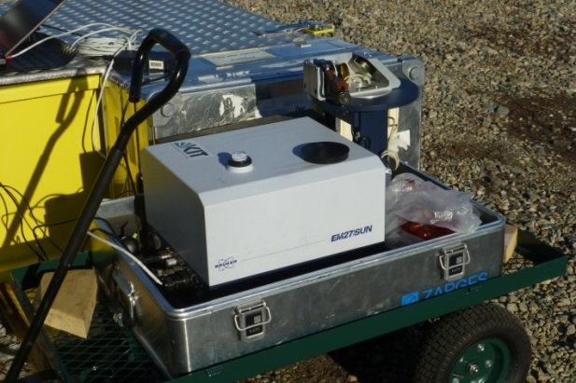
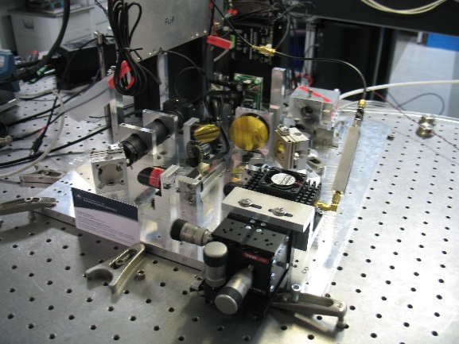
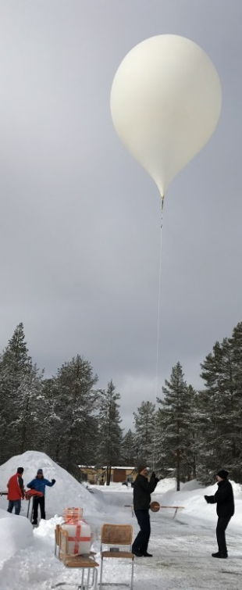
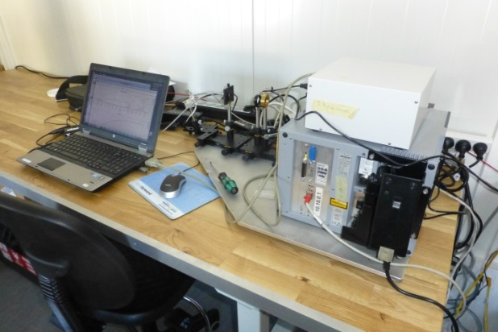
FRM4GHG campaign: Instruments overview
TCCON
Vertex 70
FRM4GHG container
AirCore launch
EM27/SUN w/ suntracker
IR cube
LHR optical breadboard

Slide 19
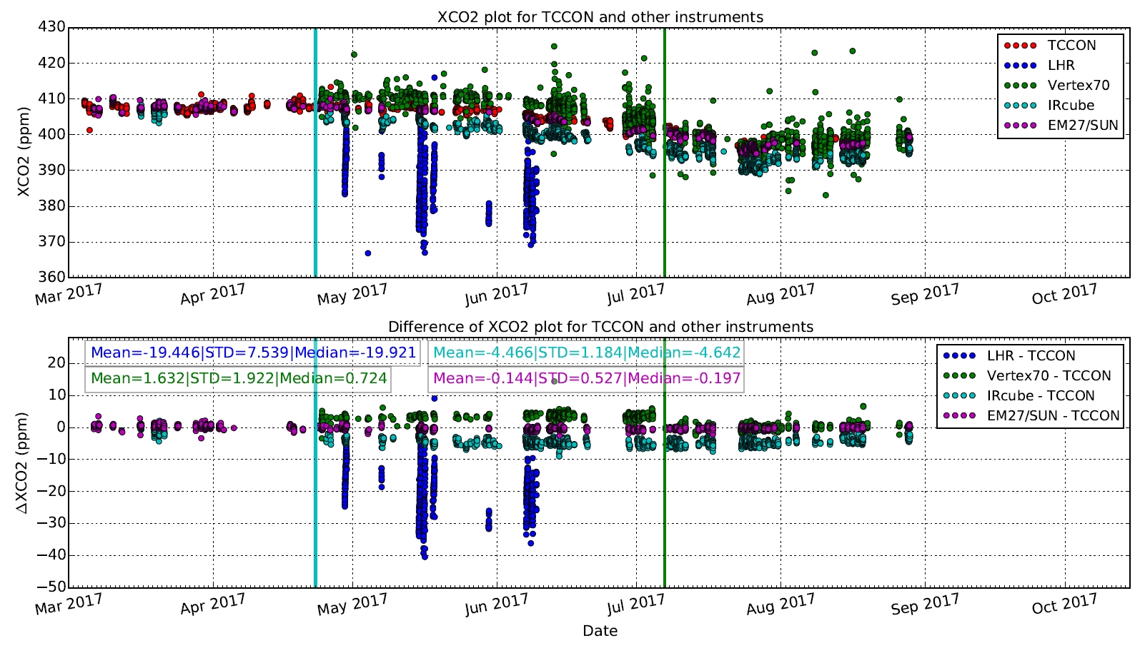
FRM4GHG – XCO2 preliminary results

Slide 20
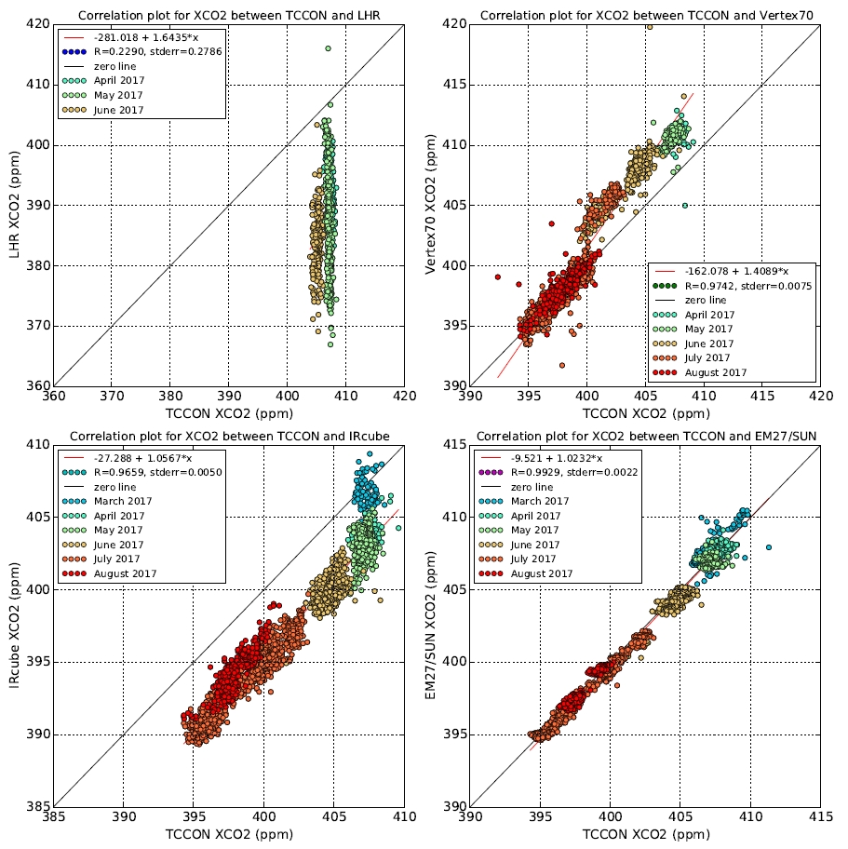
FRM4GHG – XCO2 preliminary results

Slide 21

FRM4GHG – XCH4 preliminary results

Slide 22

FRM4GHG – XCH4 preliminary results

Slide 23

FRM4GHG – XCO preliminary results

Slide 24

FRM4GHG – XCO preliminary results

Slide 25
Summary and Outlook
Low resolution FTIRs proved to be reliable and give precise measurements of GHGs.
COCCON network for measurements of XCO2 and XCH4 has been initiated and is coordinated by KIT; further addition of XCO channel has been implemented in 2016.
ESA-funded project – FRM4GHG performed in 2017 at Sodankylä TCCON site to inter-compare several low-resolution FTIRs with capabilities to measure XCO2, XCH4 and XCO gases. Performed regular AirCore launches for atmospheric profiles and have used this data as a priori for the FTIR retrievals. Preliminary results are quite promising. Final results of the inter-comparison exercise is expected in February 2018.
Further extension of the campaign will take place in 2018 at the same site in Sodankylä. The extension campaign will focus on performing a rigorous comparison of the ground-based measurement datasets with optimized working conditions of the spectrometers in continuation to the current campaign datasets, to include new species (e.g. formaldehyde and nitrous oxide), to perform a validation of the S5P level-2 products with well-characterized ground-based measurement datasets.

Slide 26

Thank you for your attention

