Slide 1

Fiducial Reference Measurements for Greenhouse Gases
(FRM4GHG)
Based on AO proposal TCCONcomp; ESA decided to fund it; for geo-return reasons, coordination was taken over by J. Notholt (UBremen)..

Slide 2
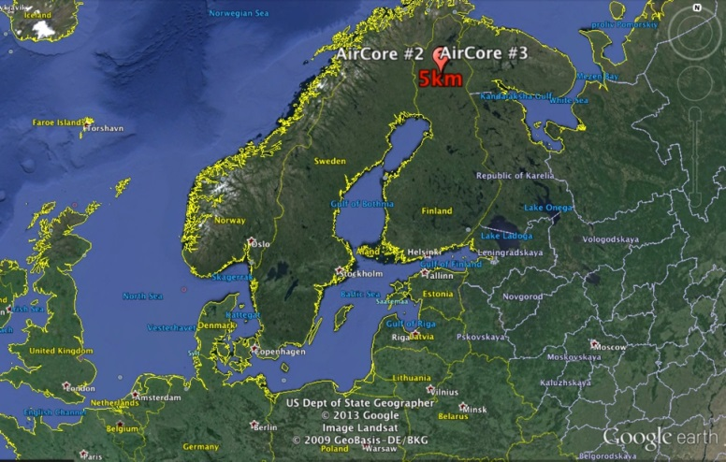
Project objectives & implementation
Assess characteristics of instruments in their capability to provide precise GHG column measurements, and that are cheaper and more mobile than the standard TCCON instrument
Perform an intercomparison of simultaneously measured total column concentrations of a few GHG (CO₂, CH₄, CO) using several different portable low-cost spectrometric instruments colocated at a TCCON site, covering all seasons
Chosen TCCON site = Sodankylä
@ 67.37°N, 26.63°E
In-situ vertical profiles of GHG are
provided by regular AirCore launches

Slide 3
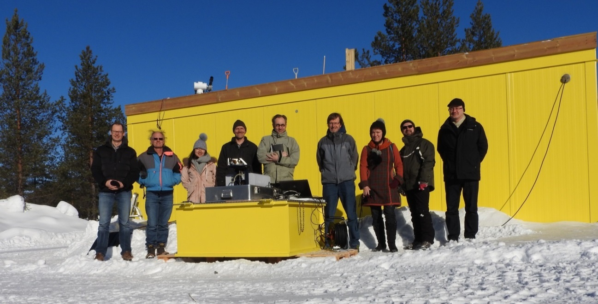

Project partners & funding
J. Notholt, C. Petri (University of Bremen, IUP)
M. De Mazière, C. Hermans, F. Scolas, M. K. Sha (Royal Belgian Institute for Space Aeronomy)
R. Kivi, P. Heikkinen, Finnish Meteorological Institute
T. Blumenstock, F. Hase, Q. Tu (Karlsruhe Institute of Technology)
N. Jones, D. Griffith (U. Wollongong)
D. Weidmann, A. Hoffmann, M. Huebner (Rutherford Appleton Lab)
H. Chen, Joram Hooghiem (University of Groningen)
Project duration: August 2016 → end Jan. 2018
Funded by ESA, Technical Officer : A. Dehn
assisted by P. Castracane
Notes:
Container acquired by FMI
Australians not wearinng shorts !

Slide 4
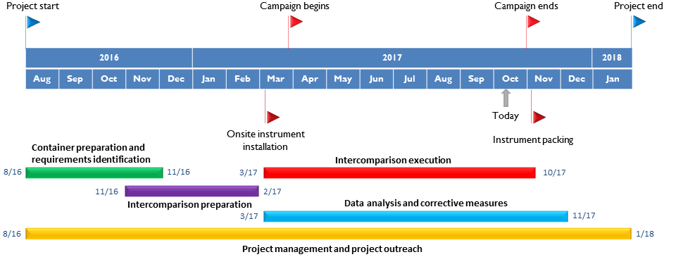
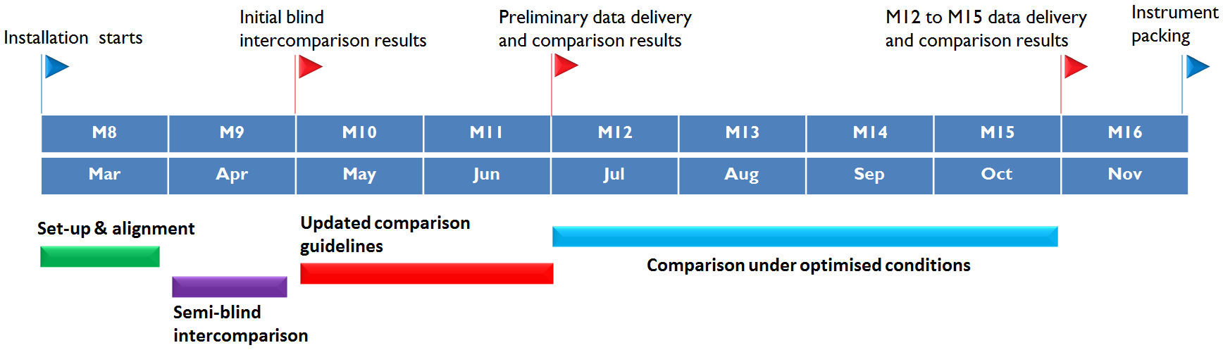
Project timeline

Slide 5
Instruments overview
Instrument | Institute | Spectral range | Resolution | Main GHGs
Bruker IFS 125HR | FMI | 1800 — 15000 cm⁻¹ | 0.004 cm⁻¹ | XCO₂, XCH₄, XCO @ 0.02 cm⁻¹
Bruker Vertex 70 | Uni Bremen BIRA-IASB | 2500 — 15000 cm⁻¹ | 0.16 cm⁻¹ | XCO₂, XCH₄, XCO
Bruker EM27/SUN | KIT | 4000 — 9000 cm⁻¹ | 0.5 cm⁻¹ | XCO₂, XCH₄, XCO
Bruker IR Cube | Uni Wollongong | 4500—15000 cm⁻¹ | 0.5 cm⁻¹ | XCO₂, XCH₄
LHR (Laser Heterodyne Radiometer) | RAL | 954—960 cm⁻¹ | 0.002 and 0.02 cm⁻¹ | CO₂, H₂O
AirCore | Uni Groningen FMI | In-situ sampling | 13.4 mbar (Amb.P. > 232 mbar)3.9 mbar (Amb.P. < 232 mbar) | CO₂, CH₄, CO vertical profiles, calibrated to WMO standards
Notes:
See extended spectral ranges and different spectral resolutions
Vertex 70 – cf. Vertex 80 here in Paris (NH3 talk on Tuesdayy).
-> Mores species than only TCCON Gases cf. InSb detecor present
Idem for RAL and IR cube ? !

Slide 6
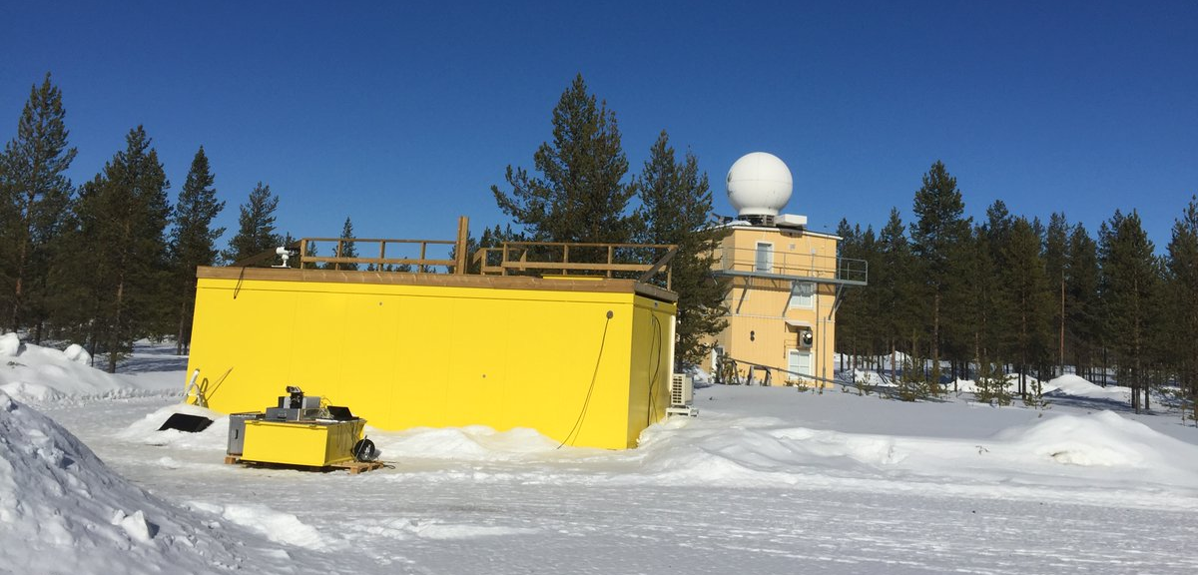
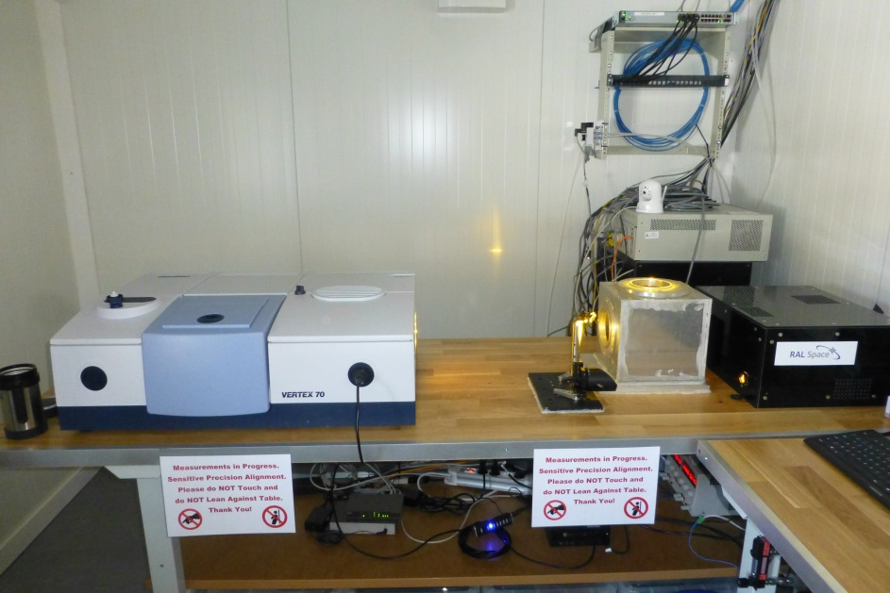
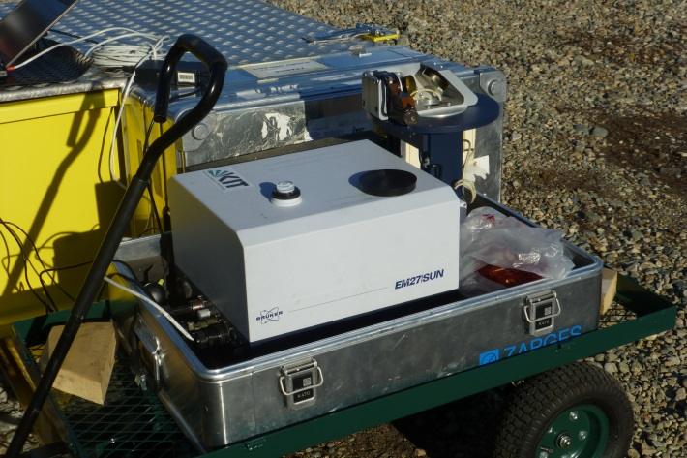
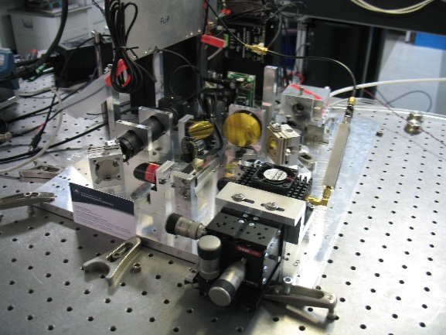
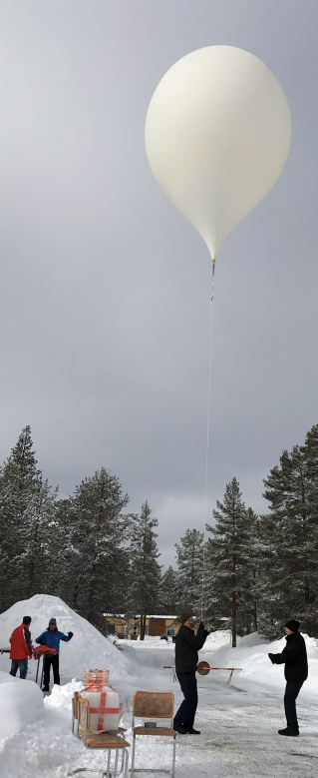
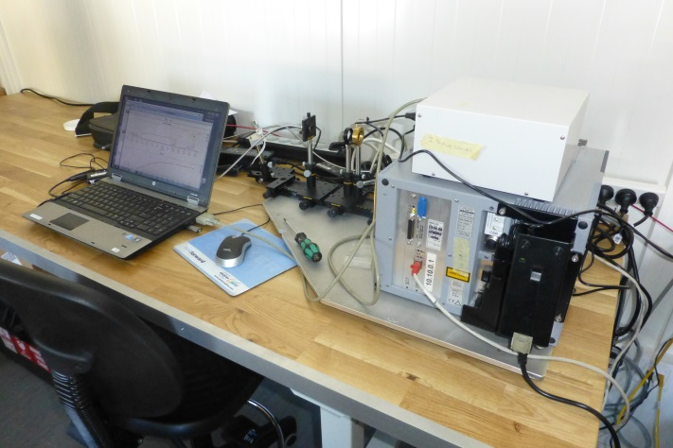
TCCON
Vertex 70
FRM4GHG container
AirCore launch
EM27/SUN w/ suntracker
LHR optical breadboard
IR cube
Notes:
Vertex 70 – cf. Vertex 80 here in Paris (NH3 talk on Tuesday).
-> Mores species than only TCCON Gases cf. InSb detecor present
Idem for RAL and IR cube ? !

Slide 7
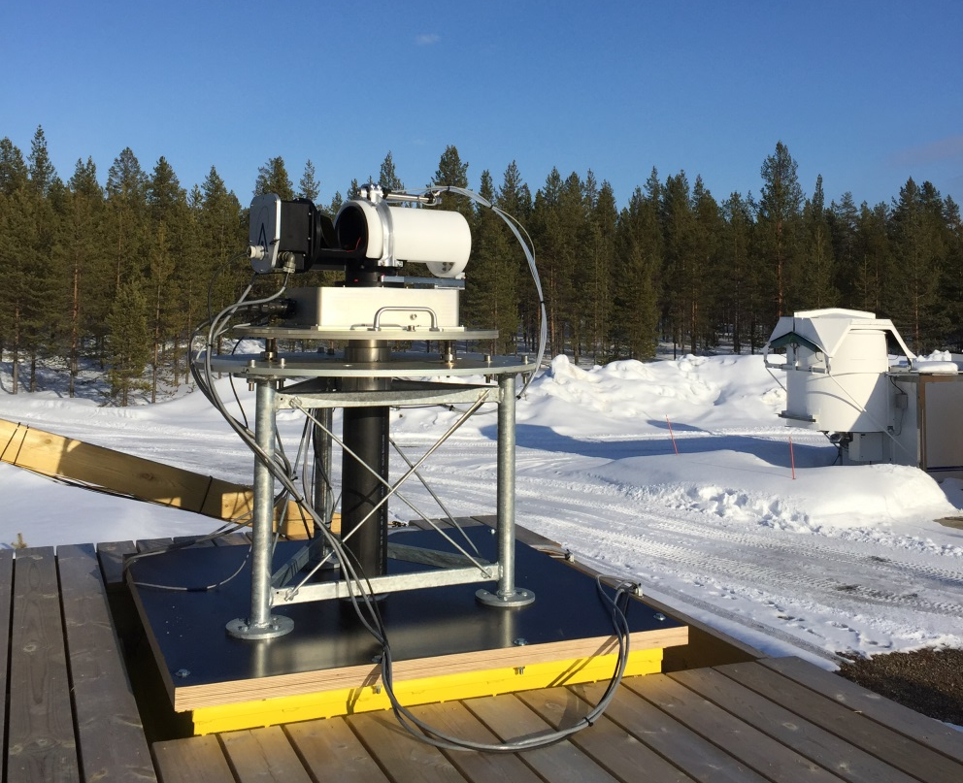
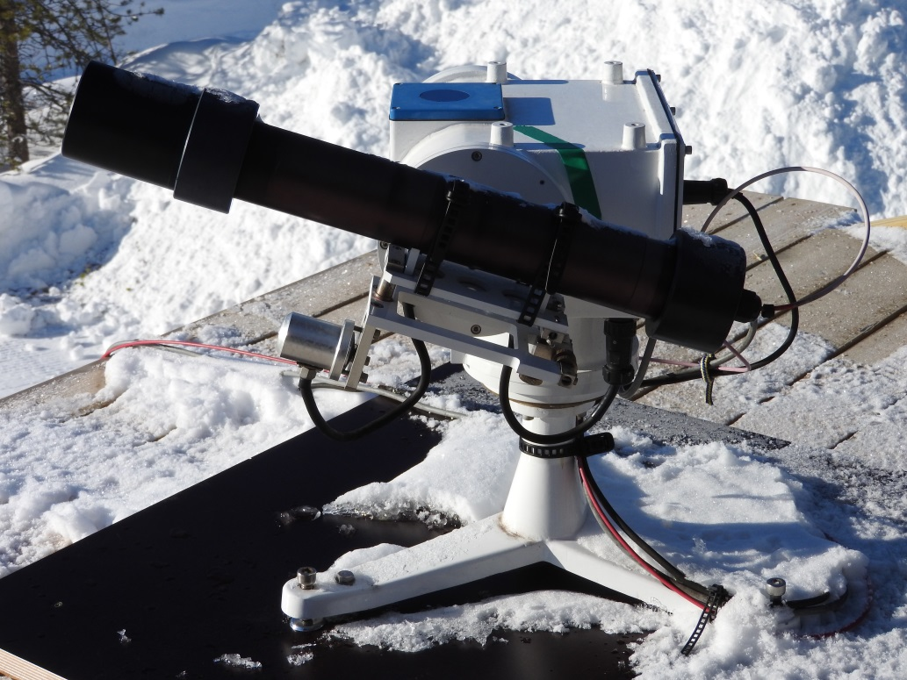
Suntrackers
Fiber-coupled to IRcube
BIRA suntracker- coupled to Vertex 70 and LHR

Slide 8
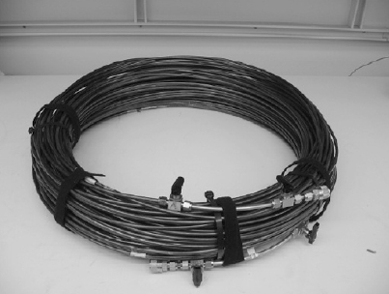
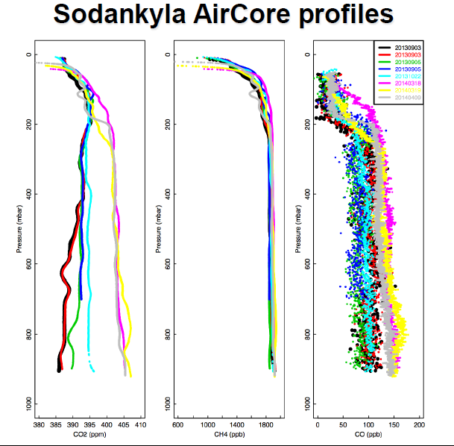
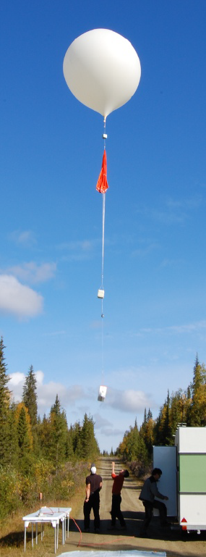
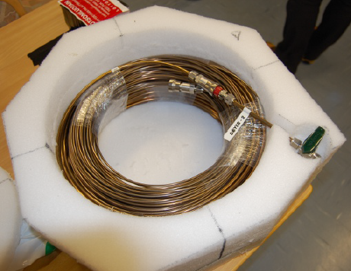
Aircore (NOAA, Karion et al., 2010)
Principle:
1. Long tube, filled with ‘fill gas’, open at 1 end, is launched in the air with a carrier (typically a balloon, up to 25 km altitude);
2. During ascent, pressure decrease evacuates fill gas from the tube.
3. During descent (typically with parachute), pressure increase → the ambient air gradually fills the tube.
4. At landing, tube is closed, taken to lab for analysis ⇒ tube air is ‘flushed’ through PICARRO GHG analyser
5. Concentration_gas (t) is converted to concentration_gas (z)
40 m (1/4” diameter)
+ 60 m (1/8” diameter);
coils: 2.8 kg;
Total package: 3.6 kg

Slide 9
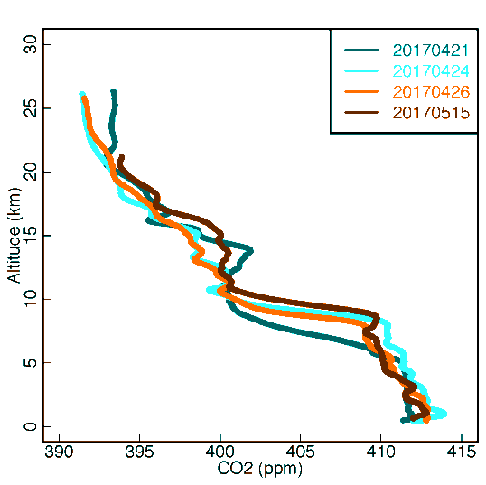
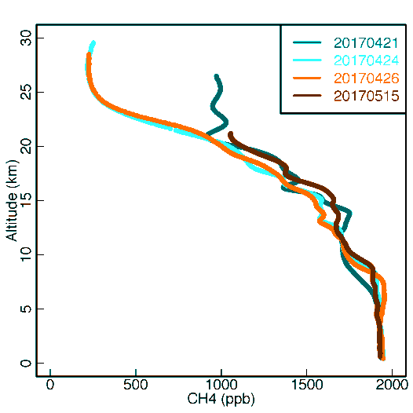
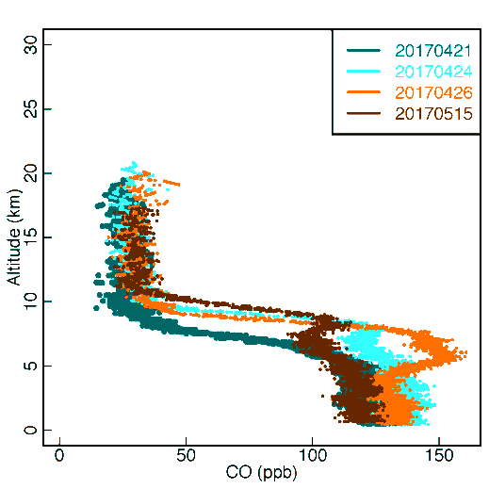
AirCore profiles during FRM4GHG
AirCore flights during the campaign
CO₂
Fight no. | Month | Date
1 | April | 20170421
2 | April | 20170424
3 | April | 20170426
4 | May | 20170515
5 | August | 20170828
6 | September | 20170904
7 | September | 20170905
8 | September | 20170906
9 | September | 20170907
CH₄
CO
Preliminary data from the first four AirCore profiles
- Vertical resolutions 0.5-1.3 km at 12 - 22 km

Slide 10
Measurement & intercomparison strategies
All instruments are operated ‘as usual’ and data are analysed ‘as usual’ ; common P/T surface data and vertical profiles are used
All teams deliver ‘incognito’
  For all measurement days and good spectra: column values for CO, CH4, CO2, H2O and O2; XCO, XCH4;
  (RAL provides only CO2 & H2O;
IR‐cube doesn’t measure CO.)
  Instrument alignment measurements
BIRA-IASB acts as the referee

Slide 11
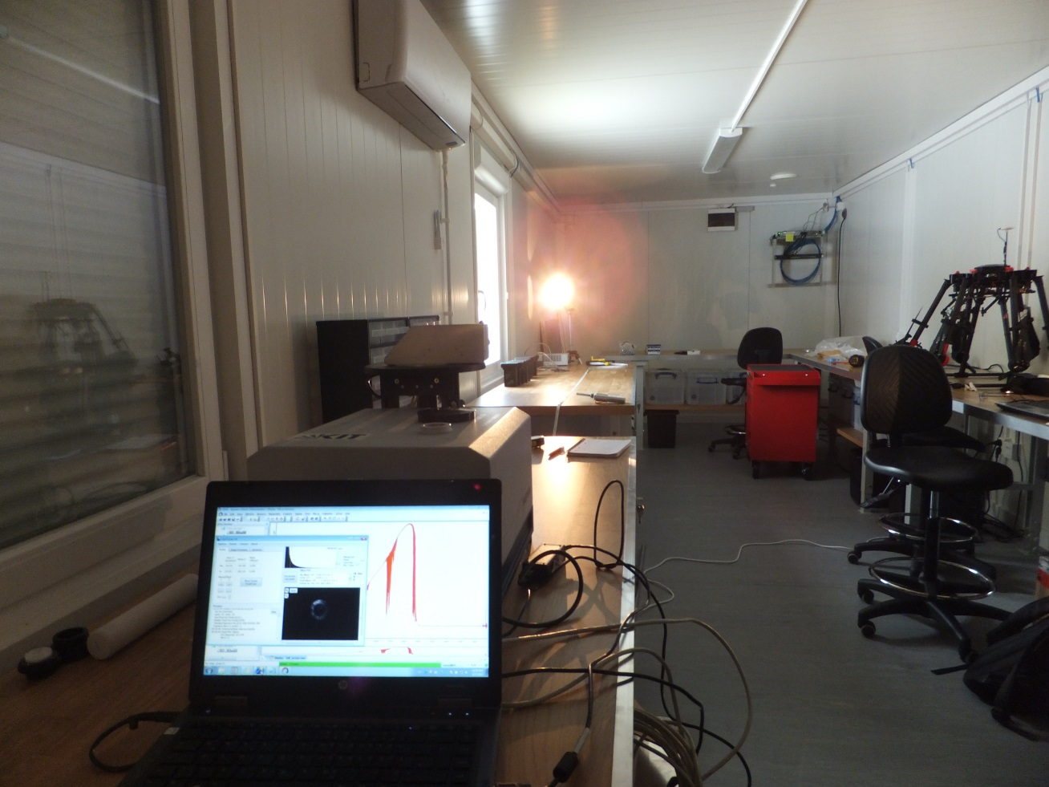
Measurement & intercomparison strategies
    TCCON and Vertex 70 ILS parameters are determined by HCl cell measurements.
    KIT and UoW retrieve ILS from water vapour band 7000‐7500 cm‐1 in open air, not from a cell.
    Linefit is used to analyze the ILS parameters (ME and Phase error) for each instrument
    RAL has gas cell measurement only before instrument was shipped to Sodankylä and will do cell measurements again after the Sodankylä campaign; it will provide FW model spectra convolved with ILS measured electronically at start of campaign – to be compared with actual observed spectra.

Slide 12
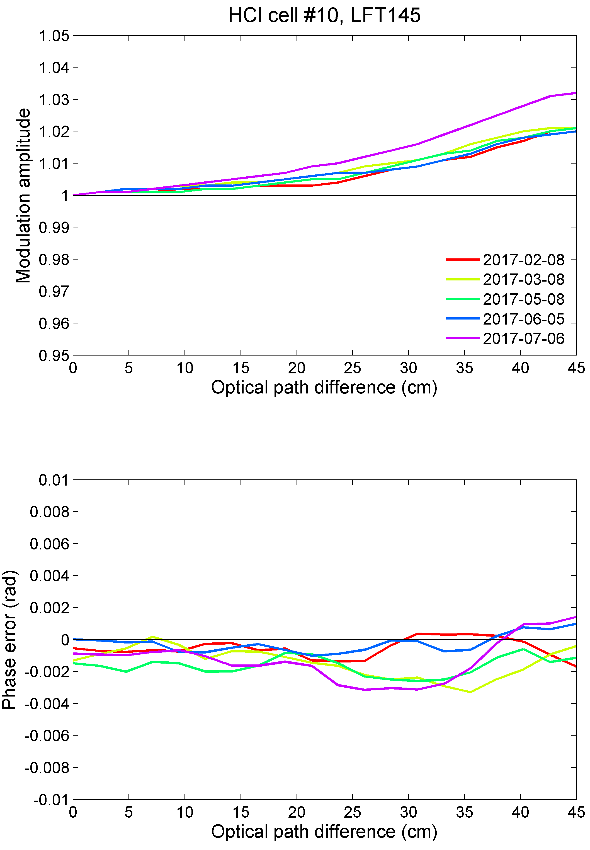
Current status of the instruments
TCCON Bruker 125HR
bad measurement
2%
< 0.005rad

Slide 13
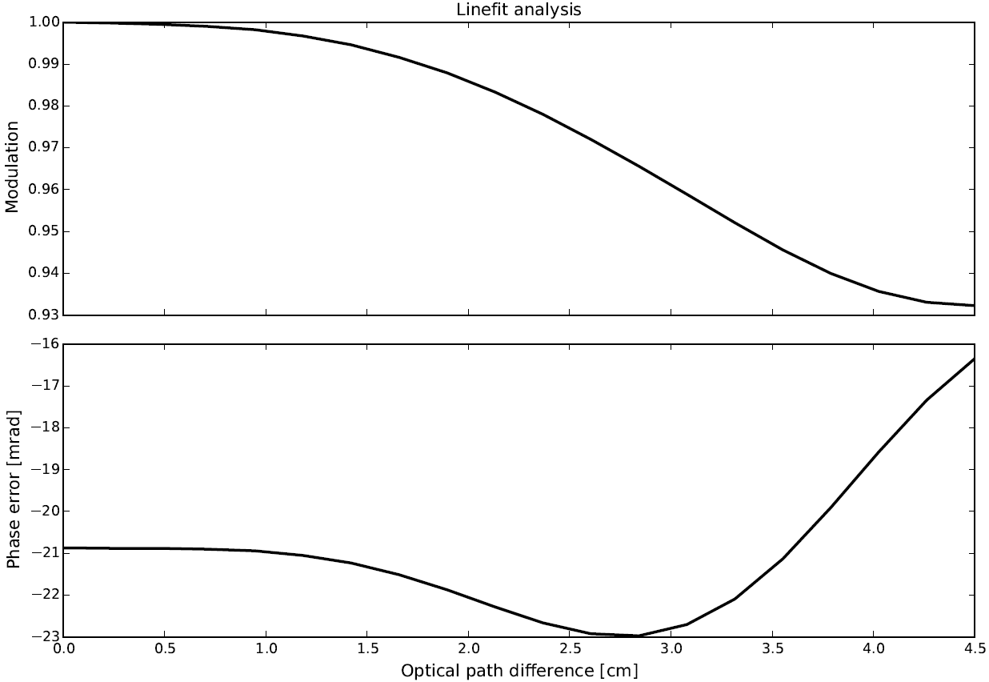
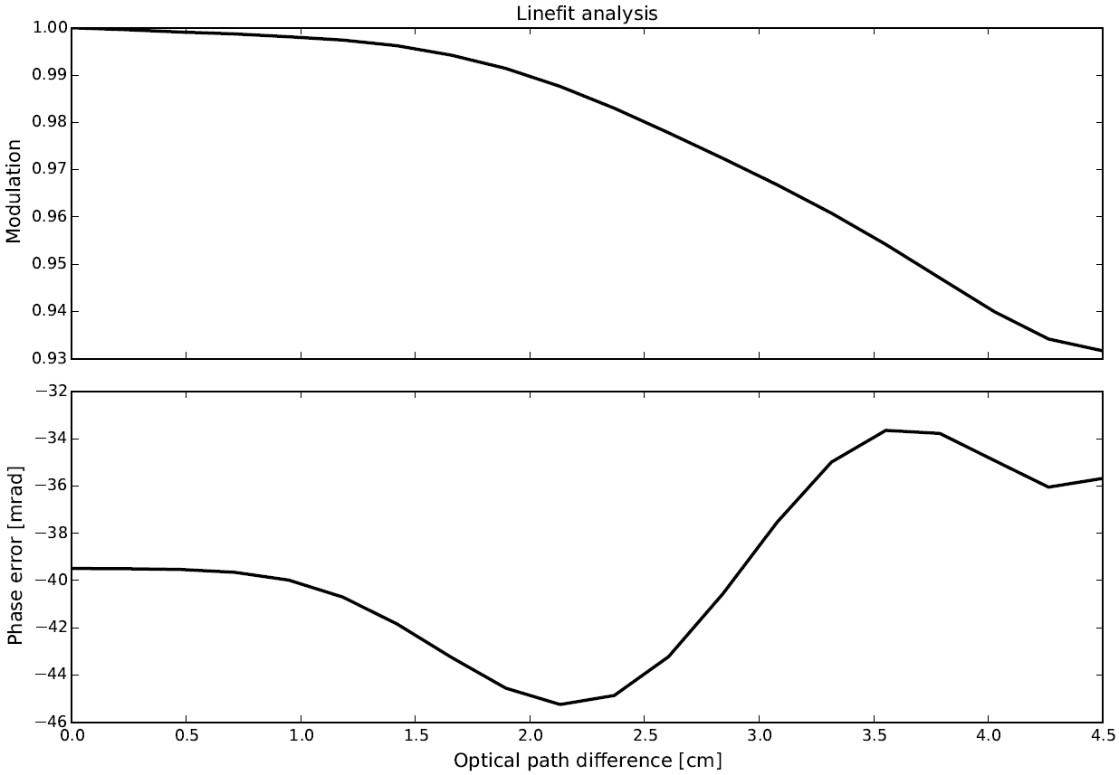
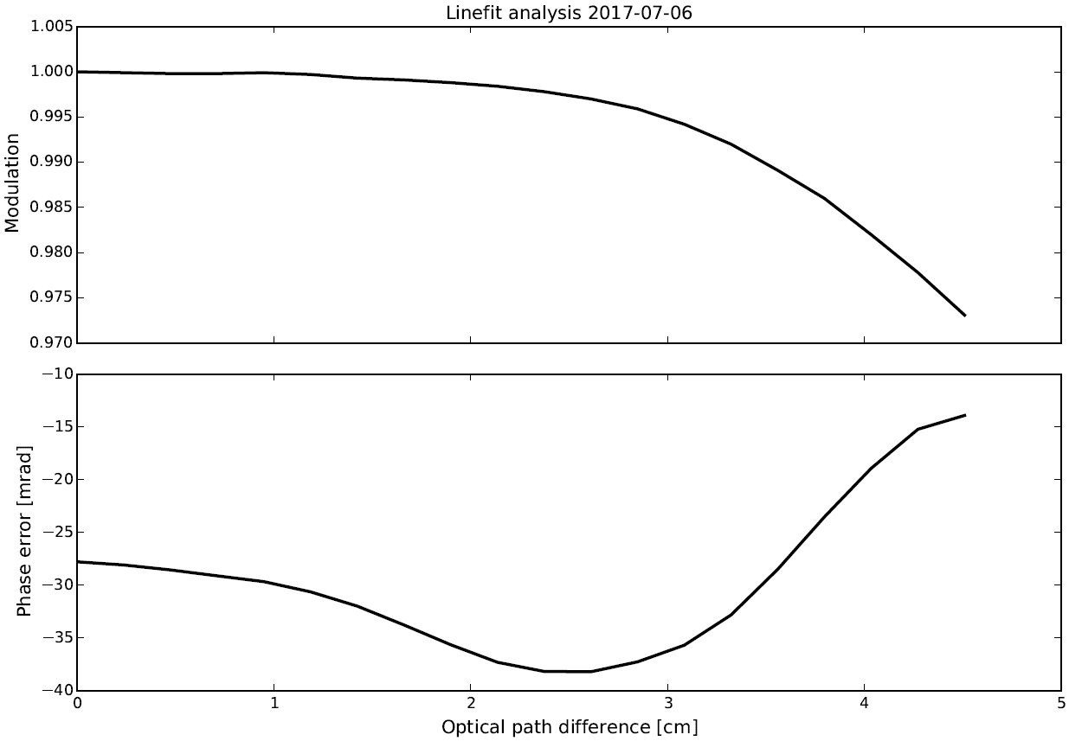
Current status of the instruments
7%
7%
19/9/2016
before shipping
22/4/2017
@ Sodankyla
Stable since the instrument left Bremen / Brussels !
2.8%
6/7/2017
@ Sodankyla
Introduce additional aperture stop
= instrument modification
Vertex 70

Slide 14
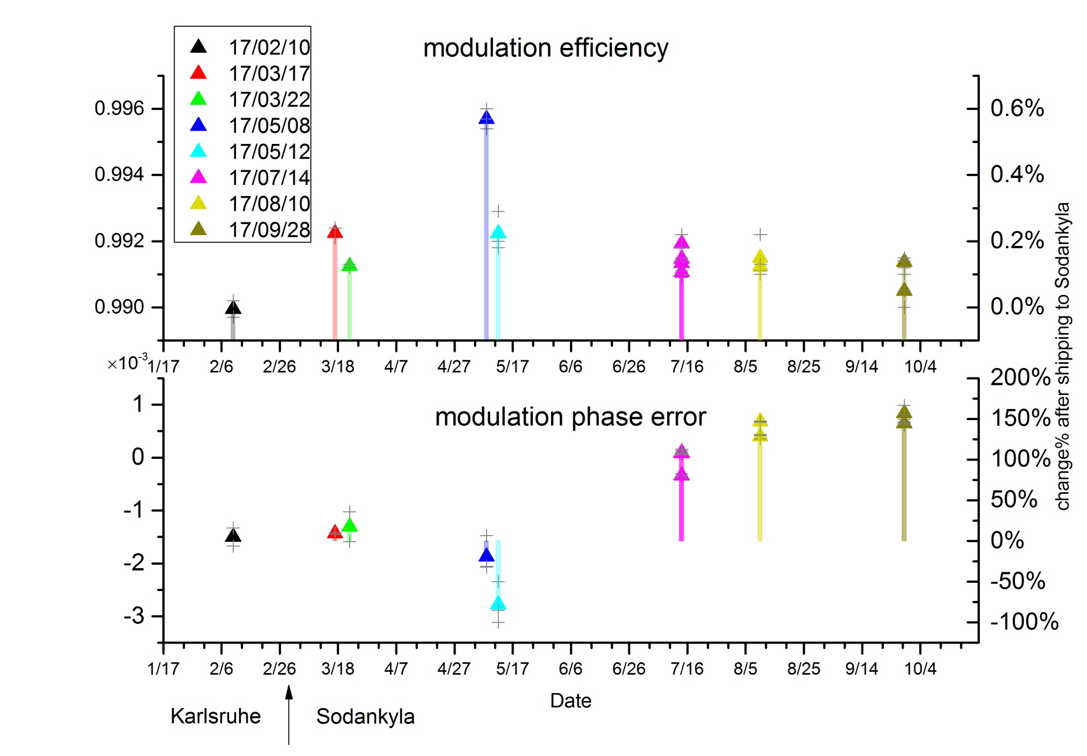
Current status of the instruments
EM27/SUN
< 0.5%

Slide 15
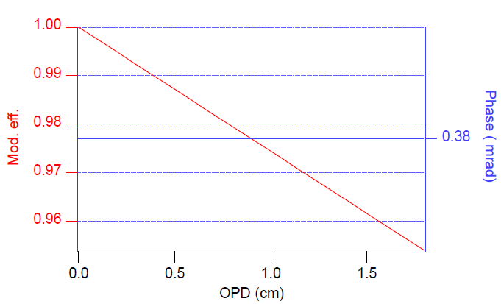
Current status of the instruments
IR cube
< 5%

Slide 16
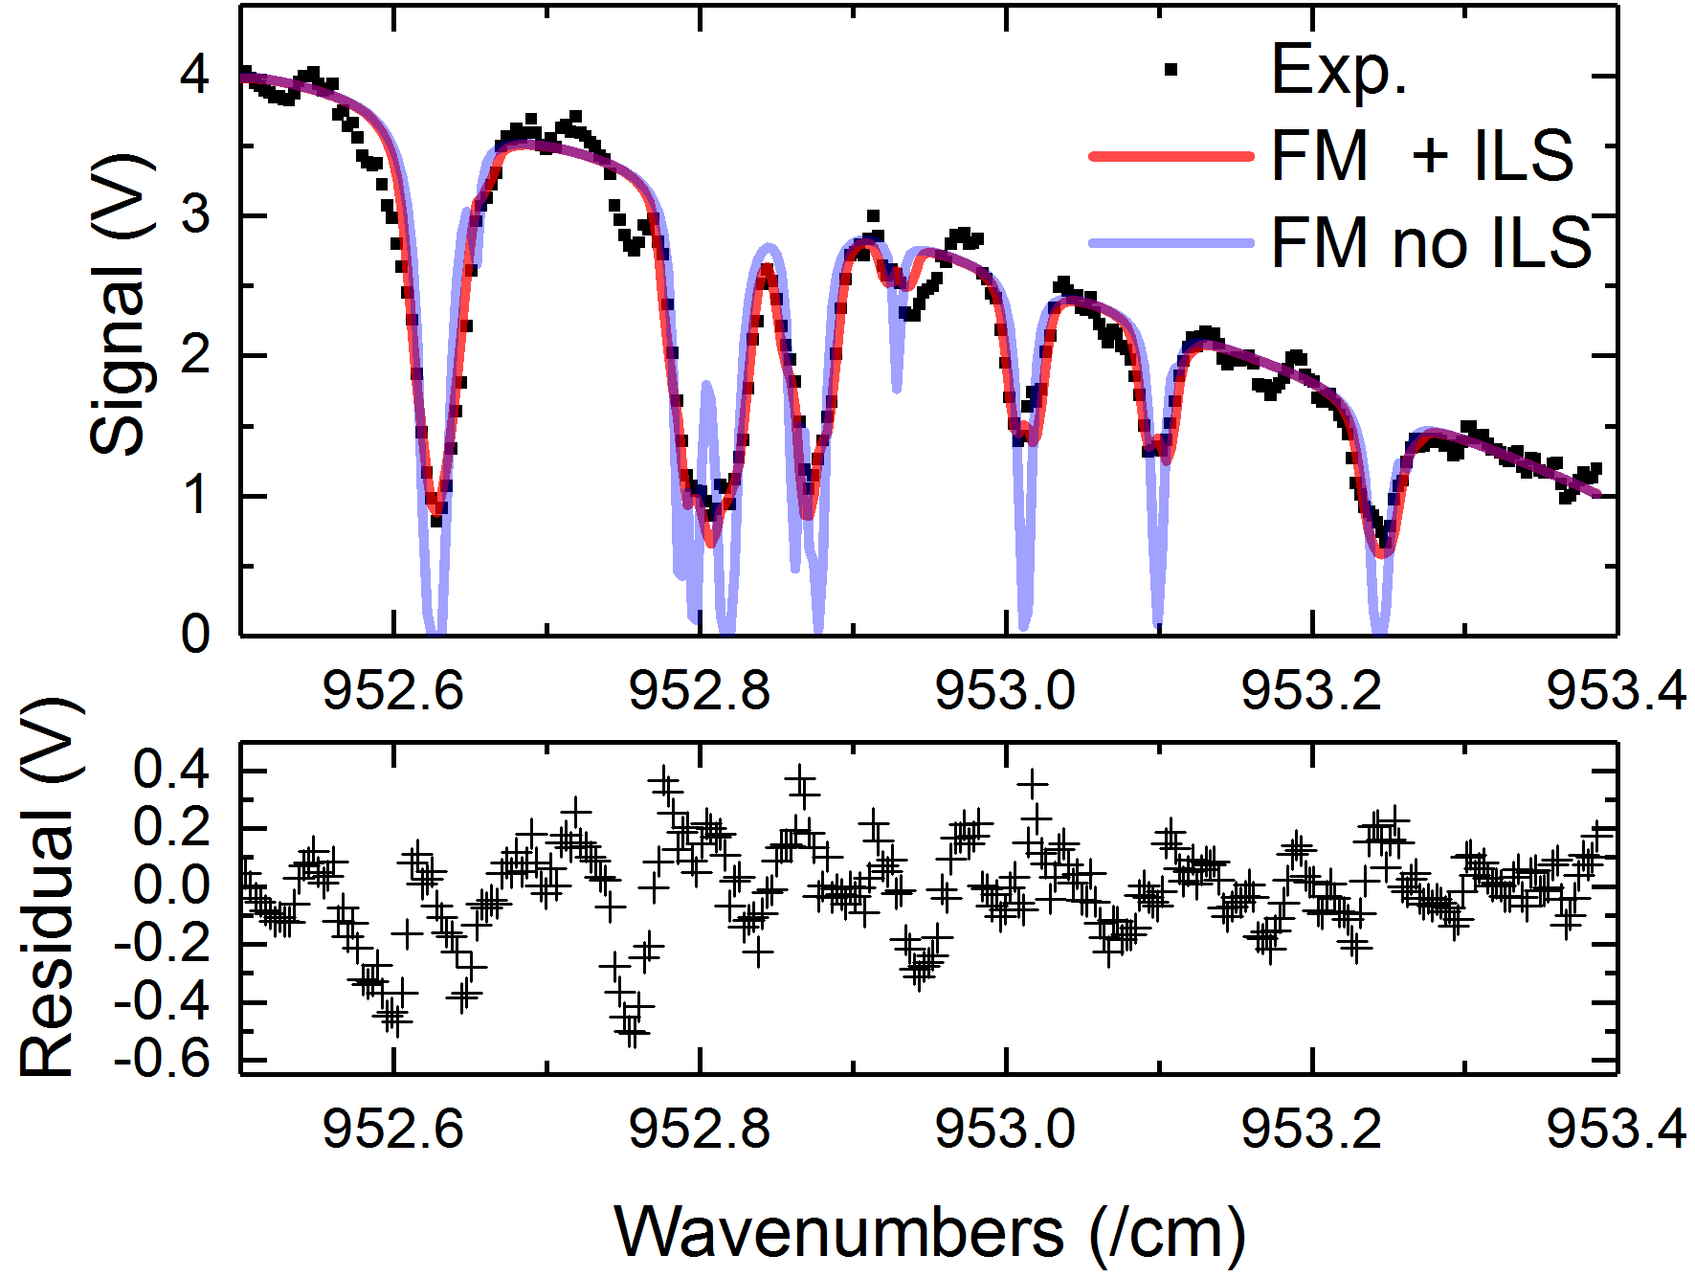
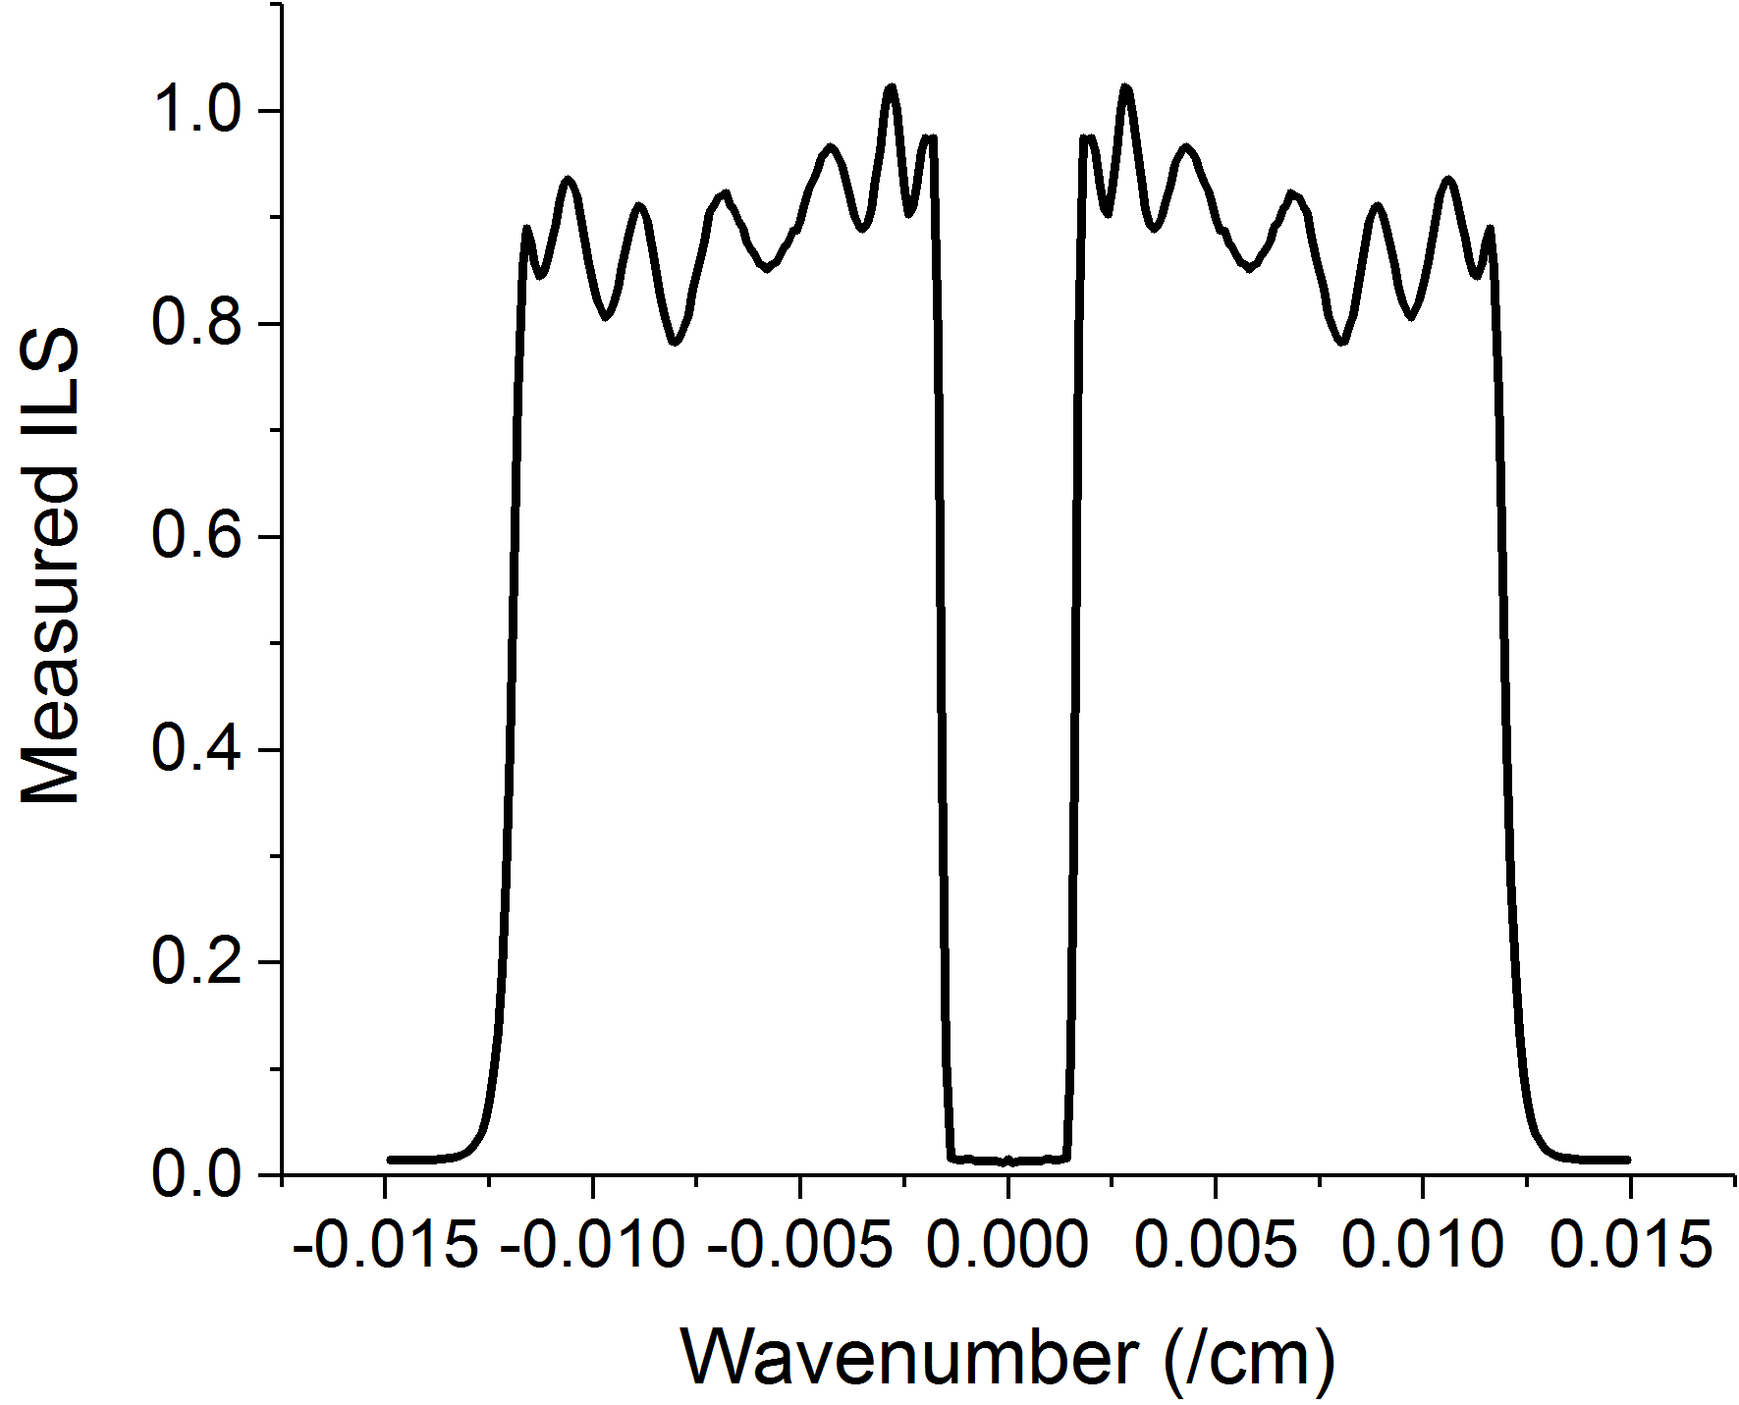
Current status of the instruments
LHR
- ILS defined by electronic filter transmission
- Measured using an RF generator
- Application of ILS to the forward transmission model (FM)
- 20 mbar of Ethane , 10 cm cell
- Note the lack of spectroscopic data (taken from HITRAN2012)

Slide 17
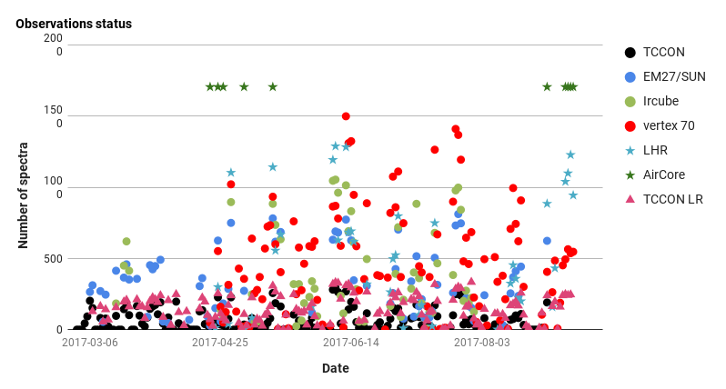
Current status of the observations

Slide 18
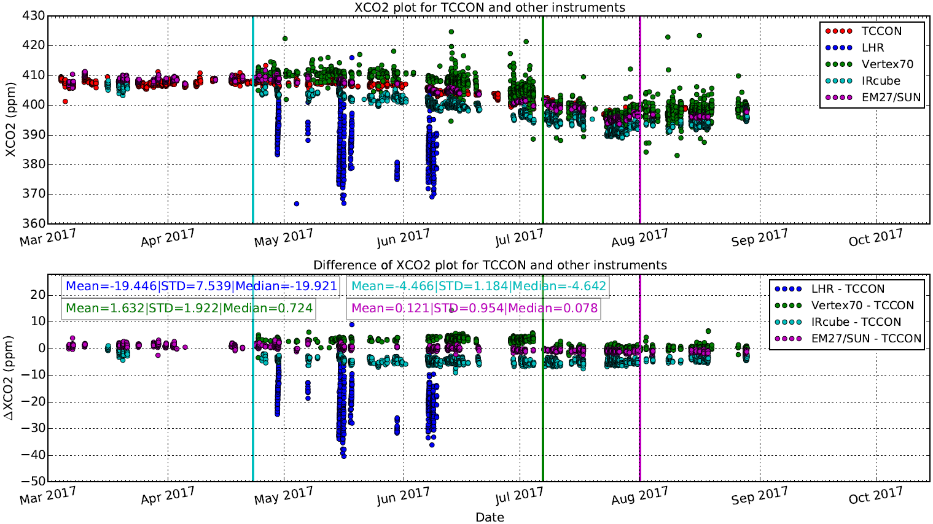
Comparison results – XCO2
IRcube: new fiber cable installed for the solar tracker
Vertex 70: installation of additional aperture in the parallel beam
EM27/SUN: a priori change from KA to SOD to TCCON map files

Slide 19
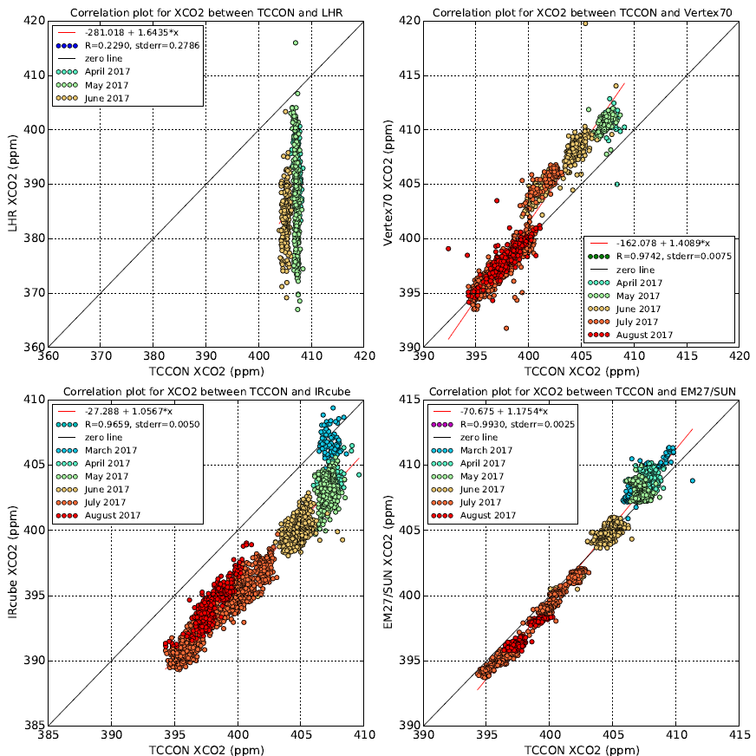
Comparison results – XCO2

Slide 20
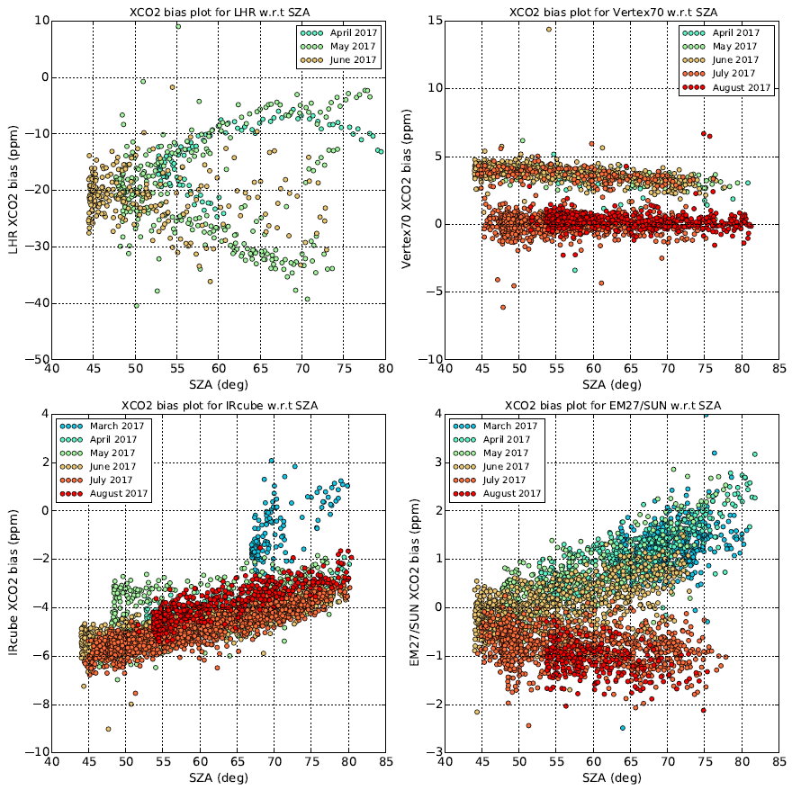
Comparison results – XCO2

Slide 21
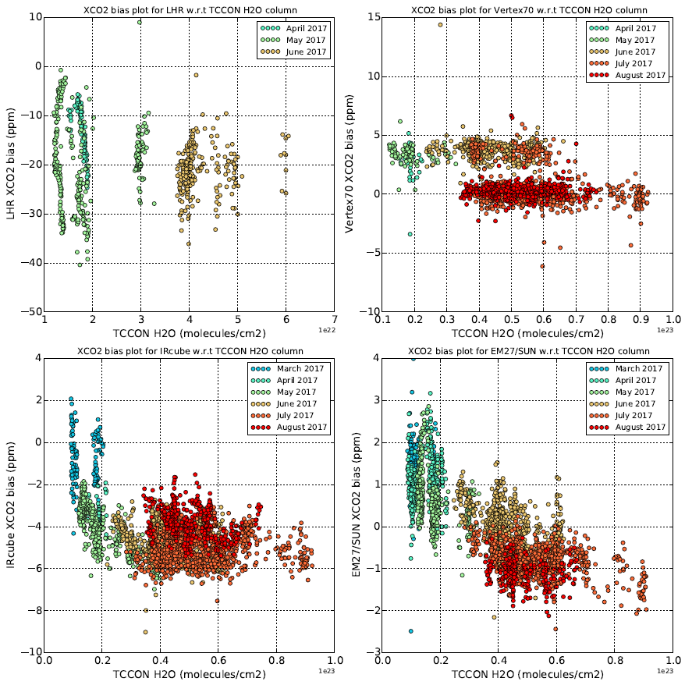
Comparison results – XCO2

Slide 22
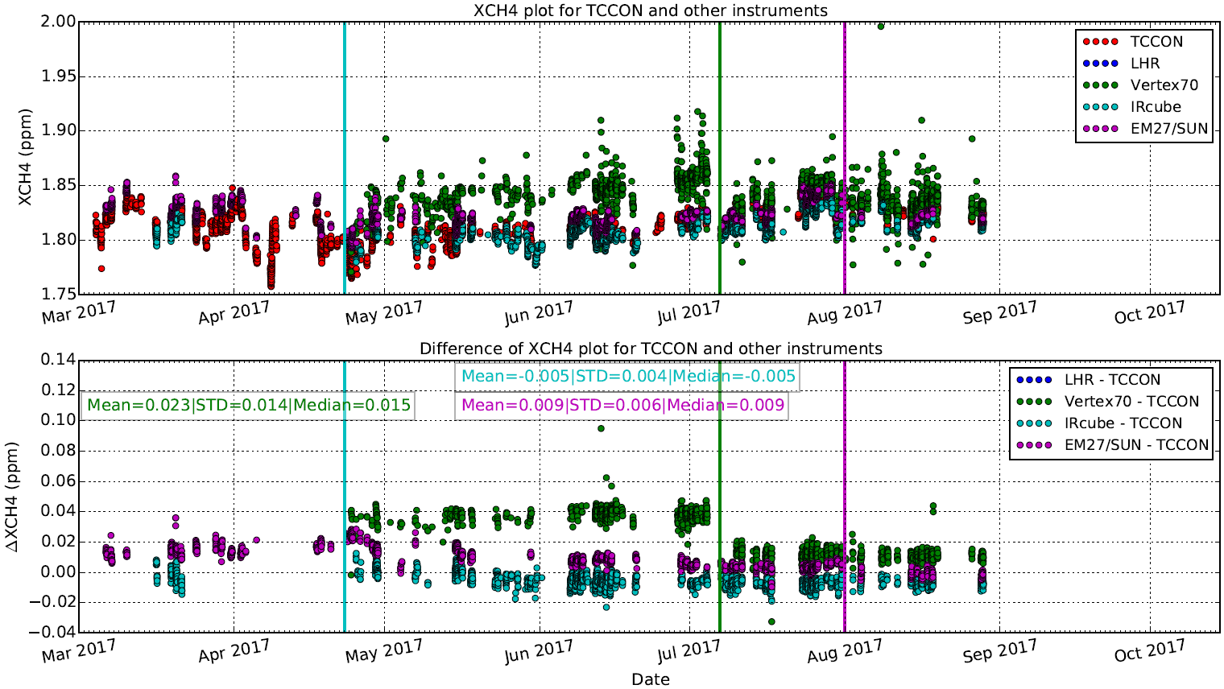
Comparison results – XCH4

Slide 23
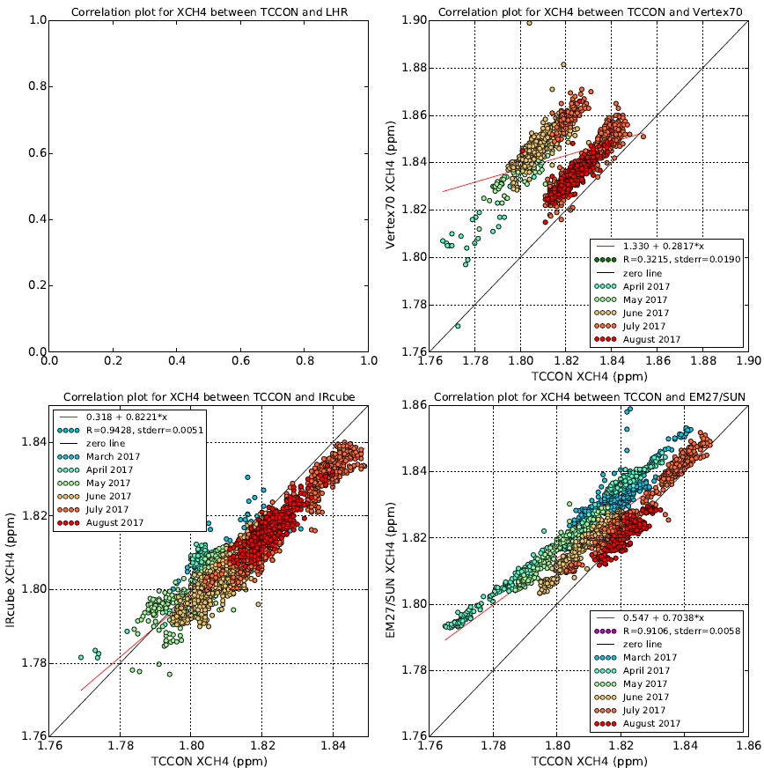
Comparison results – XCH4

Slide 24
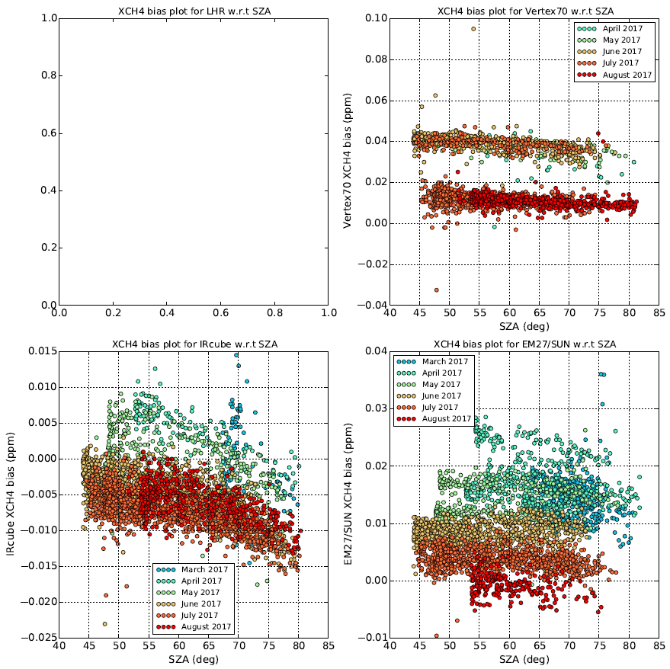
Comparison results – XCH4

Slide 25
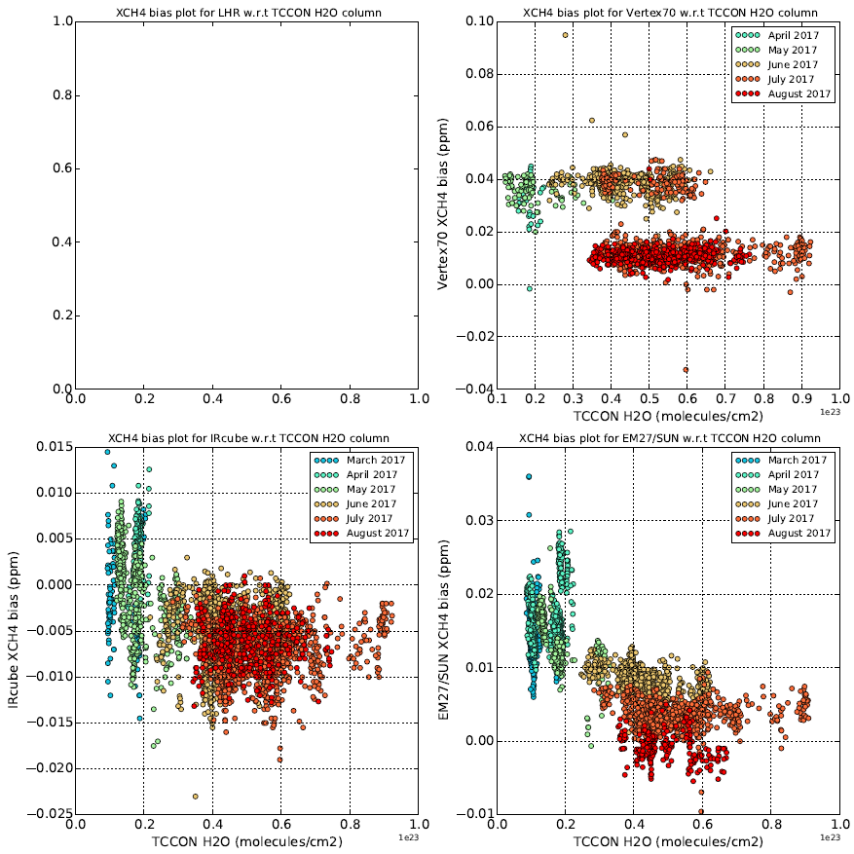
Comparison results – XCH4

Slide 26
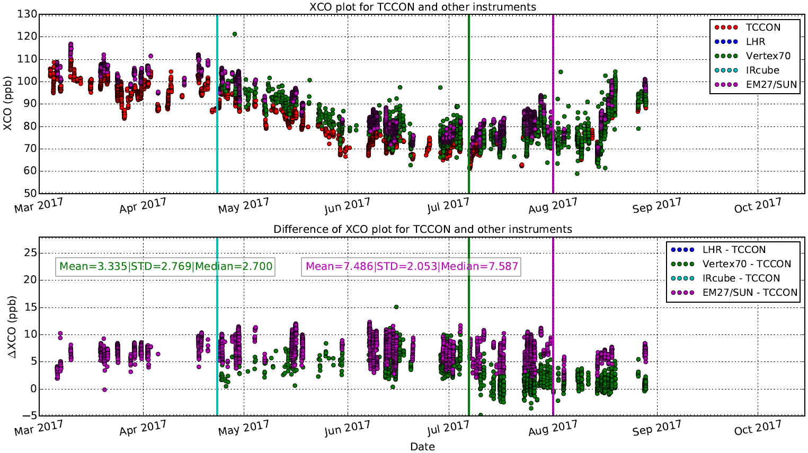
Comparison results – XCO

Slide 27
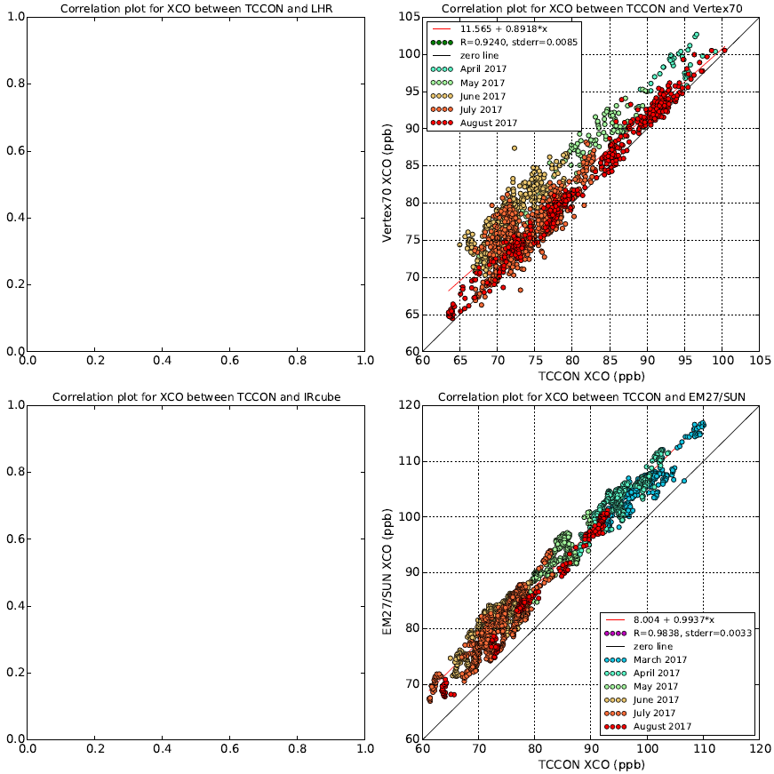
Comparison results – XCO

Slide 28
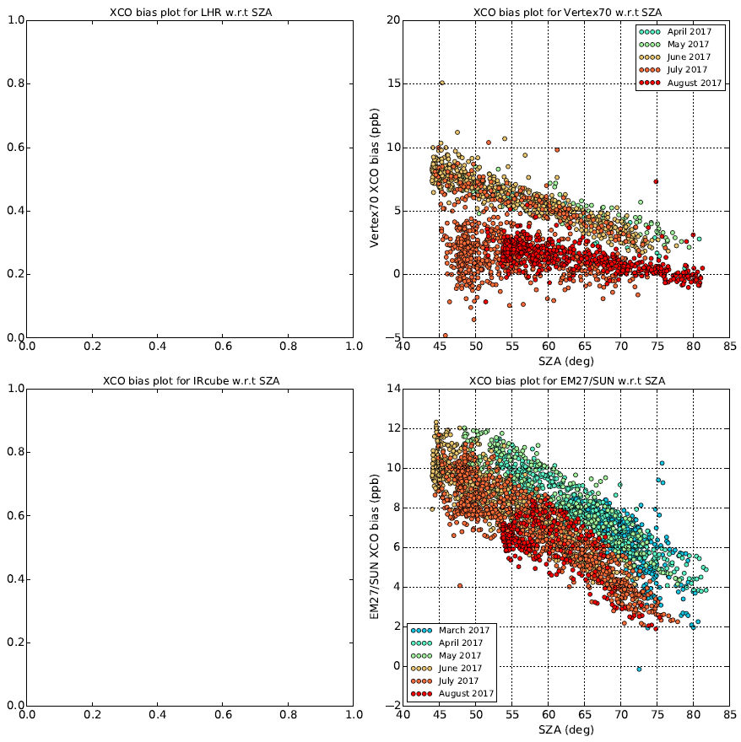
Comparison results – XCO

Slide 29
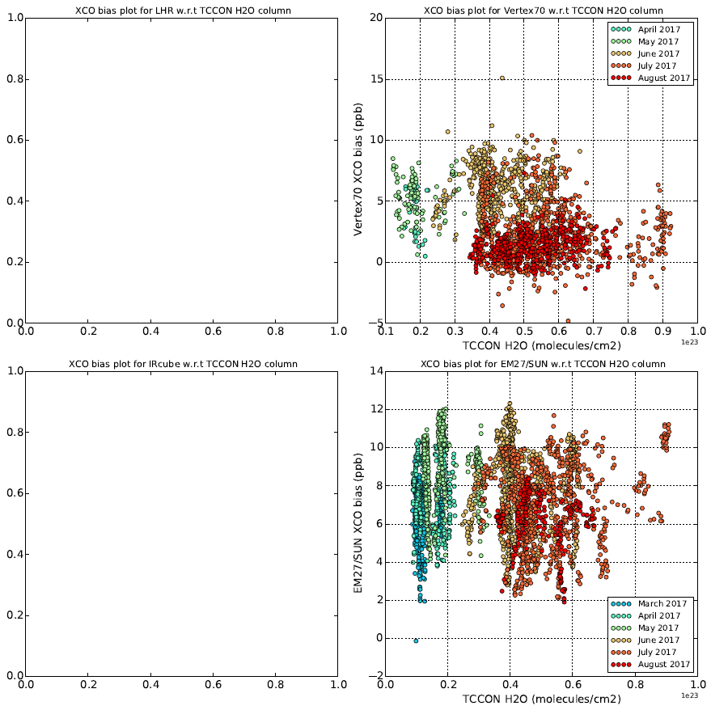
Comparison results – XCO

Slide 30
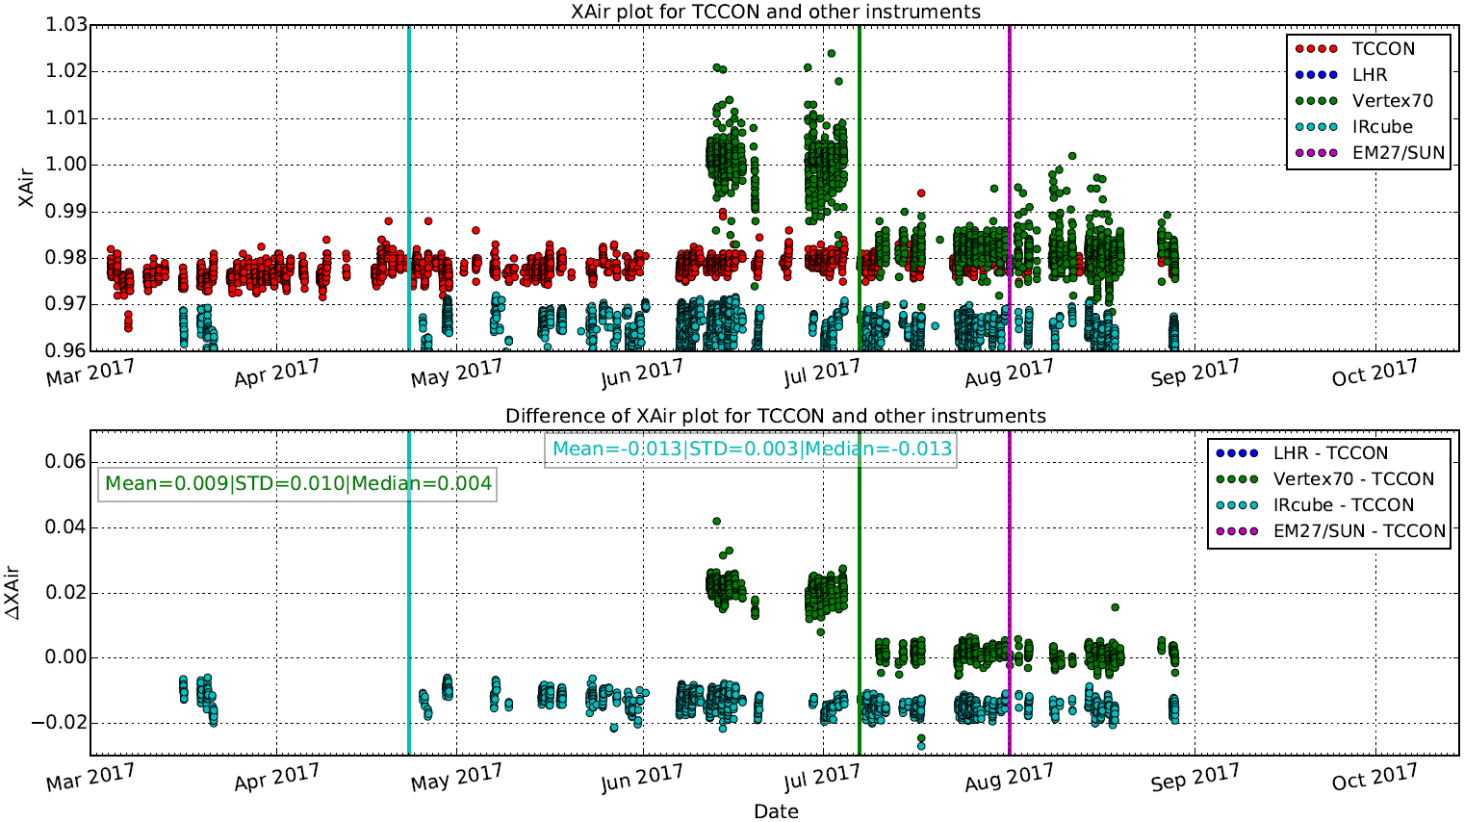
Comparison results – XAir
Xair is a measure of the instrument performance and is calculated from the O2 total column and ground pressure measured independently.The deviation of Xair value (~0.98) from unity is mostly due to spectroscopic errors.
IRcube shows a higher bias pointing towards a retrieval error. Vertex 70 shows much better match after instrument modification.

Slide 31
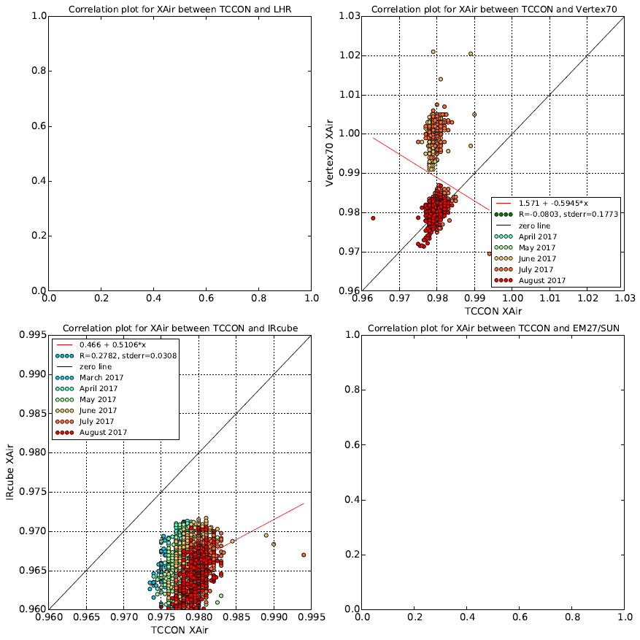
Comparison results – XAir

Slide 32
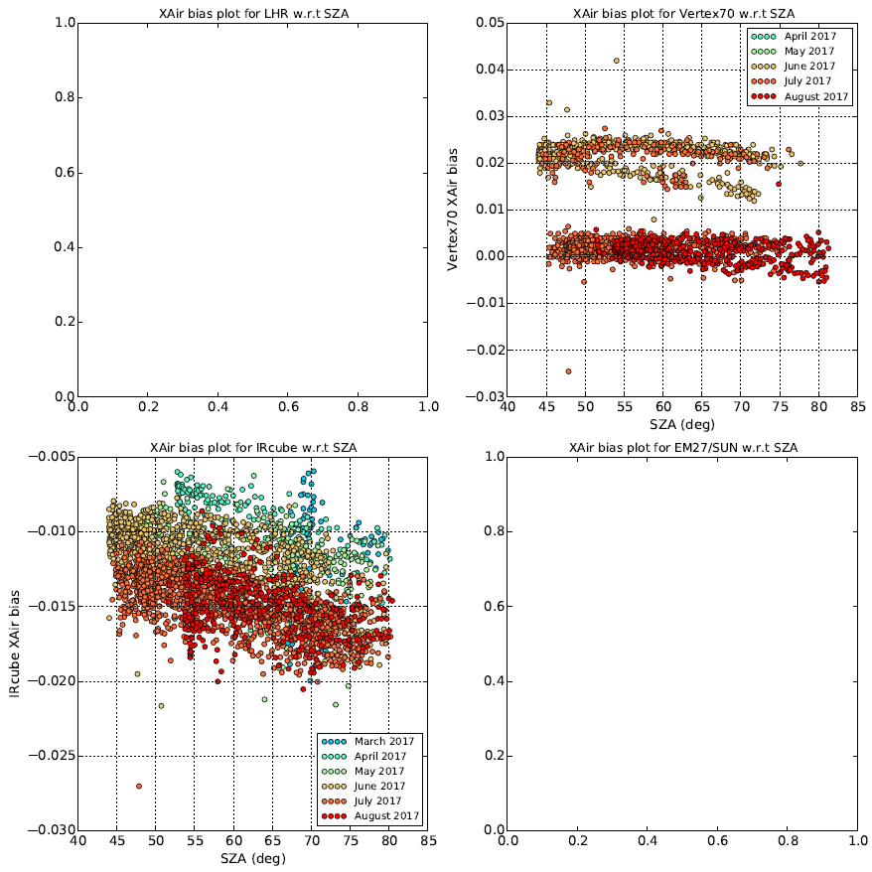
Comparison results – XAir

Slide 33
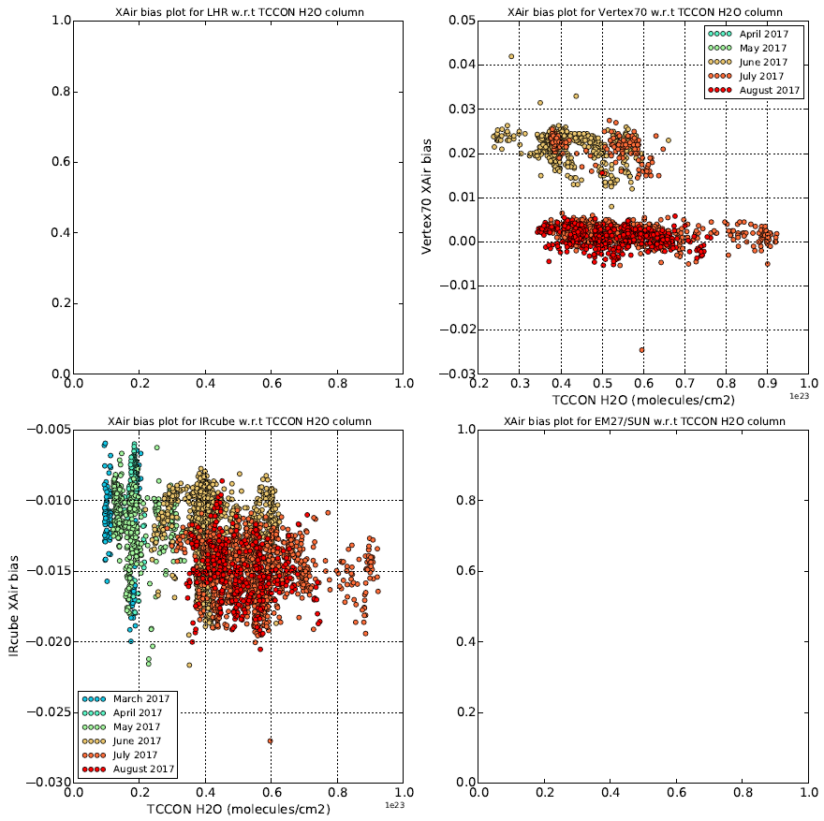
Comparison results – XAir

Slide 34
Comparison results - summary
Most instruments have been operating well since their deployment. Except two technical interventions (1) for IRcube to replace the broken optical fiber cable in April and (2) Vertex 70 had an instrument modification in July thereby improving the instrumental line shape. Nine AirCore launches made.
LHR: Large discrepancies (very high bias) in the Xgas values with diurnal variability relative to the TCCON. The instrument and retrieval teams are investigating the possible causes of these biases (note: homemade relatively new instrument, first deployment in the field, new retrieval software).
Vertex70: Instrument modification (introduction of smaller aperture ~2 cm in the parallel light beam) helped to improve the ILS and subsequently the retrieved Xgas values.
IRcube: Stable ILS during the campaign, optical fiber cable broke shortly after deployment. Cable was replaced in April. The March data is a bit off pointing towards alignment issues.
EM27/SUN: Stable ILS during the campaign, XCO2 and XCH4 values are scaled with the pre-determined values derived from comparison measurements performed w.r.t another TCCON at Karlsruhe. Biases in the Xgas values are very small relative to the TCCON. However a small seasonality is observed in the Xgas plots. The August data is processed with TCCON a priori profile whereas the other months are processed with Karlsruhe WACCM apriori. XCH4 plots show the influence of apriori on the retrieval.

Slide 35
Comparison results – TCCON vs TCCONLR
TCCON data (0.02 cm⁻¹) standard processed using GGG2014, common P/T surface data and vertical profile, daily apriori vmr profile, G.Toon assembled linelist, TCCON microwindows, ILS not taken into account in retrieval.
TCCONLR data (0.5 cm⁻¹) processed using PROFFIT scaling retrieval, common P/T surface data and vertical profile, daily apriori vmr profile, F. Hase assembled linelist, PROFFIT microwindows, ILS taken into account in retrieval – however ILS assumed as ideal at 0.5 cm-1.

Slide 36
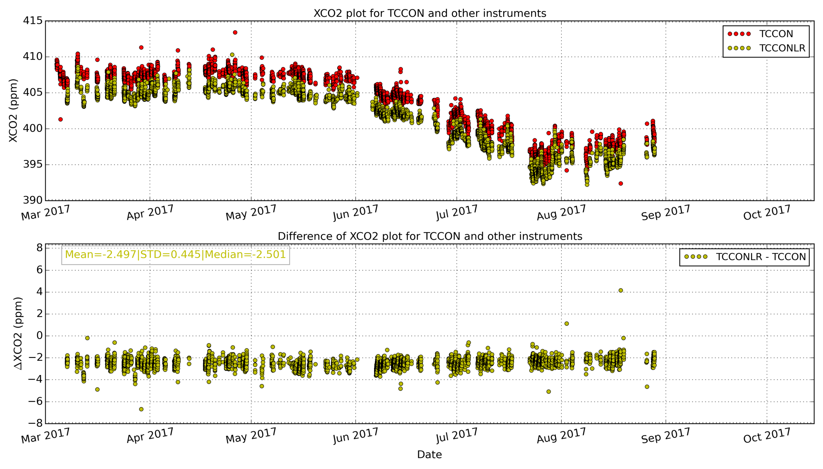
Comparison results XCO2 – TCCON vs TCCONLR

Slide 37
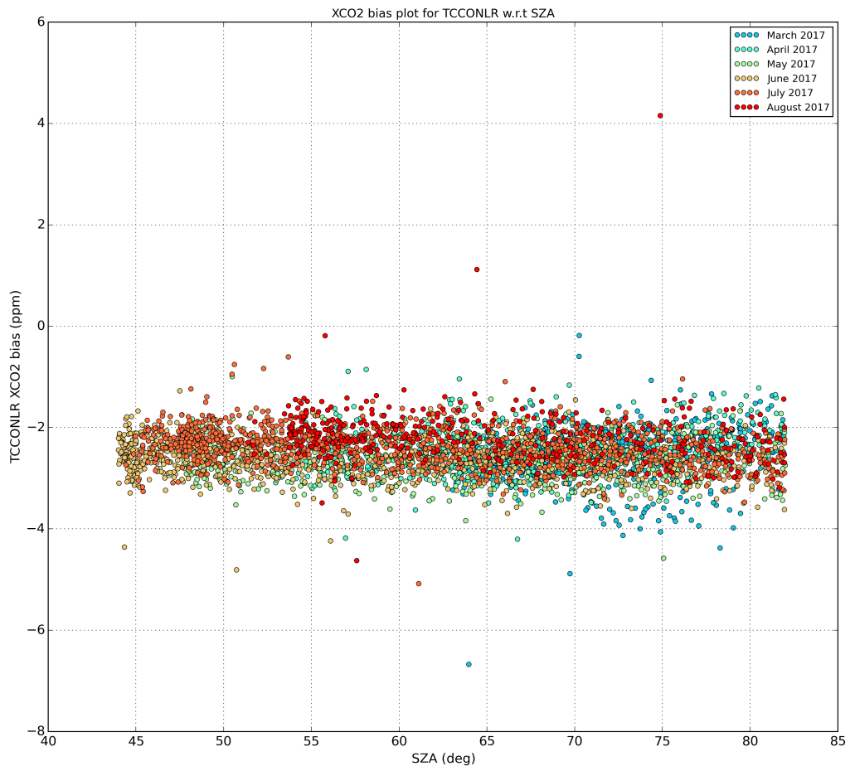
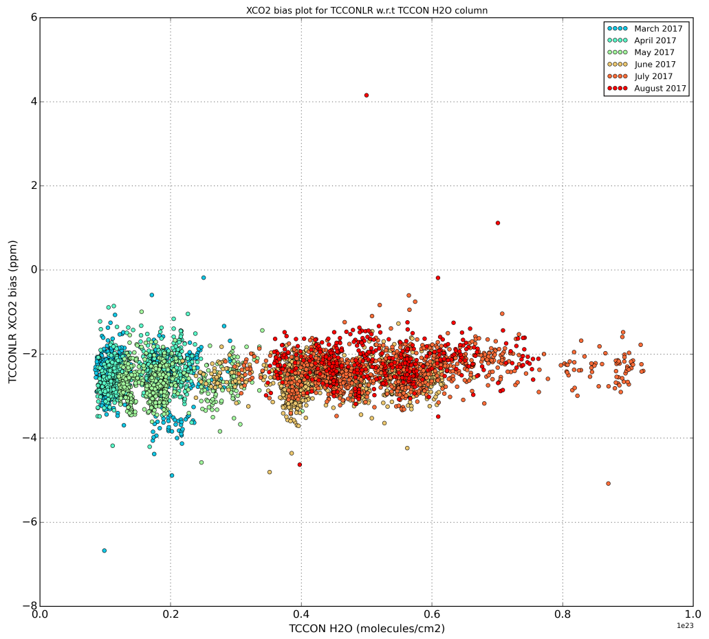
Comparison results XCO2 – TCCON vs TCCONLR

Slide 38
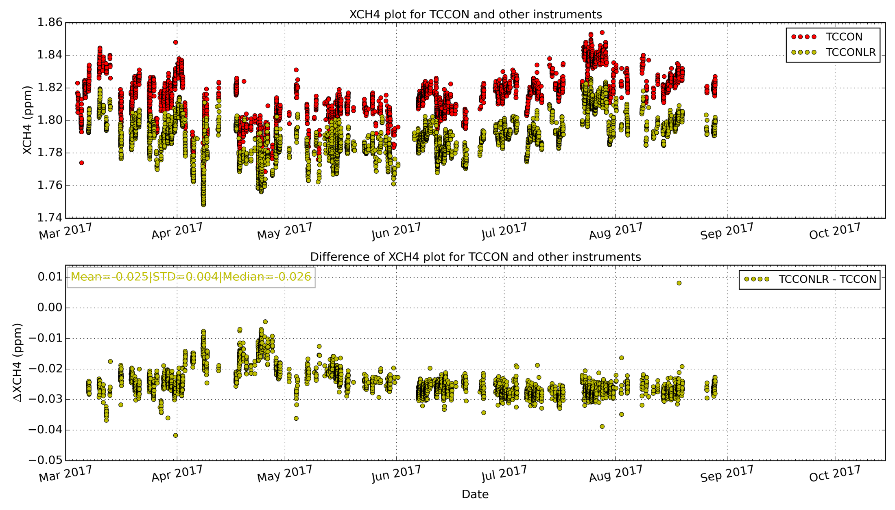
Comparison results XCH4 – TCCON vs TCCONLR

Slide 39
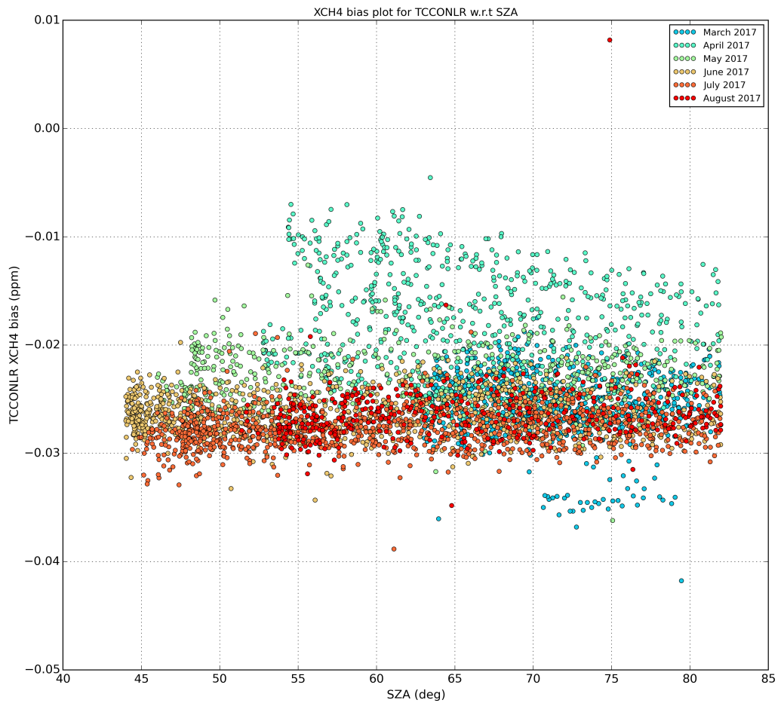

Comparison results XCH4 – TCCON vs TCCONLR

Slide 40

Comparison results XCO – TCCON vs TCCONLR

Slide 41


Comparison results XCO – TCCON vs TCCONLR

Slide 42
Next steps
Comparison of retrieval results for the whole campaign
→ Determination of calibration factors w.r.t TCCON
Verify calibration of remote sensing instruments w.r.t the AirCore
Identify sources, understand, and correct the biases observed with the instruments
Provide a significant dataset of GHG measurements which can be used for satellite validation purposes
Provide a guideline for further development of new observation sites to complement the TCCON network and provide better support for the validation of existing and future satellite missions

Slide 43
Next Steps
Extension of the campaign in 2018
Stay at Sodankyla
Add InSb species ... in particular HCHO
Perform more low resolution measurements with TCCON instrument
Add retrieval of CH4 in the 2.3 µm band same as S5P
Exchange spectra and do a round-robin intercomparison

Slide 44

Access to information, data and results
http://frm4ghg.aeronomie.be
Results (for now for internal use only)
Outreach
Pictures
Campaign blog
Follow us on twitter: #frm4ghg
Thanks

Slide 45
AirCore4S5P
Project coordinated by H. Chen (RUG)
Includes AirCore launches at La Réunion
Problem: how to recover AirCore on a small, mountainous island ?
  → develop steerable system to bring AirCore down
    past UAV_Reunion BRAIN pioneer project has not resulted in a reliable solution
    WP6 of FRM4GHG : – has not been funded.
    two independent EU proposals have not been successful
    A 2-phased proposal has been submitted to ESA for future funding
⇒ As long as we can’t guarantee reliable recovery of AirCore, there will be no launches at La Réunion

Slide 46
Backup

Slide 47

Data manipulation to get Xgas
TCCON
Table 1: GGG2014 correction factors
Gas | ADCF | ADCF_Err | AICF | AICF_Err
XCO2 | -0.0068 | 0.0050 | 0.9898 | 0.0010
XCH4 | 0.0053 | 0.0080 | 0.9765 | 0.0020
XN2O | 0.0039 | 0.0100 | 0.9638 | 0.0100
XCO | -0.0483 | 0.1000 | 1.0672 | 0.0200
XH2O | N/A | N/A | 1.0183 | 0.0100
ADCF: Airmass dependent correction factor
AICF: Airmass independent correction factor
Network wide same calibration factor used to scale the TCCON Xgas value to the WMO scale

Slide 48

Data manipulation to get Xgas
LHR:

Slide 49

Data manipulation to get Xgas
Vertex70 & Ircube: Same operation as TCCON
EM27/SUN:

