Slide 1


Findings from the 2-years ESA – Fiducial Reference Measurements for Ground-Based Infrared Greenhouse Gas Observations (FRM4GHG) project and relevance for S-5P validation
Martine De Mazière, Justus Notholt, Thomas Blumenstock, Huilin Chen, David Griffith, Frank Hase, Pauli Heikkinen, Christian Hermans, Alex Hoffman, Marco Huebner, Nicholas Jones, Rigel Kivi, Christof Petri, Mahesh Kumar Sha, Qiansi Tu, and Damien Weidmann http://frm4ghg.aeronomie.be/

Slide 2
FRM4GHG campaign

Slide 3
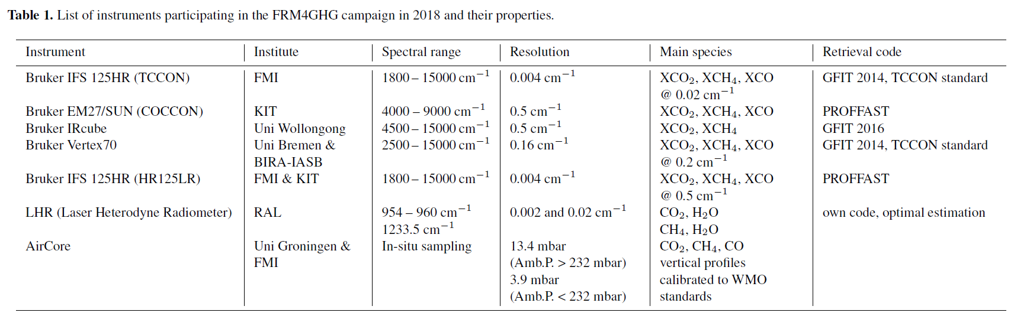
FRM4GHG campaign
Objective – perform an intercomparison of simultaneously measured total column amounts of CO₂, CH4 and CO using different portable low-cost spectrometric instruments under different atmospheric conditions in comparison to the TCCON instrument. Assess these instruments regarding their capability to complement the existing TCCON network.
Description – perform side-by-side measurements using these low-resolution instruments next to a TCCON instrument.
Location – TCCON site at Sodankylä, Finland (67.37 N, 26.63 E, 188 m.a.s.l); possibility for AirCore launches at the site
Duration – 2017 – 2019 (direct solar absorption measurements during spring-summer-autumn period (clear-sky conditions)
Notes:
Duration: only 2017-2018 data used in this presentation
LHR: experimental instrument -> performances have improved – but more work is needed -> left out of plots and results.
TCCON vs TCCONmod vs HR125LR
Point out different algos
Point out Vertex70 & InSb -> HCHO

Slide 4
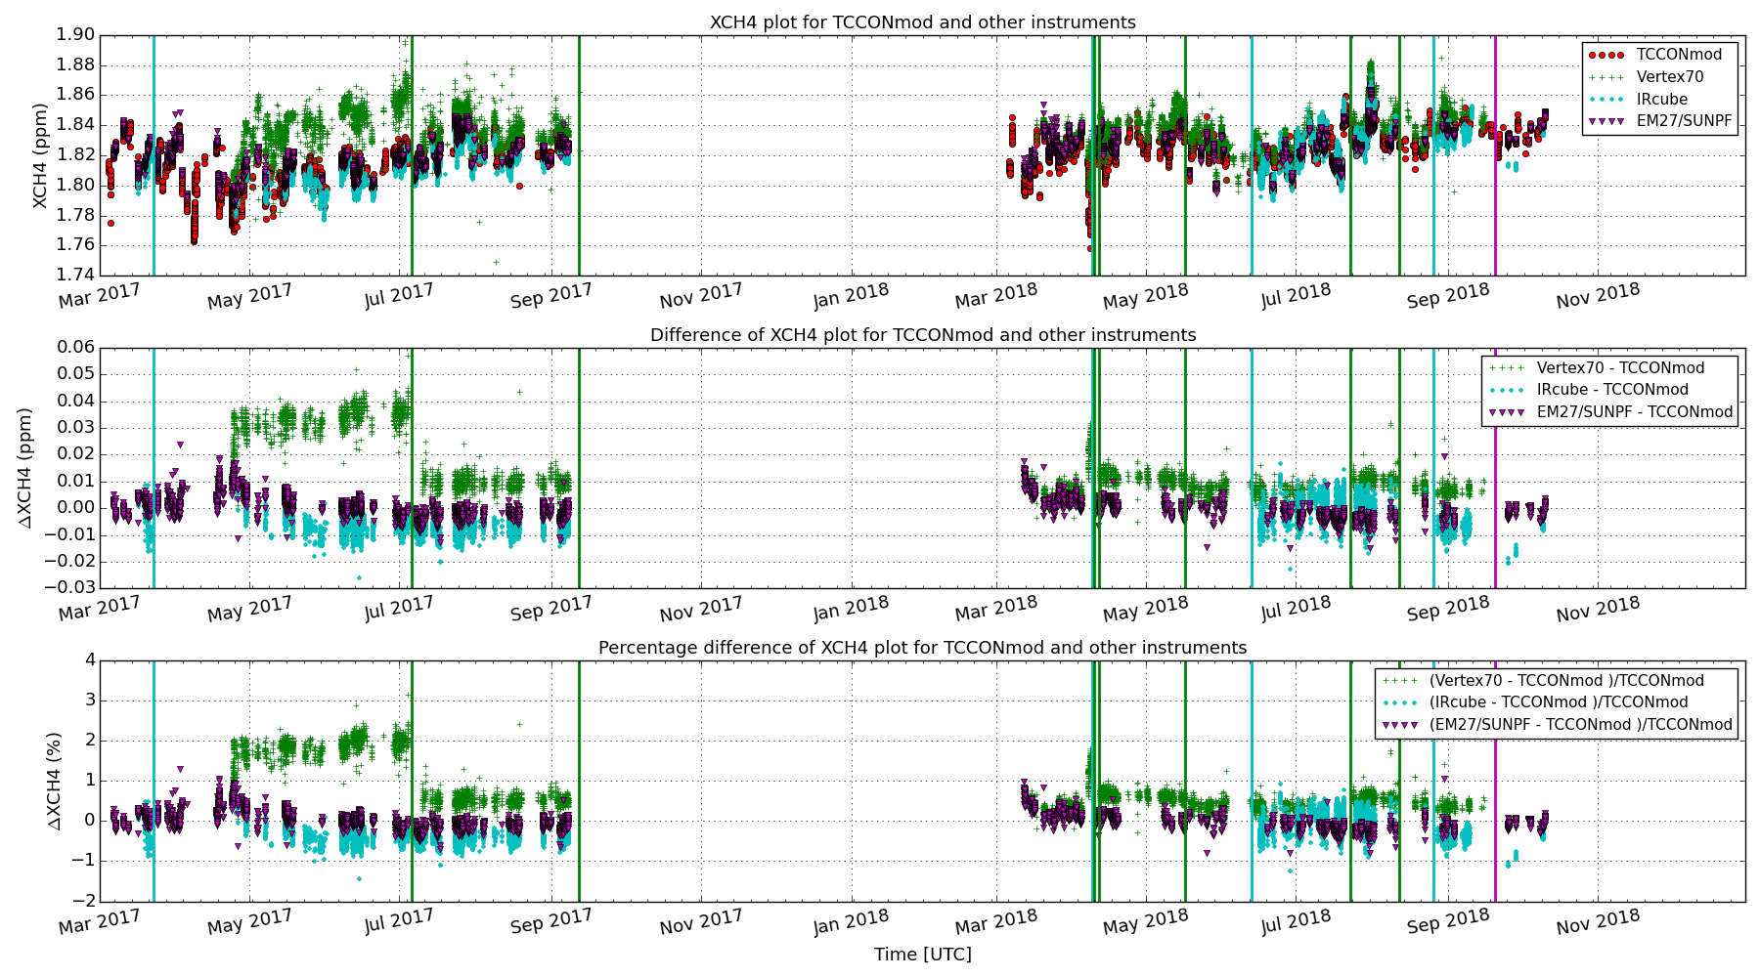
3 instruments vs TCCON – XCH4
Notes:
Point out spring issue

Slide 5
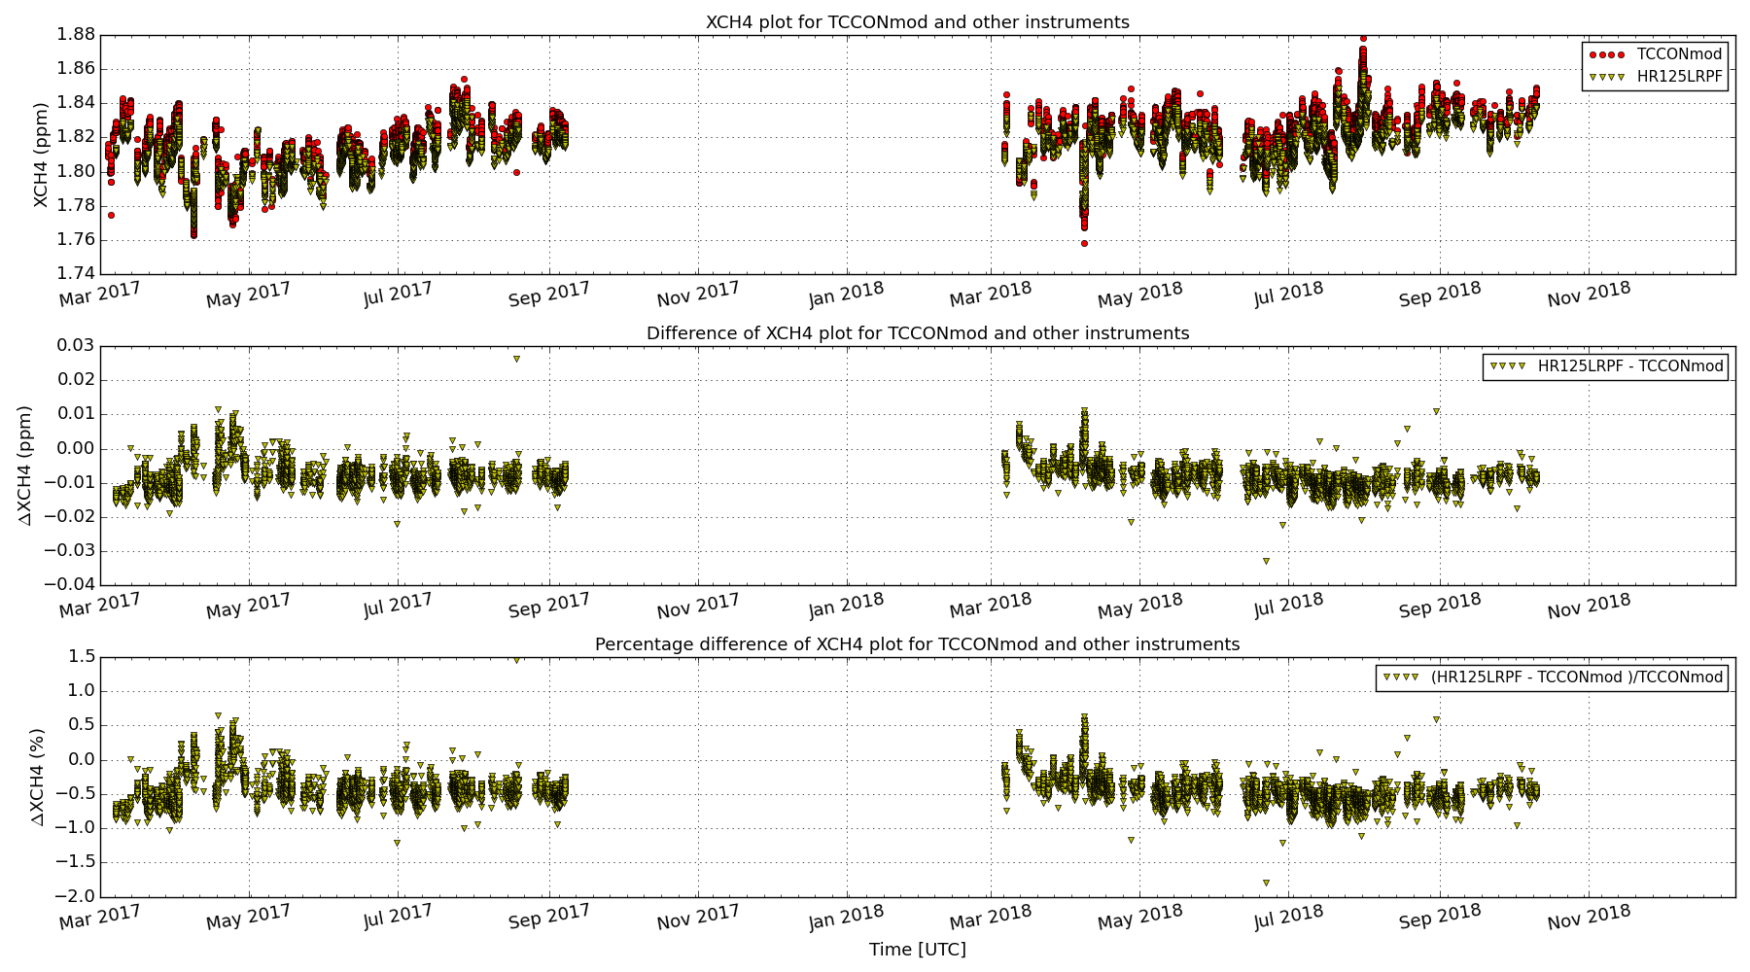
HR125LR vs TCCON – XCH4

Slide 6
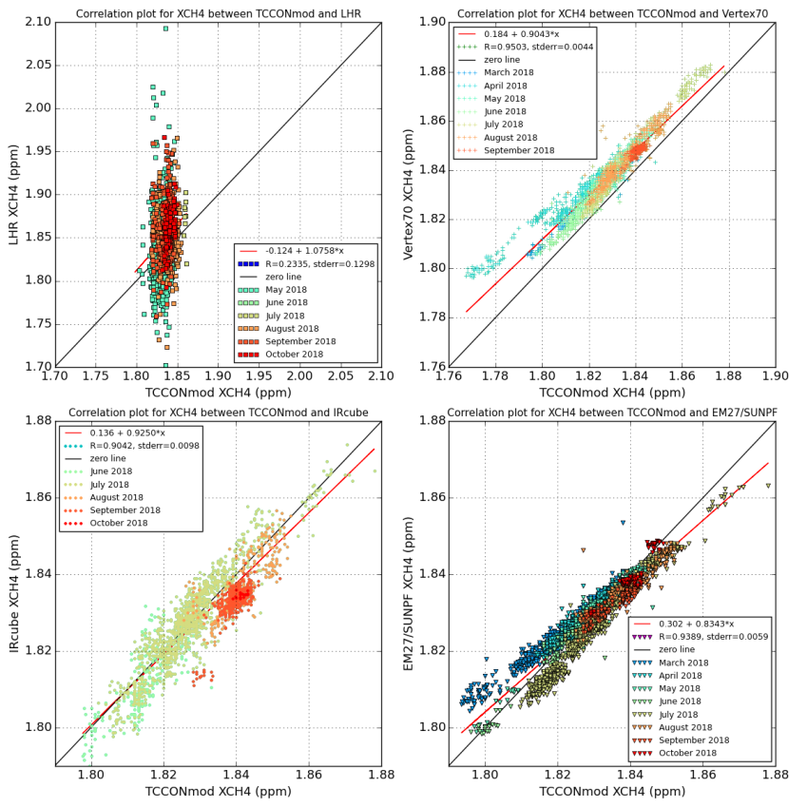
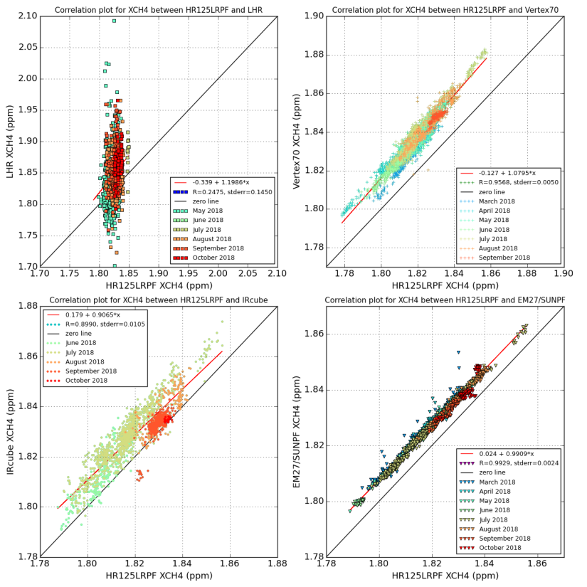
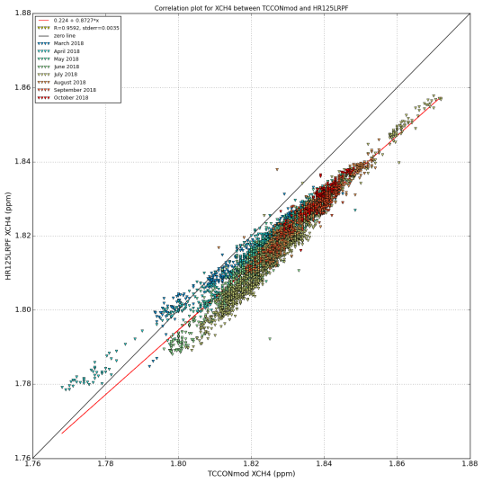
Correlation – XCH4
Vertex70
IRcube – EM27/SUN
All instruments vs TCCON
All instruments vs HR125LR
HR125LR vs TCCON

Slide 7
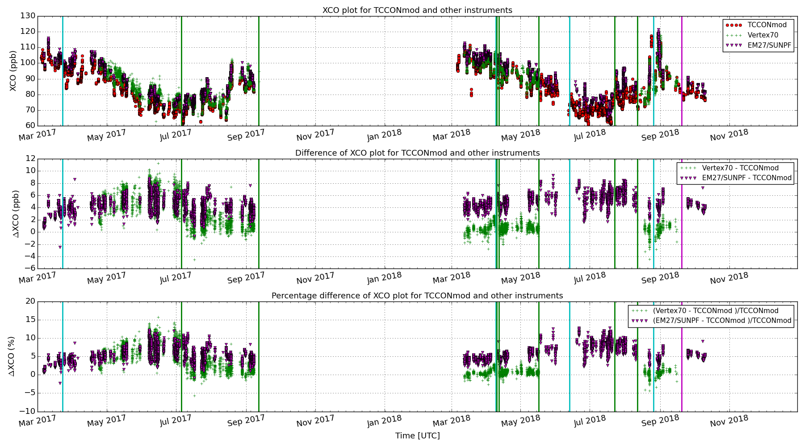
EM27SUN, VERTEX70 vs TCCON – XCO

Slide 8
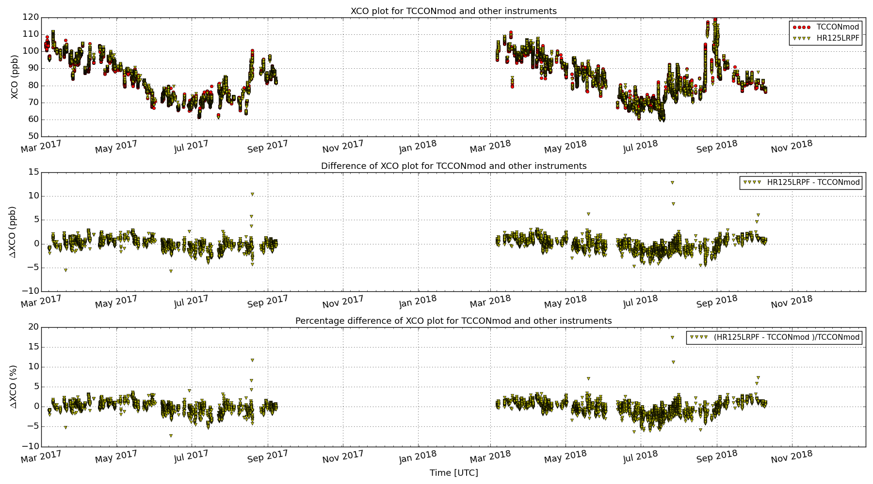
HR125LR vs TCCON – XCO

Slide 9
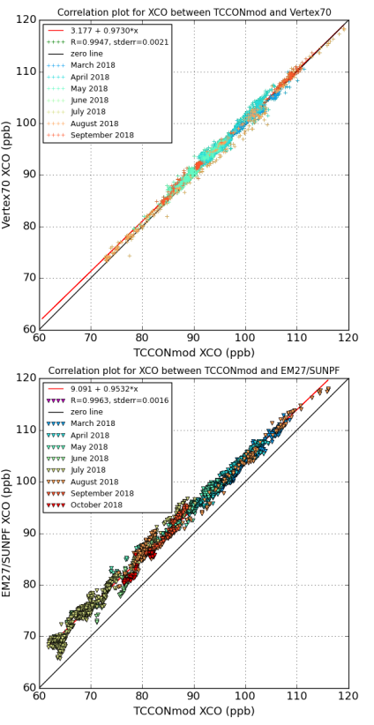
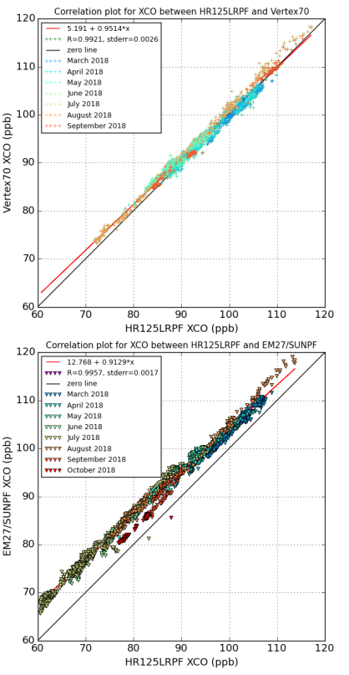
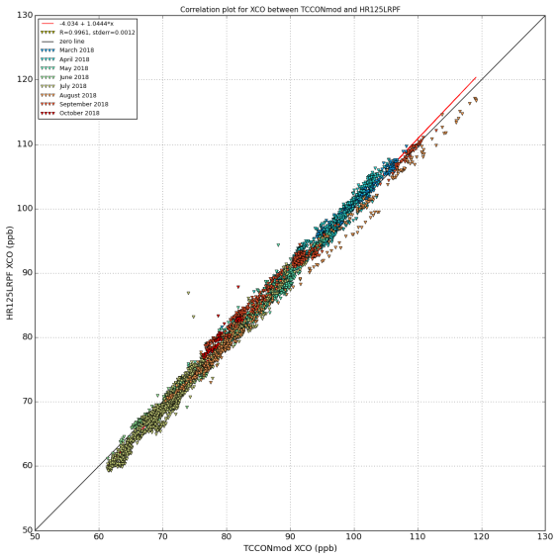
Correlation – XCO
Vertex70
EM27/SUN
All instruments vs TCCON
All instruments vs HR125LR
HR125LR vs TCCON

Slide 10
Statistics of inter-comparison – 2018 & 2017
Analysis period: 2018/03/01 – 2018/10/31
Analysis period: 2017/03/01 – 2017/11/01
Instr. Species | 125HRLR | VERTEX70 | IRCUBE | EM27/SUN
Bias (mean ± standard deviation) and correlation coefficient (r)
XCO2 / ppm |  | -1.20±0.848 (0.97) | -6.92±1.10 (0.85) | -0.58±0.50 (0.99)
XCH4 / ppm | -0.008±0.005 (0.90) | 0.009±0.004 (0.95) | -0.002±0.005 (0.90) | -0.001±0.004 (0.93)
XCO / ppb | -0.35 ± 1.23 (0.997) | 0.63±0.72 (0.99) | - | 5.11±1.30 (0.996)
Instr. Species | VERTEX70 | IRCUBE | EM27/SUNPF
XCO2 / ppm | 1.46±1.63 (0.98) | -5.023±1.040 (0.9714) | -0.885±0.593 (0.9909)
XCH4 / ppm | 0.023±0.013 (0.51) | -0.008±0.004 (0.93) | -0.001±0.005 (0.94)
XCO / ppb | 3.57±2.57 (0.95) | - | 1.69±2.37 (0.98)
TCCON specifications: CH4 (ppm): 0.004 ± 0.009 ; CO (ppb): < 2 ± <1
Notes:
XCH4: 0.023 ppm on 1.8 ppm =1.3%; 0.009 ppm on 1.8 ppm = 0.5%
TCCON: CH4 acc/prec = 0.2% / 0.5%; CO acc/prec = 2% / 1%

Slide 11
FRM4GHG-data for S-5P validation

Slide 12
Coincidence criteria for S-5P validation study
Period of study: 01 March 2018 – 31 October 2018.
S-5P data from Mission Performance Centre (MPC) provided by the Payload Data Ground Segment (PDGS) at DLR.
Coincidence criteria for CH4: Time delta = 1 hours; Geo-distance delta = 100 km radius. QA filtering: qa_value > 50; bias corrected S5P-CH4 product used for the study. From the coincident and filtered satellite measurements an average of all pixels is taken for each ground-based reference measurements.
S-5P requirements for CH4 total column: target bias = 1.5 %; target precision : < 1 %
Coincidence criteria for CO: Time delta = 1 hours; Geo-distance delta = 50 km radius. QA filtering: qa_value > 50;. From the coincident and filtered satellite measurements an average of all pixels is taken for each ground-based reference measurements.
S-5P requirements for CO total column: target bias = 15 %; target precision : < 10 %
Notes:
Albedo-dependent bias correction: based on comparisons with GOSAT,
S-5P Local overpass time = 13:30
Remember TCCON= 2,33-2,36 micron band for CO
TROPOMI: in SWIR band : spectral resolution = 0.23 nm
Corresponding to resolving power of 2300/0.23 = 10^^4 or 0.43 cm-1. spectral resolution.
Compare TCCON: 0.02 cm-1; NDACC 0.002 cm-1 spectral resolution; Vertex 0.2 cm-1
TCCON: CH4 acc/prec = 0.2% / 0.5% ; CO acc/prec = 2% / 1%

Slide 13
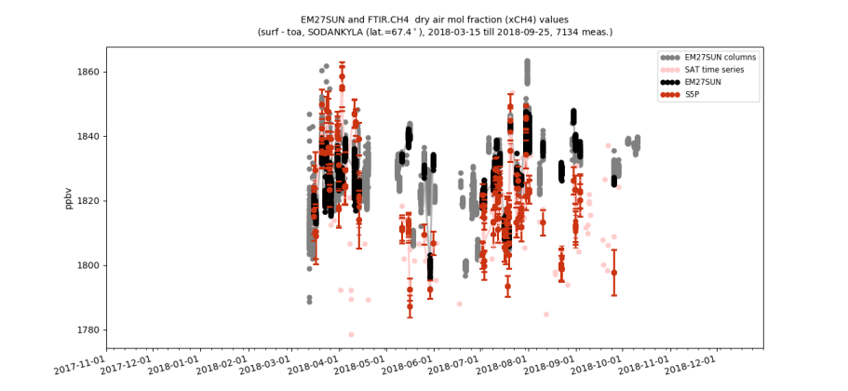
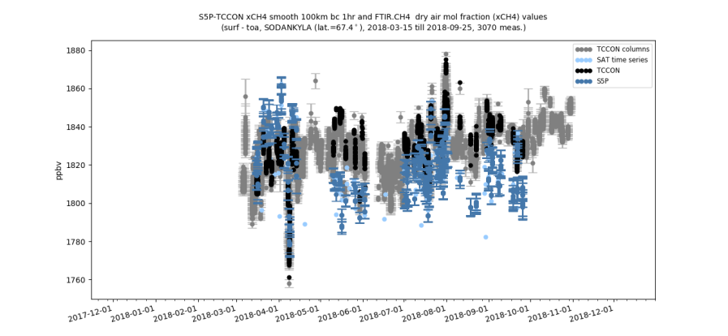
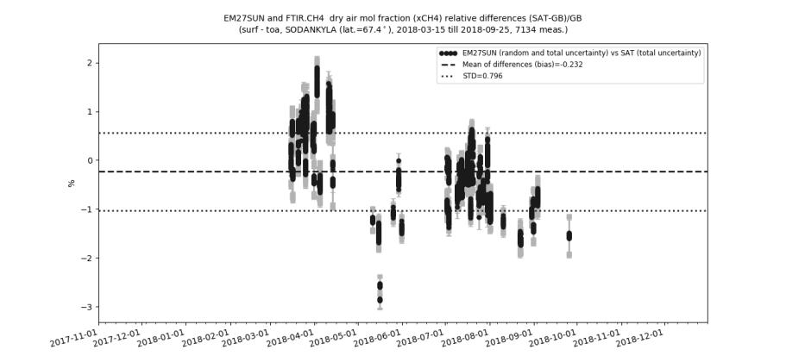
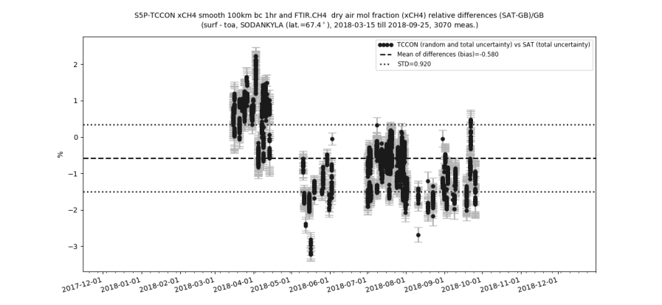
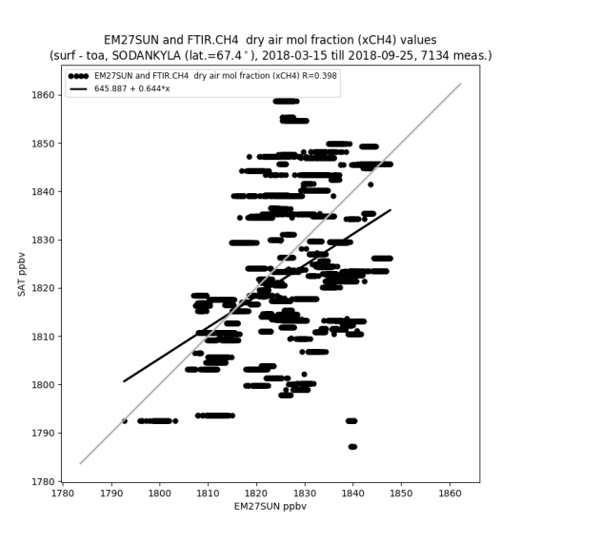
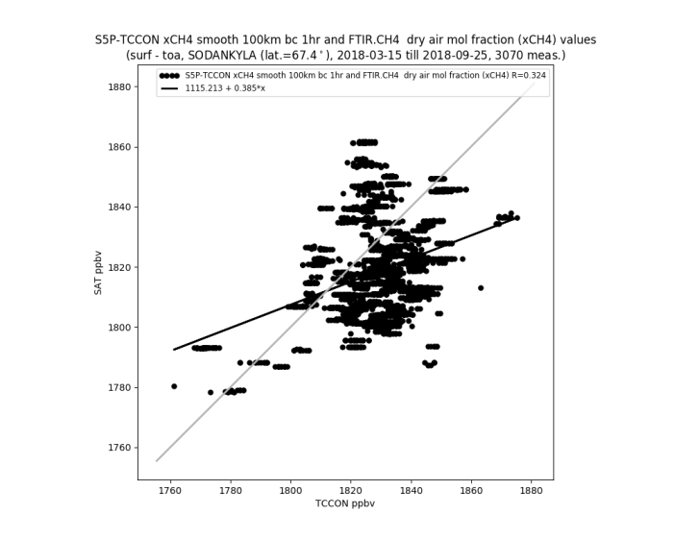
S5P-CH4 bias corrected product vs EM27/SUN
(COCCON network instrument)
Note: different number of measurements
EM27/SUN data scaled to WMO via TCCON
S5P vs TCCON
Mean bias = -0.58%, STD = 0.92%, R = 0.32
S5P vs EM27/SUN
Mean bias = -0.23%, STD = 0.80%, R = 0.40
EM27/SUN vs TCCON
Mean bias = -0.05% (-1 ppb), STD = 0.22% (4 ppb), R = 0.93
Notes:
Announce repetition of RHS plot on each slide

Slide 14
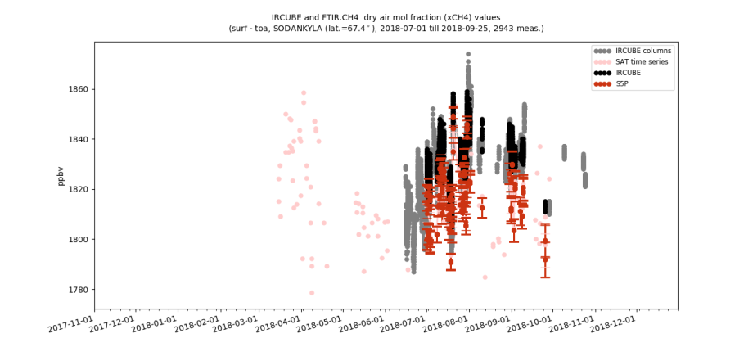
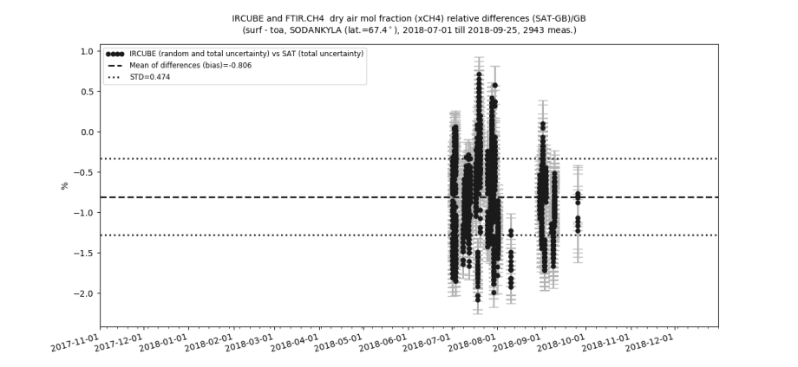
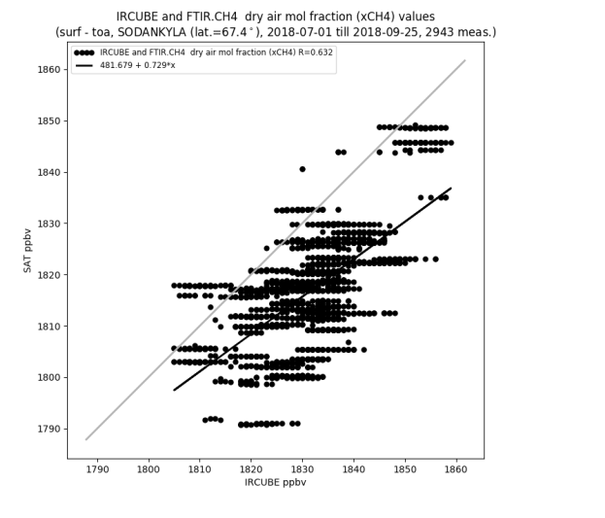
S5P-CH4 bias corrected product vs IRcube
Note: shorter time period only during summer season
IRcube data not yet scaled to WMO
S5P vs TCCON
Mean bias = -0.58%, STD = 0.92%, R = 0.32
S5P vs IRcube
Mean bias = -0.81%, STD = 0.47%, R = 0.63
IRcube vs TCCON
Mean bias = -0.11% (-2 ppb), STD = 0.27% (5 ppb), R = 0.90

Slide 15
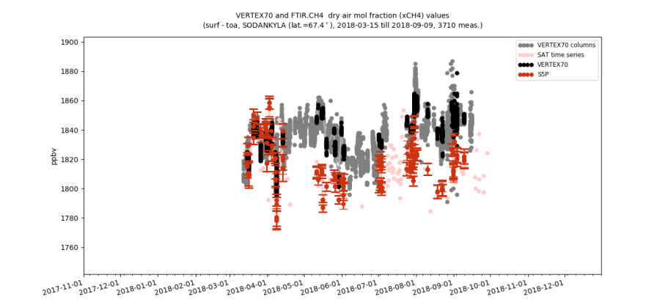
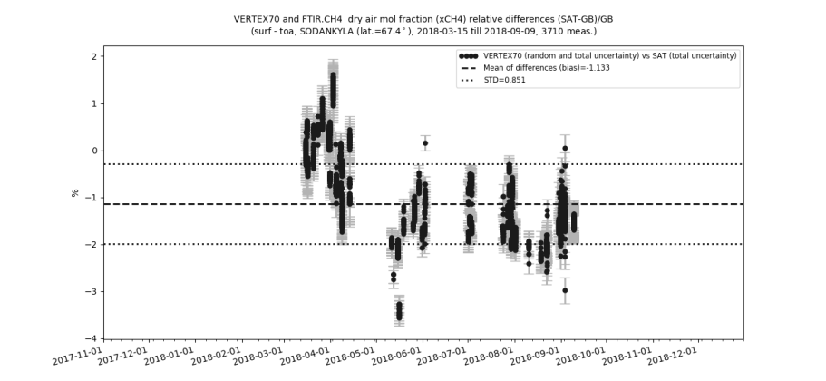
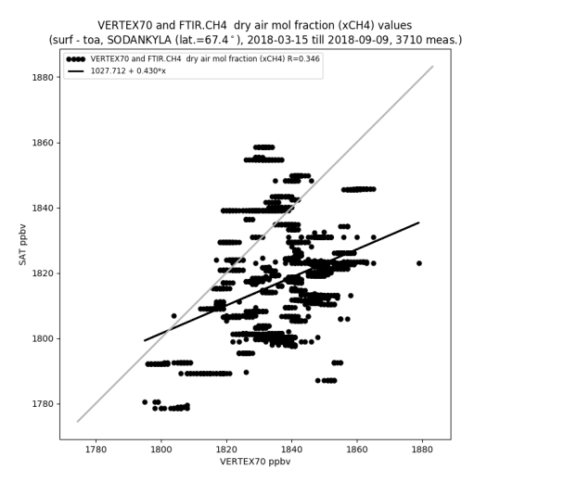
S5P-CH4 bias corrected product vs VERTEX70
VERTEX70 data not yet scaled to WMO
S5P vs TCCON
Mean bias = -0.58%, STD = 0.92%, R = 0.32
S5P vs VERTEX70
Mean bias = -1.13%, STD = 0.85%, R = 0.35
VERTEX70 vs TCCON
Mean bias = 0.50% (9 ppb), STD = 0.22% (4 ppb), R = 0.95

Slide 16
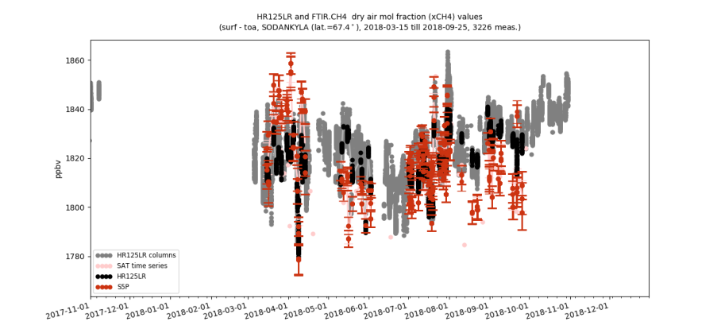
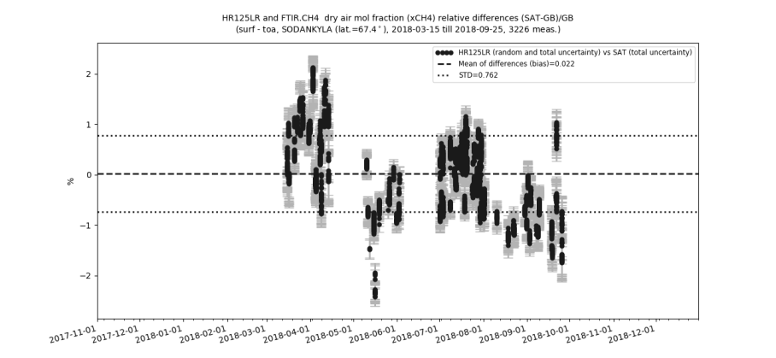
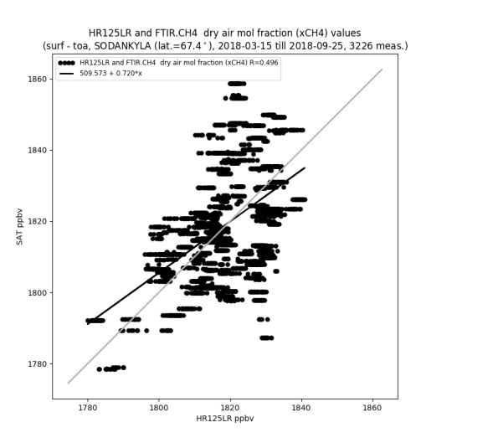
S5P-CH4 bias corrected product vs HR125LR
HR125LR data not yet scaled to WMO
S5P vs TCCON
Mean bias = -0.58%, STD = 0.92%, R = 0.32
S5P vs HR125LR
Mean bias = 0.02%, STD = 0.76%, R = 0.50
HR125LR vs TCCON
Mean bias = -0.44% (-8 ppb), STD = 0.27% (5 ppb), R = 0.90

Slide 17
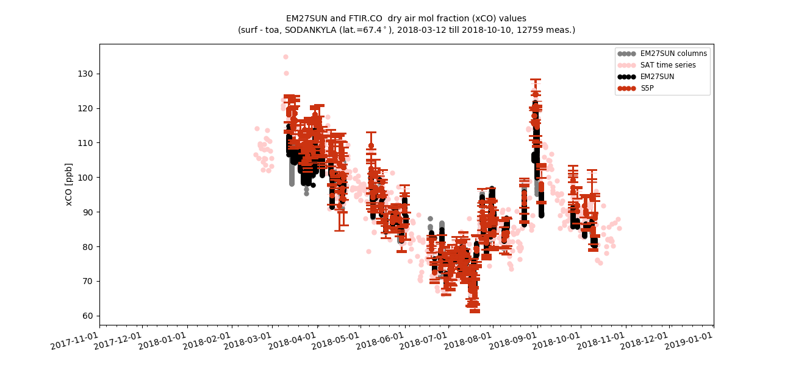
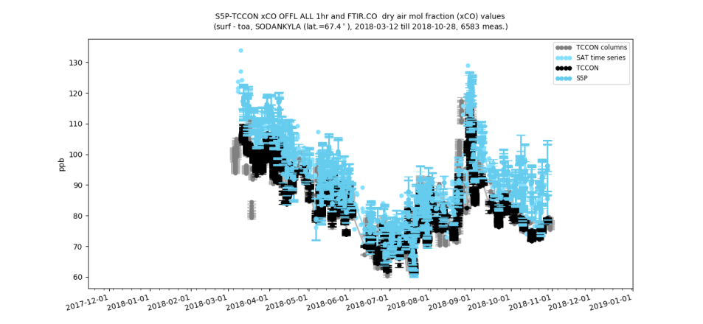
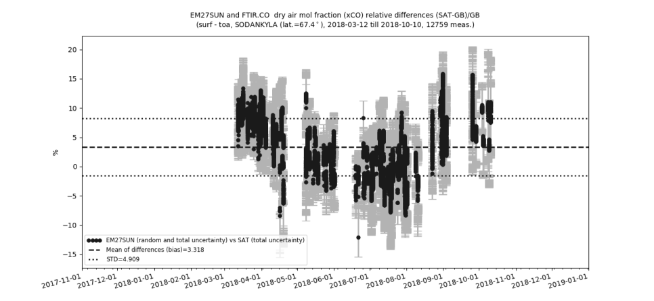
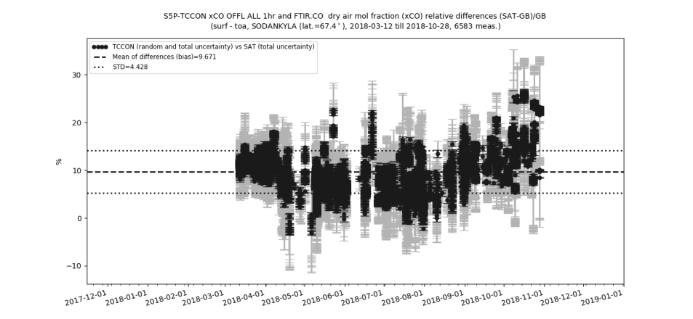
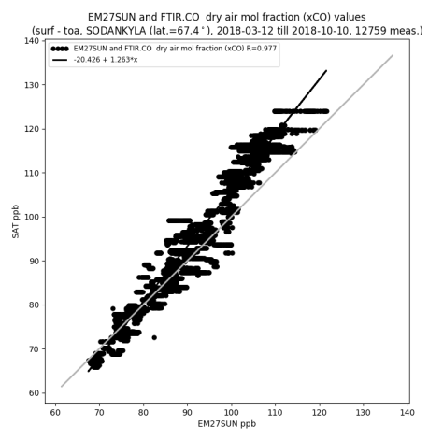
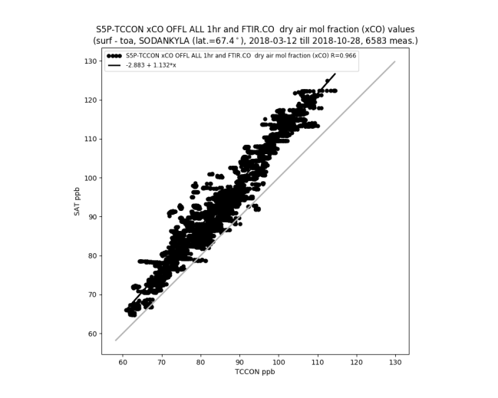
S5P-CO validation results using EM27/SUN
(COCCON network instrument)
Note:
EM27SUN data not yet corrected for spectroscopic errors
S5P vs TCCON
Mean bias = 9.67%, STD = 4.43%, R = 0.967
S5P vs EM27SUN
Mean bias = 3.32%, STD = 4.91%, R = 0.977
EM27/SUN vs TCCON
Mean bias = 5.66% (5.09 ppb), STD = 1.37% (1.23 ppb), R = 0.996

Slide 18
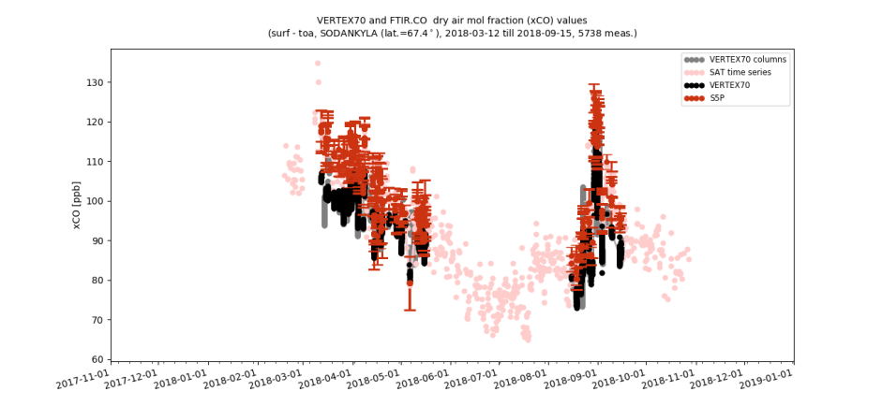
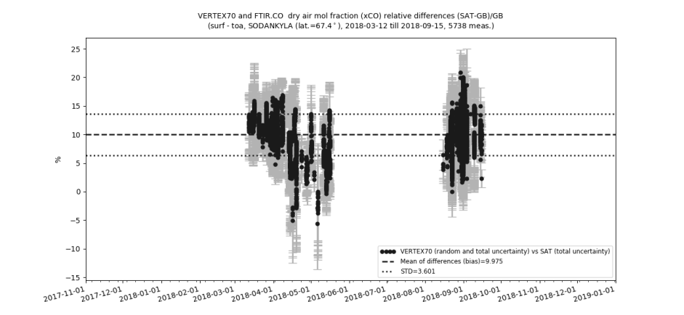
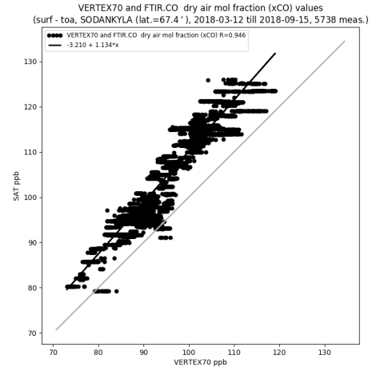
S5P-CO validation results using VERTEX70
Note: shorter time period only during summer season
VERTEX70 data not yet scaled to WMO
S5P vs TCCON
Mean bias = 9.67%, STD = 4.43%, R = 0.967
S5P vs VERTEX70
Mean bias = 9.98%, STD = 3.60%, R = 0.946
VERTEX70 vs TCCON
Mean bias = 0.7% (0.63 ppb), STD = 0.84% (0.76 ppb), R = 0.995

Slide 19
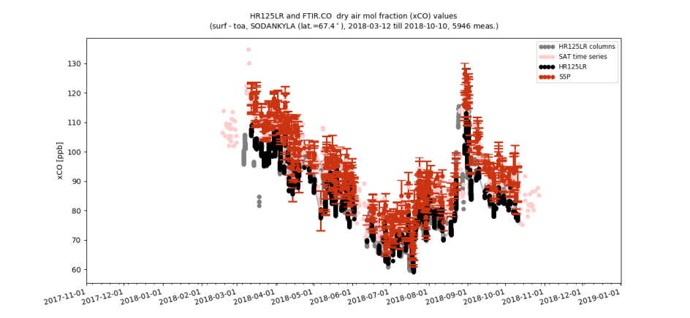
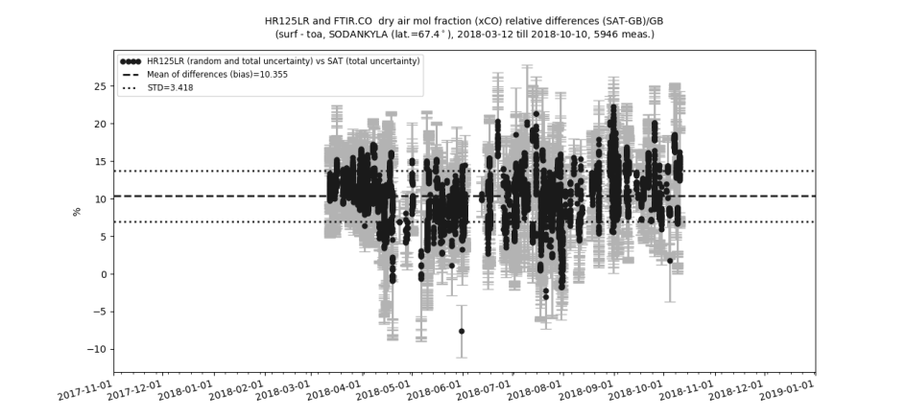
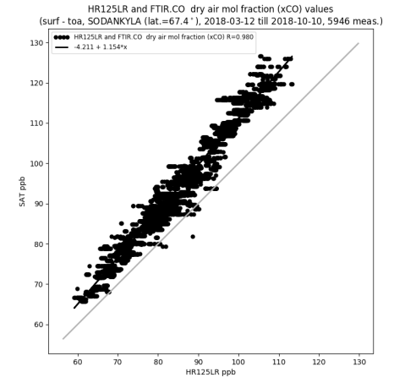
S5P-CO validation results using HR125LR
Note:
HR125LR data not yet scaled to WMO
S5P vs TCCON
Mean bias = 9.67%, STD = 4.43%, R = 0.967
S5P vs HR125LR
Mean bias = 10.36%, STD = 3.42%, R = 0.98
HR125LR vs TCCON
Mean bias = -0.39% (-0.35 ppb), STD = 1.37% (1.23 ppb), R = 0.996

Slide 20
Conclusions
Assessment of low-resolution TCCON-alternative instruments for CH4, CO – and CO2
  The CH4 and CO seasonal cycles are consistent between TCCON and other low-resolution datasets.
  We see a small bias in CH4 during spring due to the high difference between the prior relative to the true atmospheric state, the column averaging kernel at high solar zenith angles and the retrieval sensitivities.
  The differences seen in the CH4 intercomparisons including the HR125LR data with respect to the standard TCCON data highlight the impact of the different spectral resolutions.
  The scatter of the CH4 intercomparison results are within the limit of the TCCON precision (0.3%) with a high correlation between the low- and high-resolution datasets. The low-resolution instruments (except EM27/SUN) are not yet scaled to the WMO reference which is the reason for the bias.
Results of S-5P validation using low-resolution instruments
  The validation results for S-5P CH4 and CO show a scatter and correlation comparable to the results obtained with TCCON
  The validation of the CO2 product from OCO-2 using the low-resolution instruments is in progress
⇒ EM27/SUN (COCCON network instrument), IRcube, and Vertex70 can complement the TCCON network, and can be considered suitable reference networks / instruments for the validation of S-5P CH4 and CO products.

Slide 21
Notes
Disclaimer: The presented work has been performed in the frame of the FRM4GHG project. Results are based on preliminary (not fully calibrated/validated) Sentinel-5 Precursor data that will still change.
Acknowledgements: Sentinel-5 Precursor is a European Space Agency (ESA) mission on behalf of the European Commission (EC). The TROPOMI payload is a joint development by ESA and the Netherlands Space Office (NSO). The Sentinel-5 Precursor ground-segment development has been funded by ESA and with national contributions from The Netherlands, Germany, and Belgium.
This validation work has been performed within the FRM4GHG project which received funding from the European Space Agency's FRM Programme under grant agreement no. ESA-IPL-POE-LG-cl-LE-2015-1129.

Slide 22
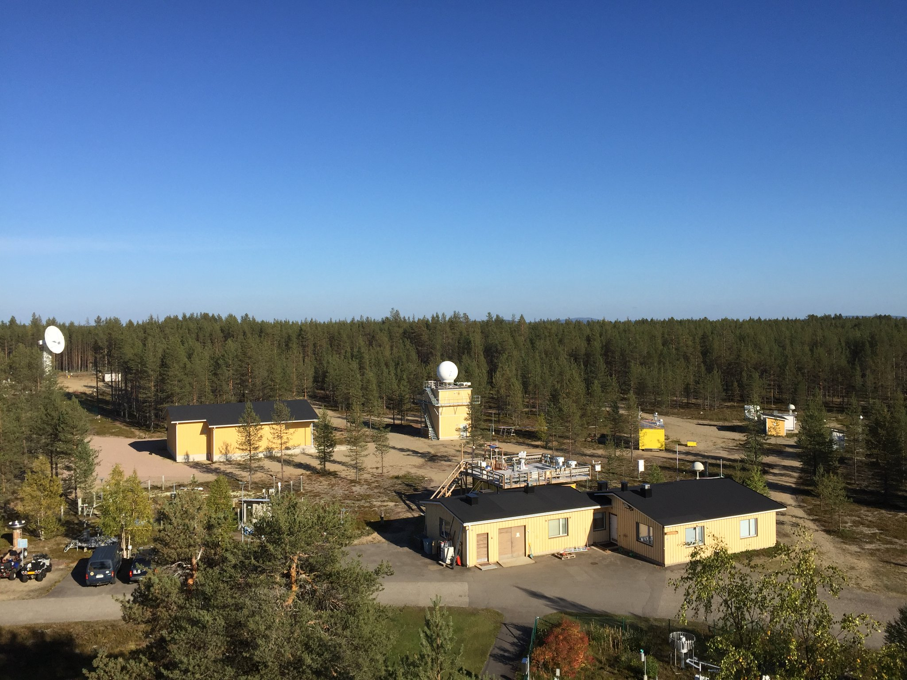
Thank you for your attention!

