Slide 1
Ground-Based Remote Sensing FTIR Networks, their Complementarities and Usefulness for the Validation of Satellite GHG Products
Mahesh Kumar Sha*, Martine De Mazière, Justus Notholt, Thomas Blumenstock, Huilin Chen, David Griffith, Frank Hase, Pauli Heikkinen, Benedikt Herkommer, Christian Hermans, Nicholas Jones, Rigel Kivi, Nicolas Kumps, Bavo Langerock, Neil Macleod, Christof Petri, Qiansi Tu, Corinne Vigouroux, Thorsten Warneke, Damien Weidmann, Minqiang Zhou, TCCON team, NDACC-IRWG team and Angelika Dehn
*Royal Belgian Institute for Space Aeronomy (BIRA-IASB)
*mahesh.sha@aeronomie.be
24/11/2021

Slide 2

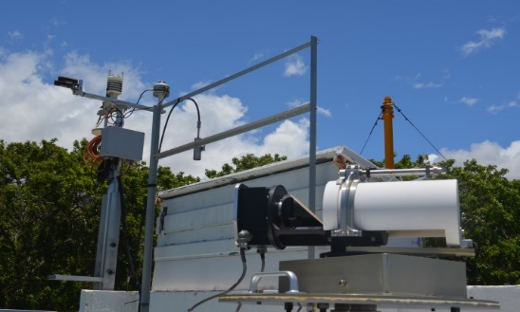
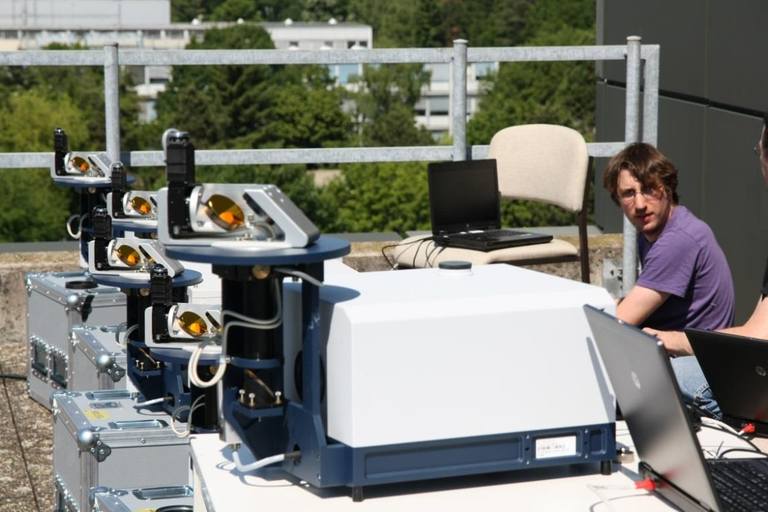
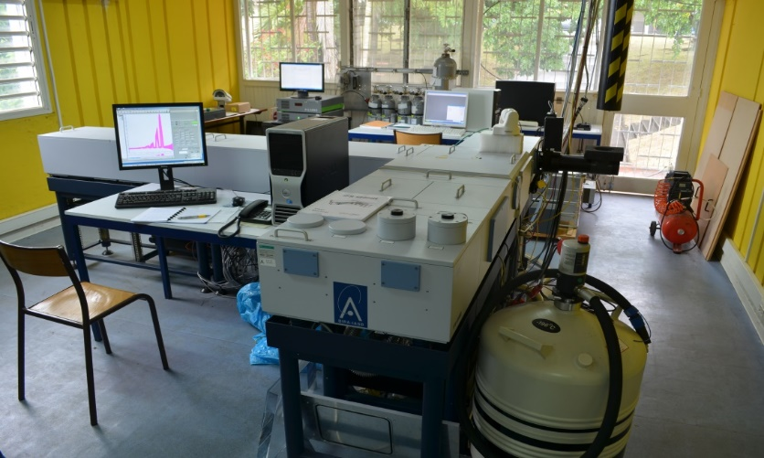
NDACC IRWG
TCCON
COCCON
Bruker IFS 120HR/125HR
Resolution 0.0036cm⁻¹
Profile retrievals (DOF 1 to 5 depending on the species, independent atmospheric altitude layers)
https://www2.acom.ucar.edu/irwg
Bruker IFS 125HR
Resolution 0.02cm⁻¹
Profile scaling retrievals
tccon.org
Bruker EM27/SUN
Resolution 0.5cm⁻¹
Profile scaling retrievals
http://www.imk-asf.kit.edu/english/COCCON.php

Slide 3
NDACC IRWG
TCCON
COCCON
Bruker IFS 120HR/125HR
Resolution 0.0036cm⁻¹
Profile retrievals (DOF 1 to 5 depending on the species, independent atmospheric altitude layers)
Targets: O3, CH4, N2O,
(CO2, HCHO, SF6, CFCs, HCFCs, H2O, HDO not official)
CO, HNO3, HCl, HF, HCN, C2H6, CLONO2
(C2H2, PAN, OCS, CH3OH, NH3, HCOOH, NO2 not official)
Retrieval software: SFIT or PROFFIT
Measurements every ±10’
Spectral range: SWIR, MIR and thermal IR
21 (+3) stations worldwide
no central processing, QA/QC for selected targets in CAMS operational validation
Bruker IFS 125HR
Resolution 0.02cm⁻¹
Profile scaling retrievals
(profile retrievals are in development)
Targets: CO2, CH4, N2O, H2O, HDO, CO, HF
Retrieval software GGG
Measurements every ~ 3’
Spectral range: SWIR
28 stations worldwide
central QA/QC
Bruker EM27/SUN
Resolution 0.5cm⁻¹
Profile scaling retrievals
Targets: CO2, CH4, CO, H2O
Retrieval software PROFFAST
Measurements every ~ 1’
Spectral range: SWIR
> 60 instruments worldwide (some fixed sites, mostly for campaigns operations)
central calibration & processing facility at KIT, Germany

Slide 4
NDACC IRWG
TCCON
COCCON
Operational usage in: CAMS validation, EUMETSAT IASI validation, ESA TROPOMI validation (RD delivery through CAMS27)
Recent and ongoing harmonisation efforts in QA4ECV, GAIA-CLIM, CAMS27, C3S-311a-Lot3. Upcoming SFIT/PROFFIT: improve harmonization of uncertainties evaluation, improve spectroscopy
Selected NDACC stations have joined ACTRIS EU research infrastructure: with central processing facility, training, QA/QC, …
CO2 retrieval strategy under development (UBremen & BIRA)
Operational usage in: CAMS validation, ESA TROPOMI validation (limited RD delivery), OCO-2/3 & GOSAT/2 cal/val, …
GGG2020 (release early 2022) will improve prior profiles (shape and possible bias), improve spectroscopy, reduce remaining airmass and H2O dependences, reduce scatter in CO product and verify calibration factor, improve diagnostics for instrumental issues.
Negotiations are ongoing for selected TCCON stations to join ICOS EU research infrastructure, with central processing facility
Profile retrievals under development. Tropospheric partial columns can be derived indirectly
Operational usage in: ESA TROPOMI validation (started in 2020), OCO-2/3, GOSAT/2, …
A new PROFFAST version is under preparation (FRM4GHG2.0 activity) – available by spring 2022, will include redefined line shape description and incorporate new line lists
EM27/SUN as travelling standard within TCCON, COCCON can complement TCCON, support by ESA for COCCON-PROCEEDS and follow-up crucial for current capabilities of COCCON
Towards extension of COCCON with VERTEX70/INVENIO and IRcube (2 other low resolution FTIR instruments – with higher spectral resolution and additional species) – ESA FRM4GHG project https://frm4ghg.aeronomie.be
https://global-evaluation.atmosphere.copernicus.eu
http://cdop.aeronomie.be/validation/valid-results
https://mpc-vdaf-server.tropomi.eu
Ongoing comparisons NDACC/TCCON in recent papers: https://doi.org/10.5194/amt-12-5979-2019 (CO),https://doi.org/10.5194/amt-12-1393-2019 (N2O), CH4 Profile retrievals from TCCON spectra: https://doi.org/10.5194/amt-12-6125-2019, FRM4GHG paper – low resolution FTIR comparison to TCCON: https://doi.org/10.5194/amt-13-4791-2020, S-5P CH4 and CO validation using TCCON and NDACC-IRWG data – https://doi.org/10.5194/amt-14-6249-2021

Slide 5
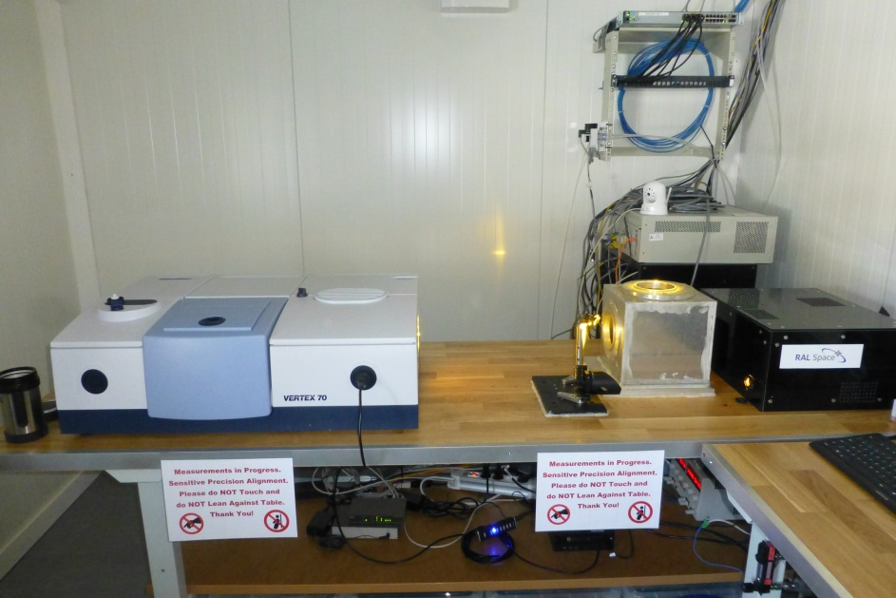

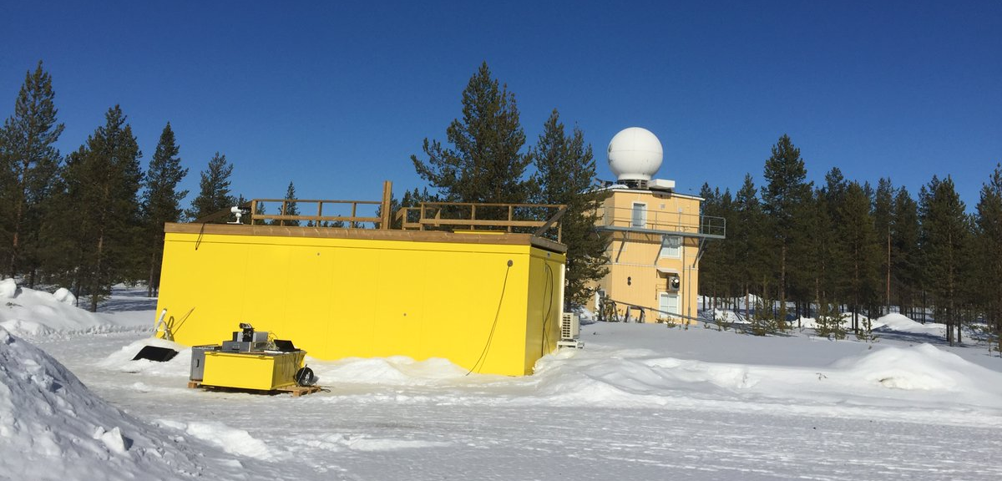
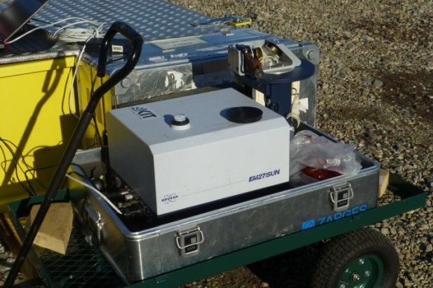
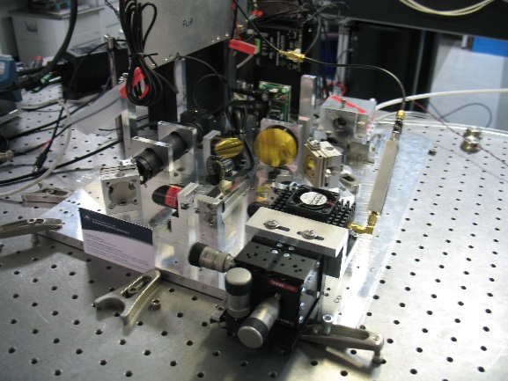
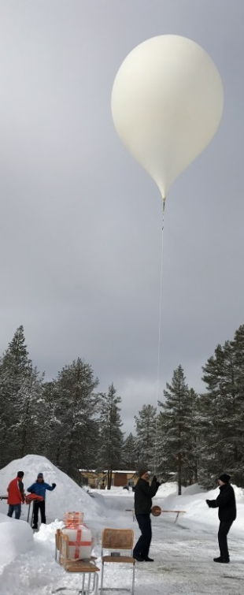
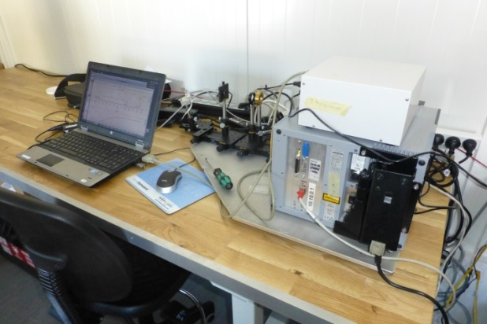
TCCON
Vertex 70
FRM4GHG container
AirCore launch
EM27/SUN with suntracker
Instrumentation used during the ESA funded FRM4GHG project
Details in Sha et al. 2020, AMT paper
IRcube
LHR optical breadboard

Slide 6
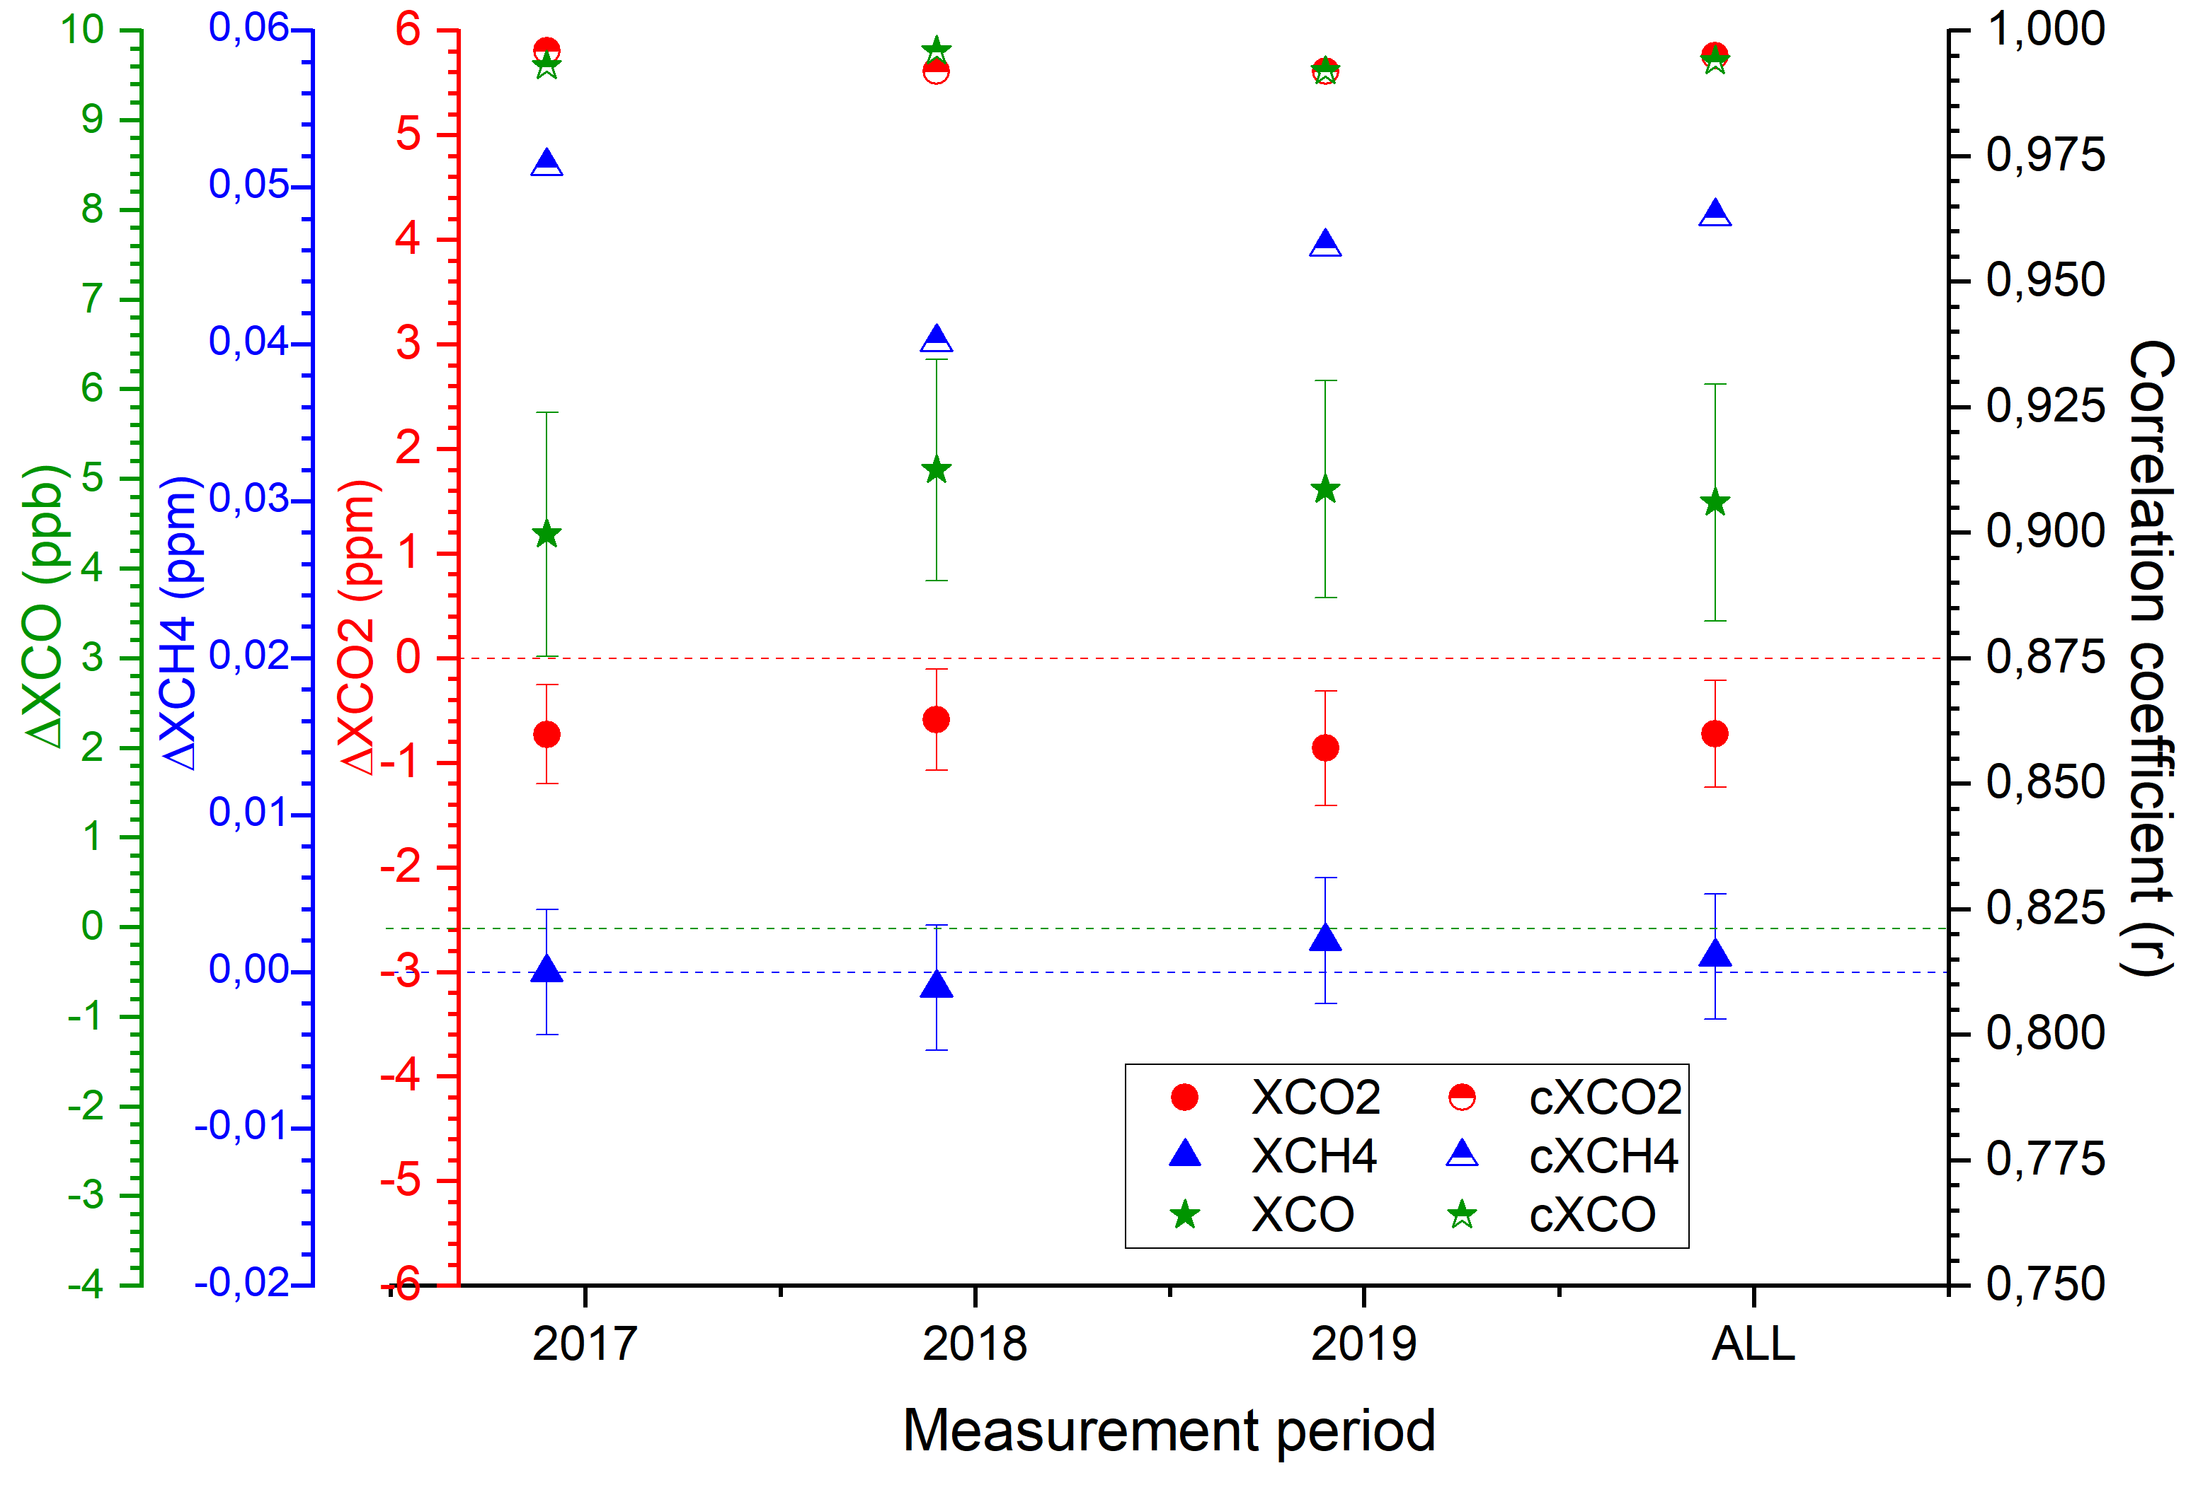
EM27/SUN – COCCON
Species | Duration | XCO₂ / ppm | XCH₄ / ppm | XCO / ppb
Bias (mean standard ± deviation) and correlation coefficient (r)
EM27/SUN vs TCCON | 2017 | -0.727±0.474 (0.996) | 0.000±0.004 (0.973) | 4.384±1.361 (0.993)
EM27/SUN vs TCCON | 2018 | -0.587±0.485 (0.992) | -0.001±0.004 (0.938) | 5.101±1.234 (0.996)
EM27/SUN vs TCCON | 2019 | -0.859±0.548 (0.992) | 0.002±0.004 (0.957) | 4.886±1.210 (0.992)
EM27/SUN vs TCCON | 2017 – 2019 | -0.722±0.510 (0.995) | 0.001±0.004 (0.963) | 4.738±1.321 (0.994)
TCCON precision requirements: XCO₂: < 0.25% ~ 1 ppm
XCH₄: 0.5% ~ 0.009 ppm; XCO: < 4% ~ < 4 ppb
The bias values are very close to each other and the small difference seen from year-to-year is due to the data representative issue.
Year-to-year variability (FRM4GHG – 3 y @ Sodankylä)
XCO₂ – 0.137 ppm (0.03%) with 1σ (0.5 ppm)
XCH₄ – 0.001 ppm (0.05%) with 1σ (0.004 ppm)
XCO – 0.363 ppb (0.4%) with 1σ (1.32 ppb)
Year-to-year variability (Frey et al. 2019 – 3.5 y @ Karlsruhe)
https://doi.org/10.5194/amt-12-1513-2019
XCO₂ – 0.02 ppm (0.005%) with 1σ (0.6 ppm)
XCH₄ – 0.001 ppm (0.05%) with 1σ (0.004 ppm)
The constant bias will be scaled following the strategy developed in COCCON
EM27/SUN to be used as travelling standard and visit TCCON sites for performing side-by-side measurements

Slide 7
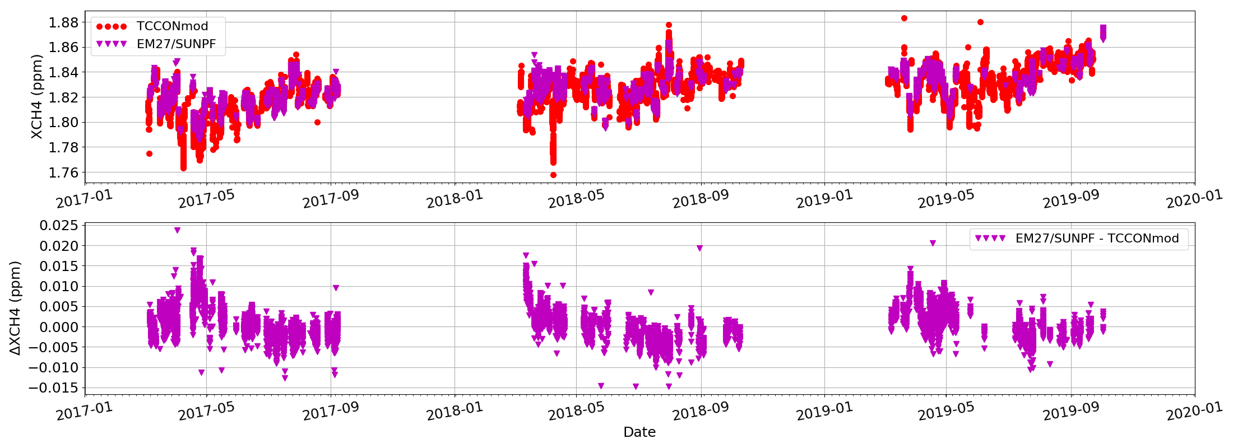
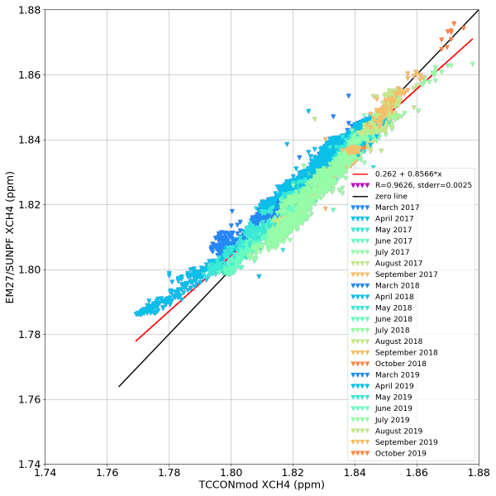
EM27/SUN – COCCON
TCCON priori used for both retrievals
Seasonality seen in the bias. About 10 ppb during spring polar vortex conditions – not very usual for standard TCCON site,
~ 3 – 5 ppb bias during summer – Autumn period ➔ significant ~ the accuracy requirement (0.2%, about 3.6 ppb) of TCCON.
Seasonal bias between TCCON and low-resolution (LR) EM27/SUN is not a drawback. It is understood – due to different instrument sensitivities (averaging kernels – AKs) and the a priori difference from the true atmospheric state. As the satellite sensors tend to use low resolution, the sensitivity match is better and therefore the smoothing error in the validation is smaller for the LR spectrometer.

Slide 8
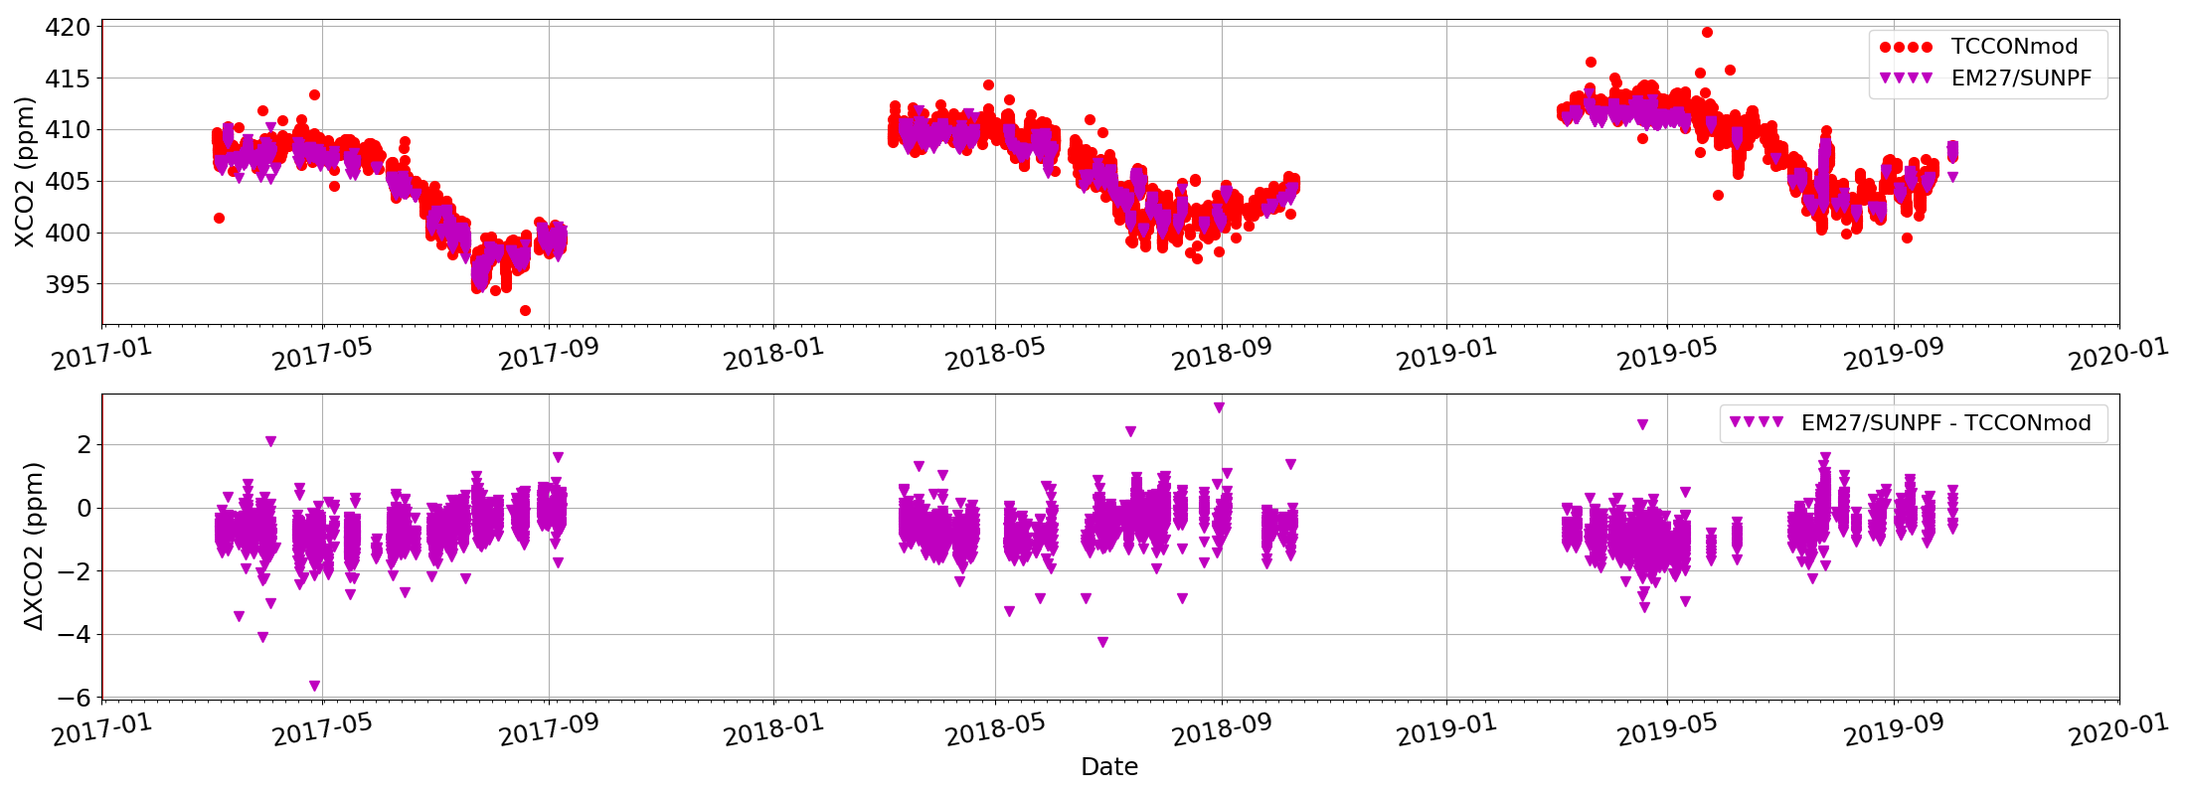
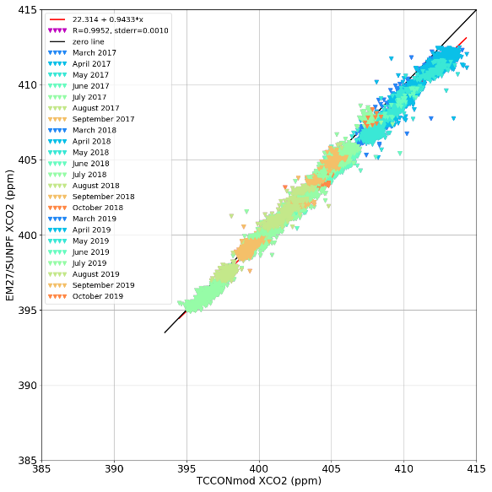
EM27/SUN – COCCON
TCCON priori used for both retrievals
Seasonality seen in the bias (~ 1 ppm) ➔ significant ~ the accuracy requirement (0.25%, about 1 ppm) of TCCON.
The seasonality of the bias for other sites will depend on the variability of the profile shape during the year and their difference to the true profile.

Slide 9
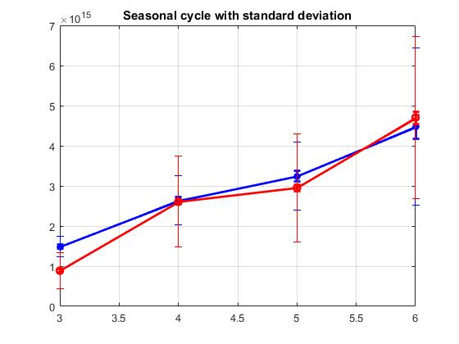
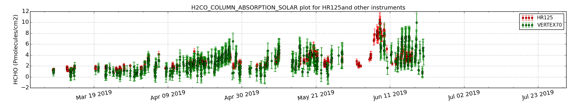
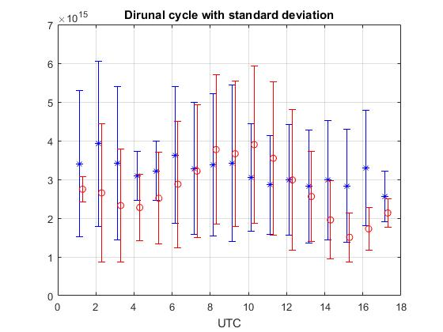
Vertex70 spectrometer – HCHO in MIR
Compact spectrometer using InGaAs detector for measurements of CO2, CH4, CO , H2O in the NIR.
Performance comparable to the reference TCCON data at Sodankylä and EM27/SUN-COCCON.
High resolution with Bruker IFS 125HR (HR125) – 0.005 cm⁻¹
Low resolution with Bruker Vertex70 (Vertex70) – 0.2 cm⁻¹
Detector and fliter – CaF2 or KBr beamsplitter and LN2 cooled InSb detector covering 2400 – 3310 cm⁻¹ region (NDSC-3 filter).
Micro-windows – MW1: 2763.42 – 2764.17 cm⁻¹; MW2: 2765.65 – 2766.01 cm⁻¹;
MW3: 2778.15 – 2779.10 cm⁻¹; MW4: 2780.65 – 2782.00 cm⁻¹;
Other details similar to Vigouroux et al. 2018; https://doi.org/10.5194/amt-11-5049-2018
Optimisation of retrieval strategy will be done as part of FRM4GHG2.0 project
Vertex70
HR125
Months

Slide 10
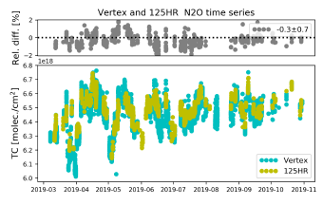
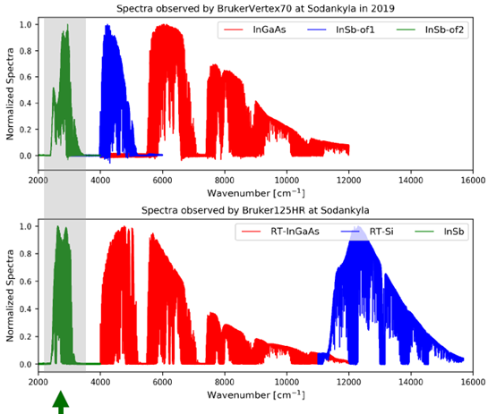
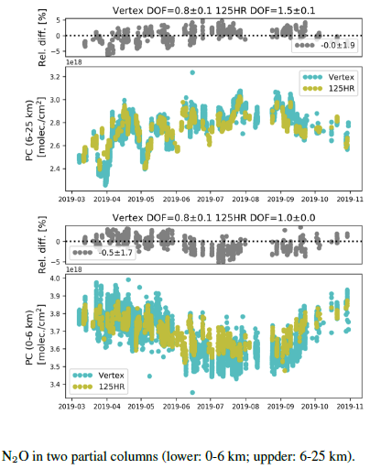
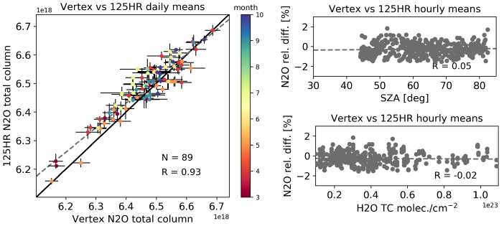
Vertex70 spectrometer – N2O in MIR
Vertex70 uses dual detector –
RT-InGaAs (NIR) and LN2-InSb (MIR)
Resolution 0.2 cm-1
Typical sampling 6 scans ~ 52 sec
Retrieval uncertainties
Systematic Random
125HR: 3.6 % 1.5 %
Vertex70: 3.7 % 1.8 %
Key results for N2O total column retrievals
Mean difference: -0.3 ± 0.7 % (within retrieval uncertainties of 125HR and Vertex70)
DOF 2.6±0.1 for 125HR; 1.6±0.1 for Vertex70
Correlation: 0.93
No dependence on H2O and SZA
Mean difference 6 – 25 km: 0.0 ± 1.9 % Mean difference surface – 6 km: -0.5 ± 1.7 %
Mean difference in partial column is closer to the mean difference in total column. However, the std of the differences in partial column is larger than in the total column.
The seasonal variation in the residual of the two layers are opposite in sign, the compensation contribution from the two layers make the residual of the total column to almost have no seasonal variation.
Zhou et al. 2021 (in preparation)

Slide 11
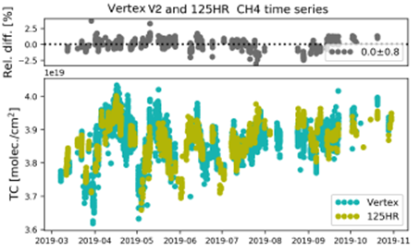
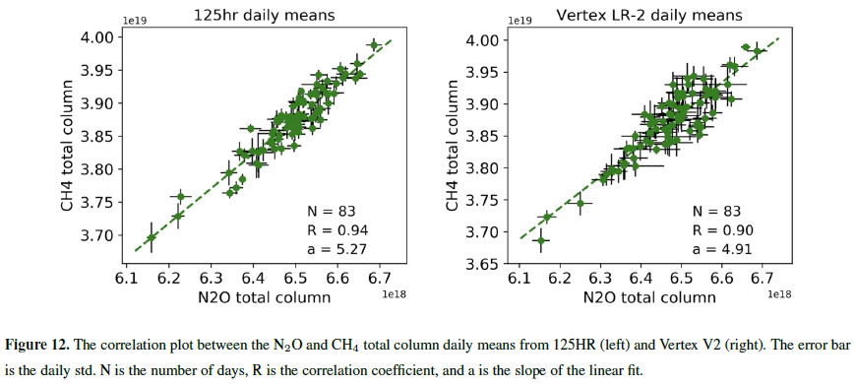
Vertex70 spectrometer – CH4 in MIR
Key results for CH4 total column retrievals
Mean difference V2: 0.0 ± 0.8 %.
Correlation: 0.87
DOF 2.1±0.2 for 125HR; 1.3±0.1 for Vertex70
Retrieval uncertainties
Systematic Random
125HR: 3.9 % 1.6 %
Vertex70: 4.3 % 2.4 %
The correlations between the two comparisons are in good agreement.
The difference of the slopes between the N2O and CH4 total columns observed by the 125HR and Vertex70 are within their combined uncertainty.
Zhou et al. 2021 (in preparation)
The differences between the Vertex70 N2O and CH4 retrievals and reference data from 125HR and AirCore are within the estimated uncertainties. Portable FTIRs of this kind will help to fill the gap of the NDACC network and contribute to satellite validation, model verification and other scientific studies. They may have the potential of becoming a travelling standard for few target NDACC gases upon calibration to the in-situ profile measurements.

Slide 12
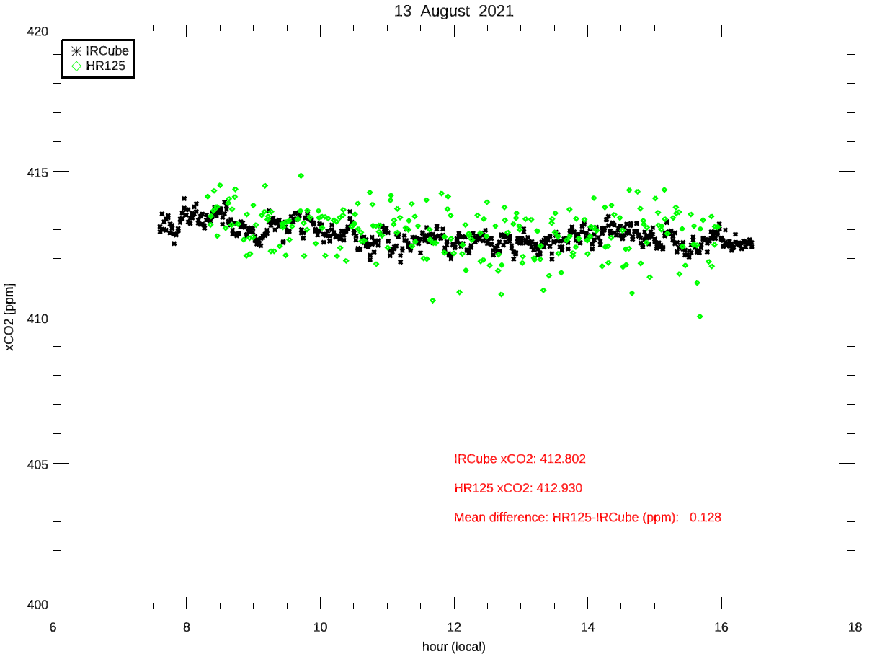
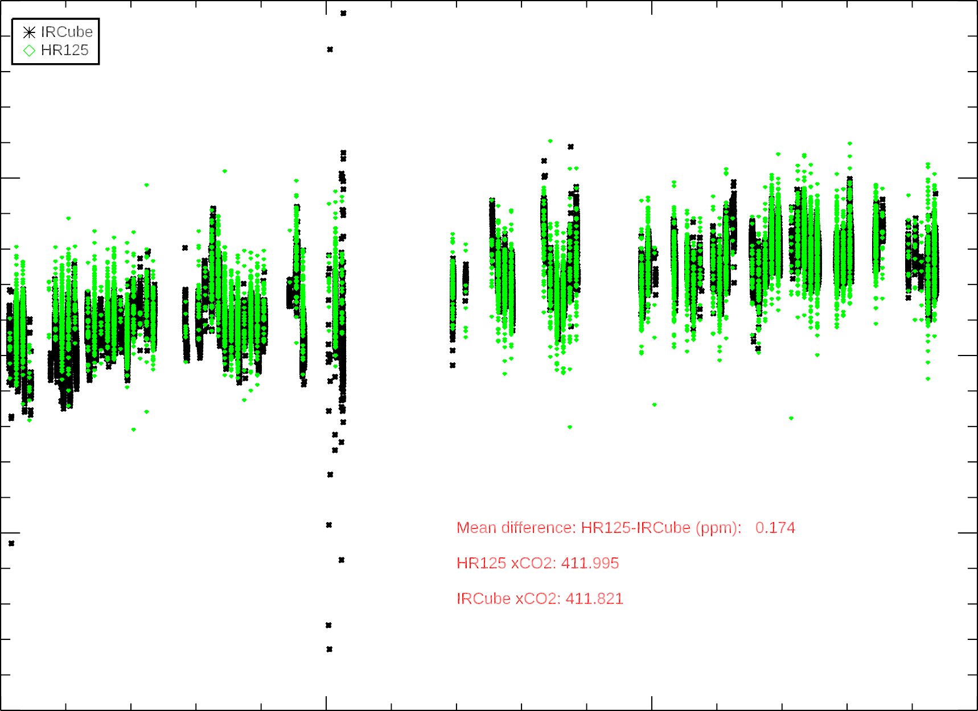
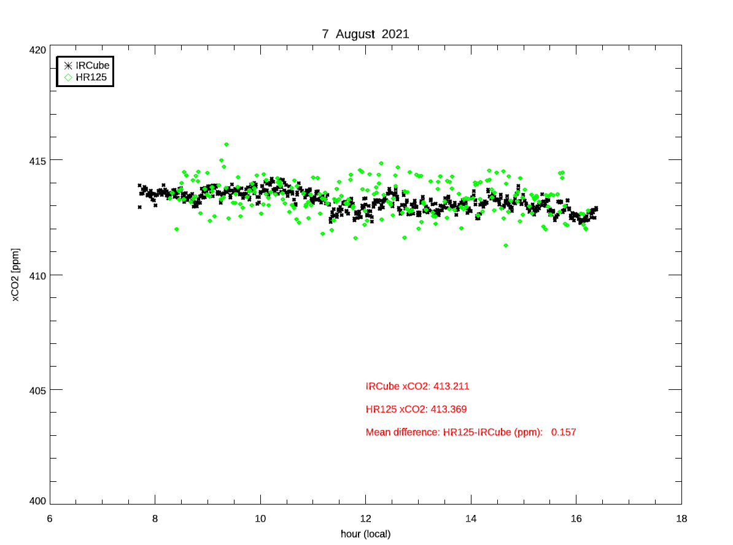
IRcube – low resolution FTIR measuring CO2 and CH4
Compact spectrometer using InGaAs detector (4500 – 15000 cm⁻¹)
Novel design which uses a fibre-optic feed from an independent solar tracker
Mean difference (5 months): HR125-IRCube = 0.174 ppm

Slide 13
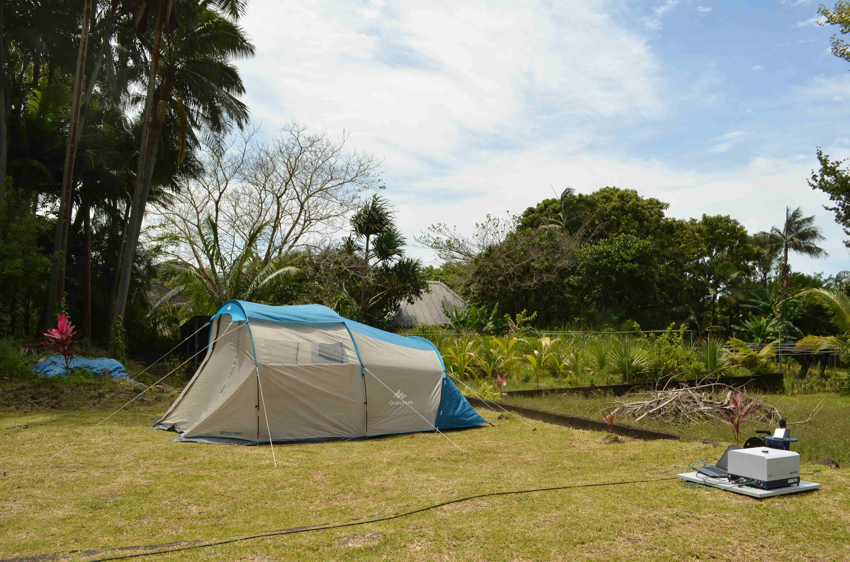
Thank you for your attention
Ground-based high-resolution FTIR data form the backbone for satellite validation and model evaluation of several products
Portable low-resolution FTIRs complement the high-resolution FTIRs for some applications (e.g. total column measurements), fill gaps in the networks, target hot spots, travelling standard, …,
Play key role for validation of satellite missions and model evaluations
Please visit https://frm4ghg.aeronomie.be/ for more information on the low-resolution FTIRs

