Slide 1
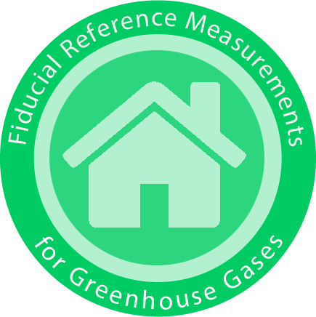


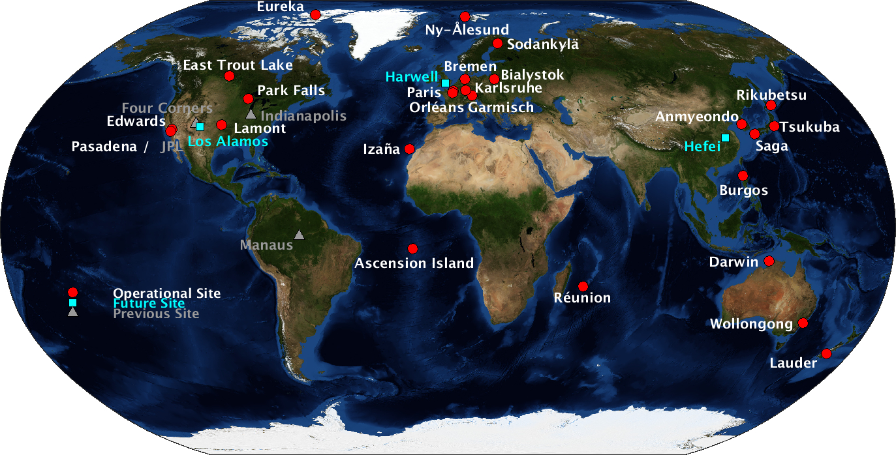
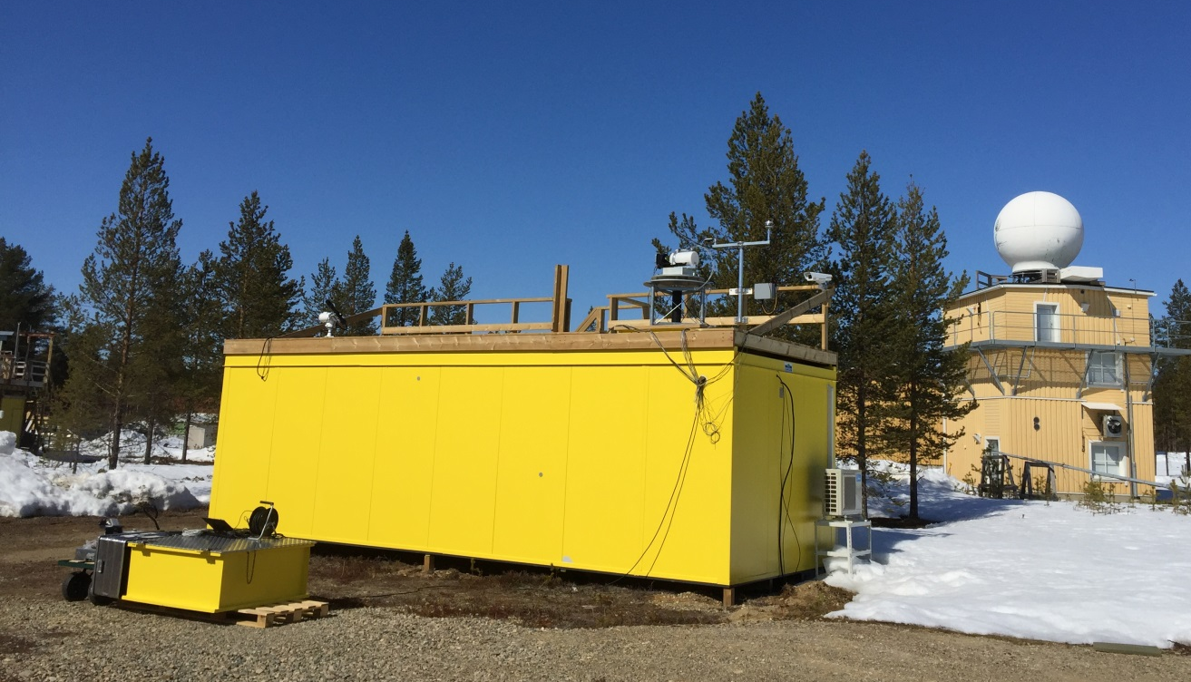

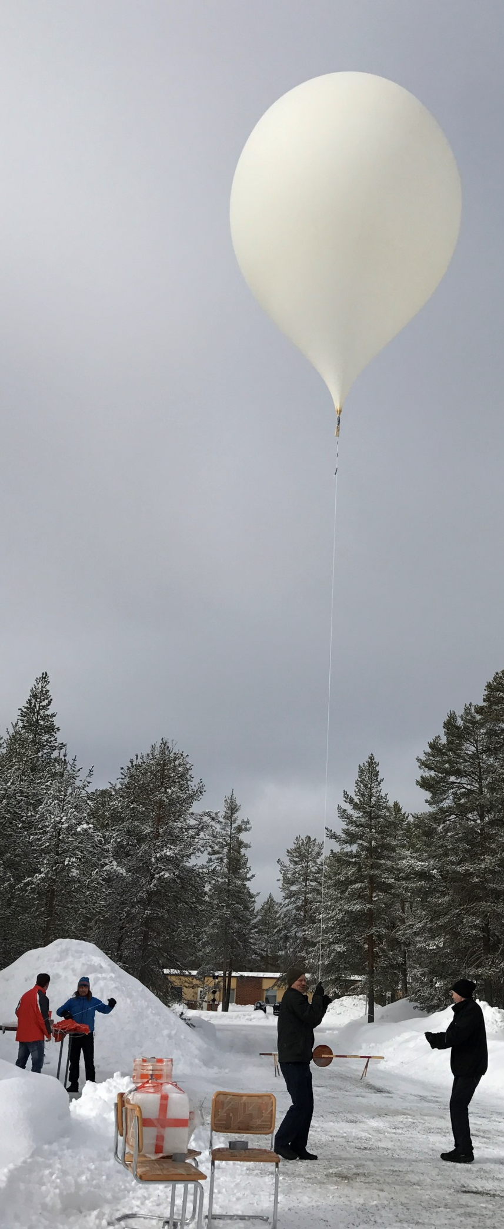
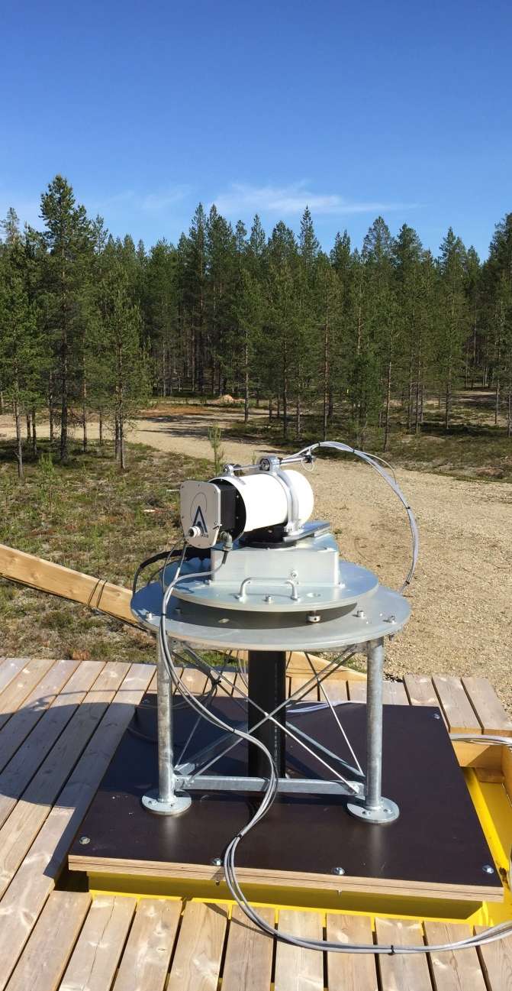
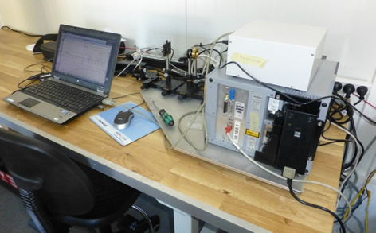
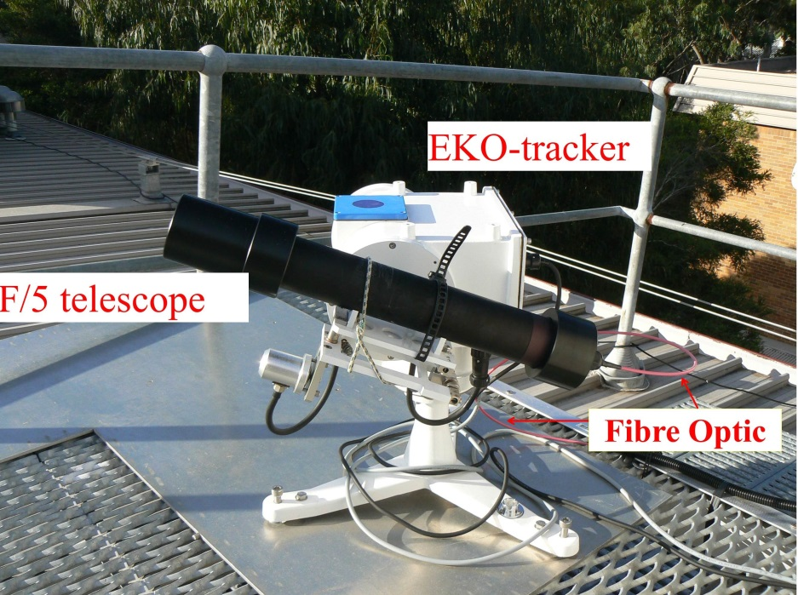
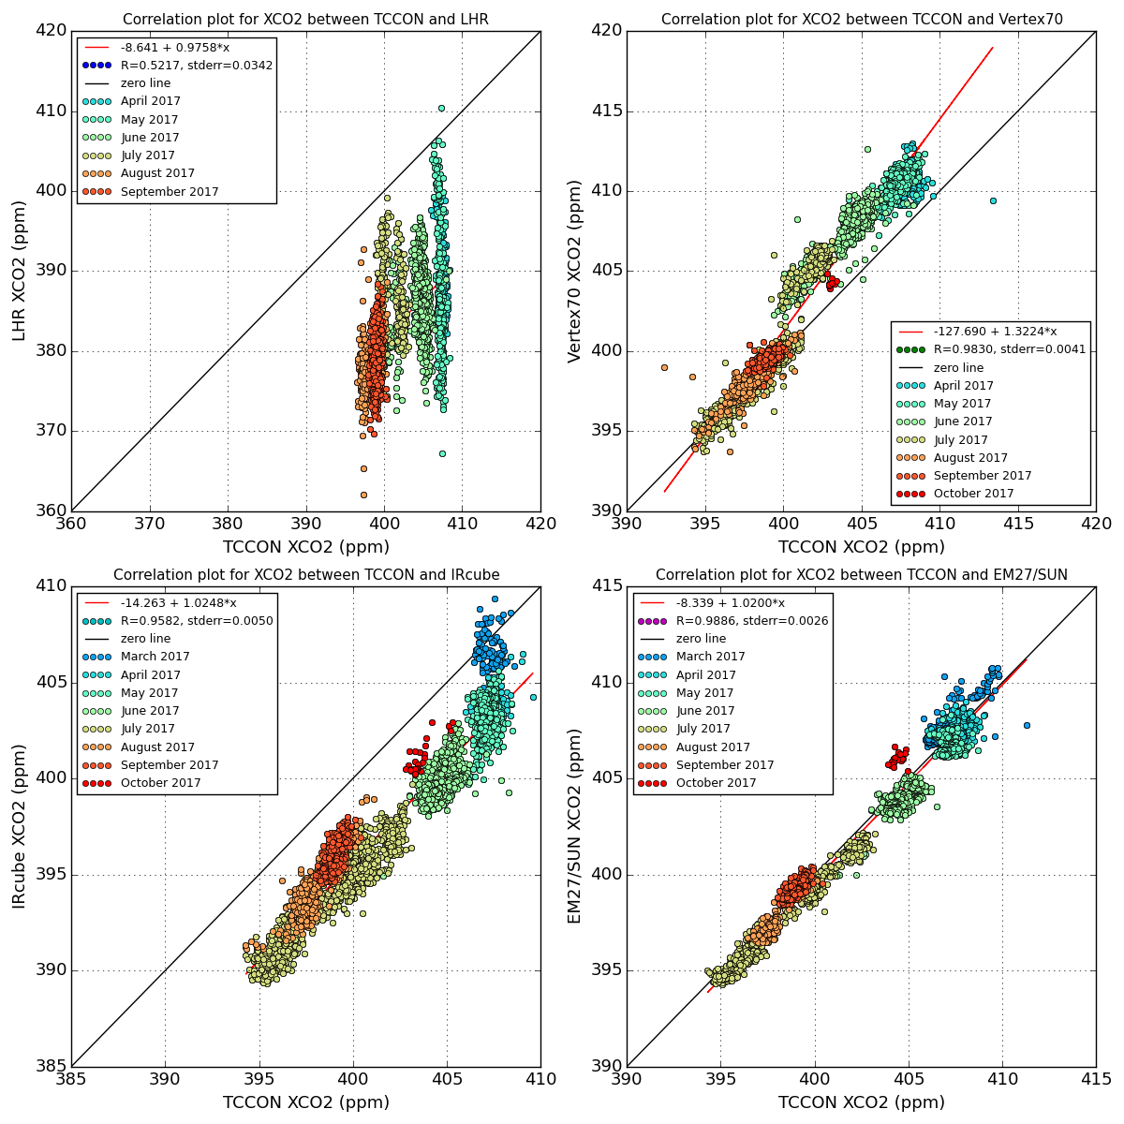
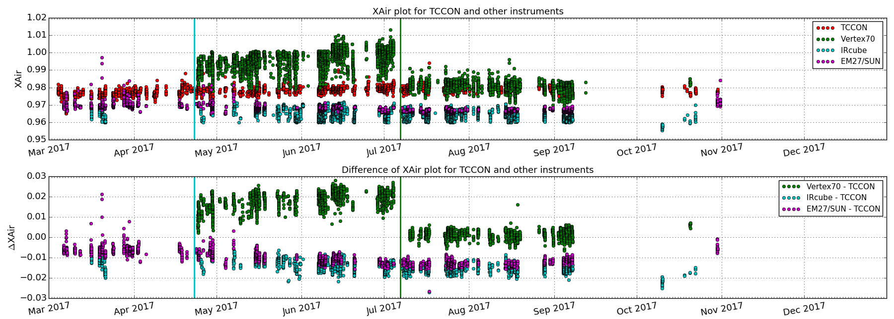
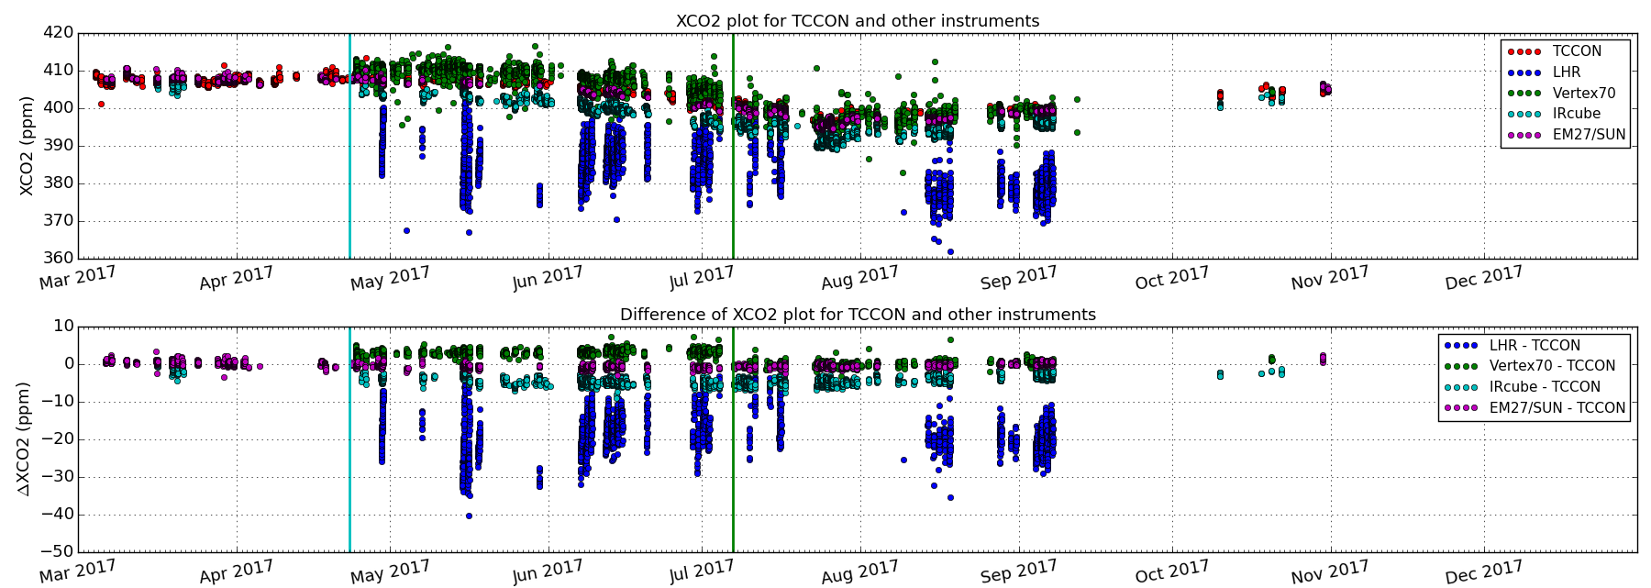
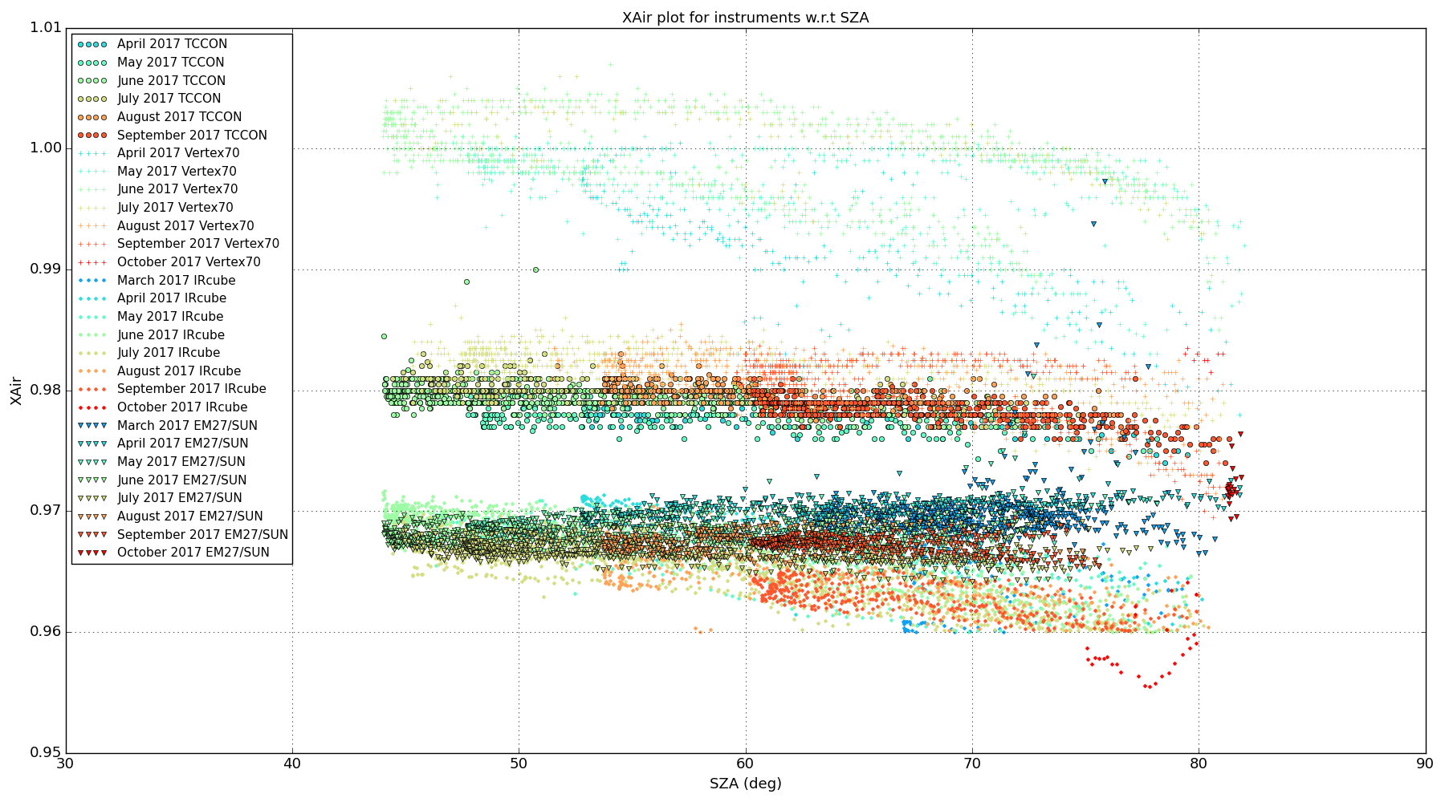
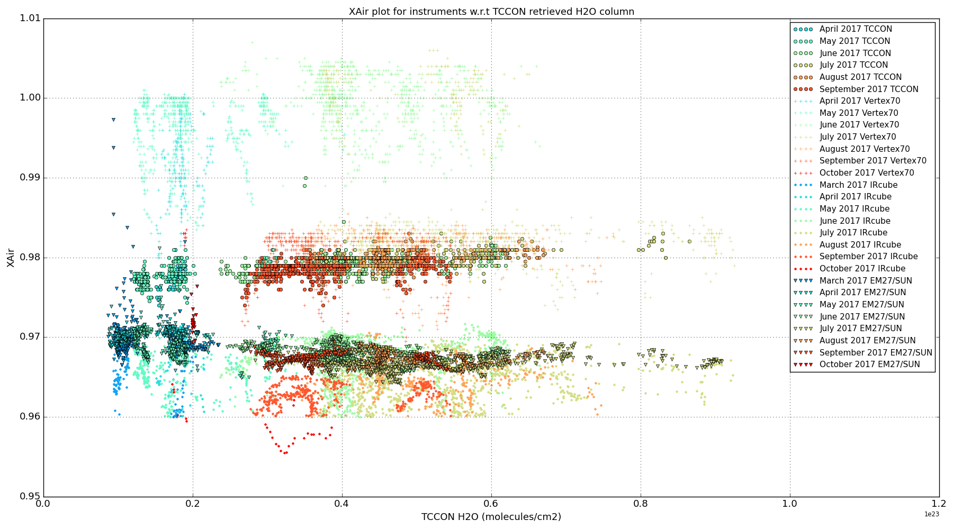
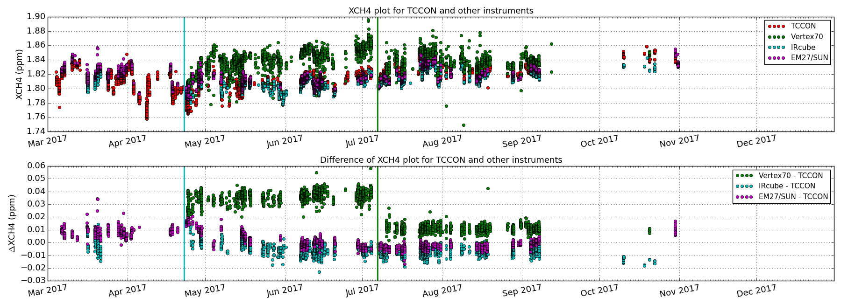
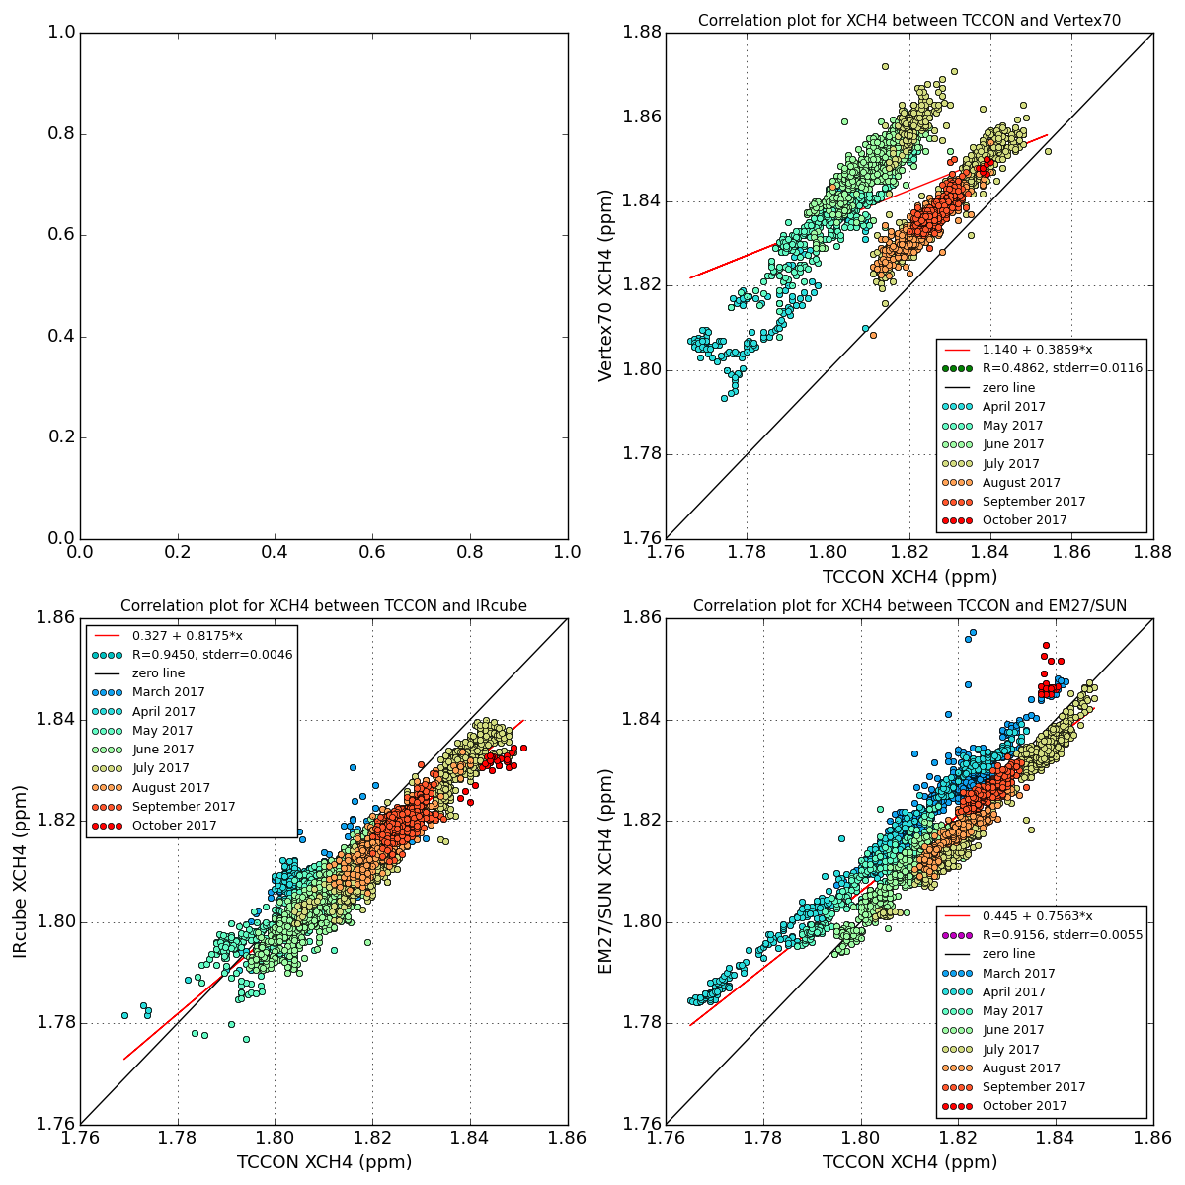

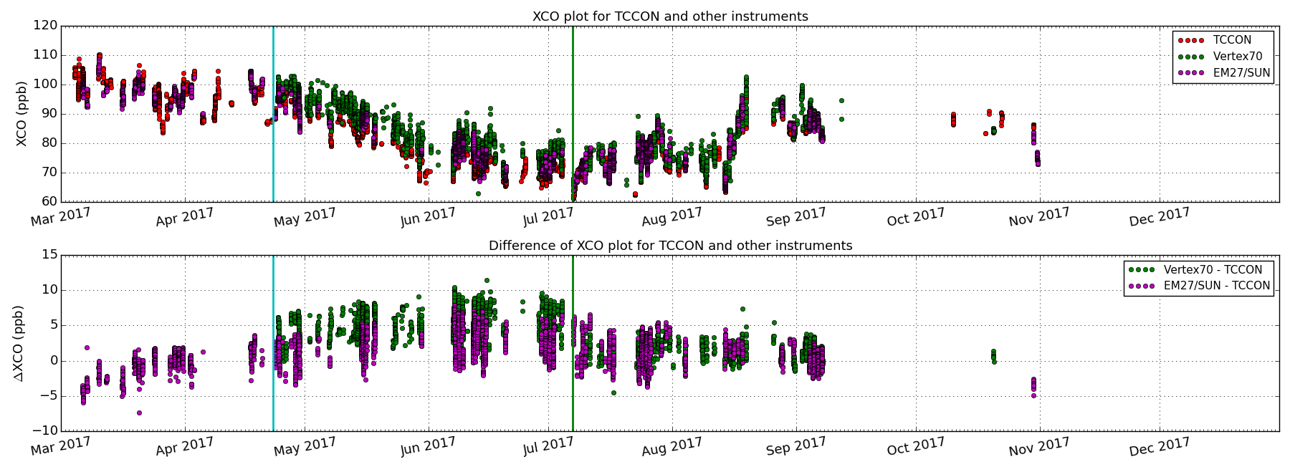
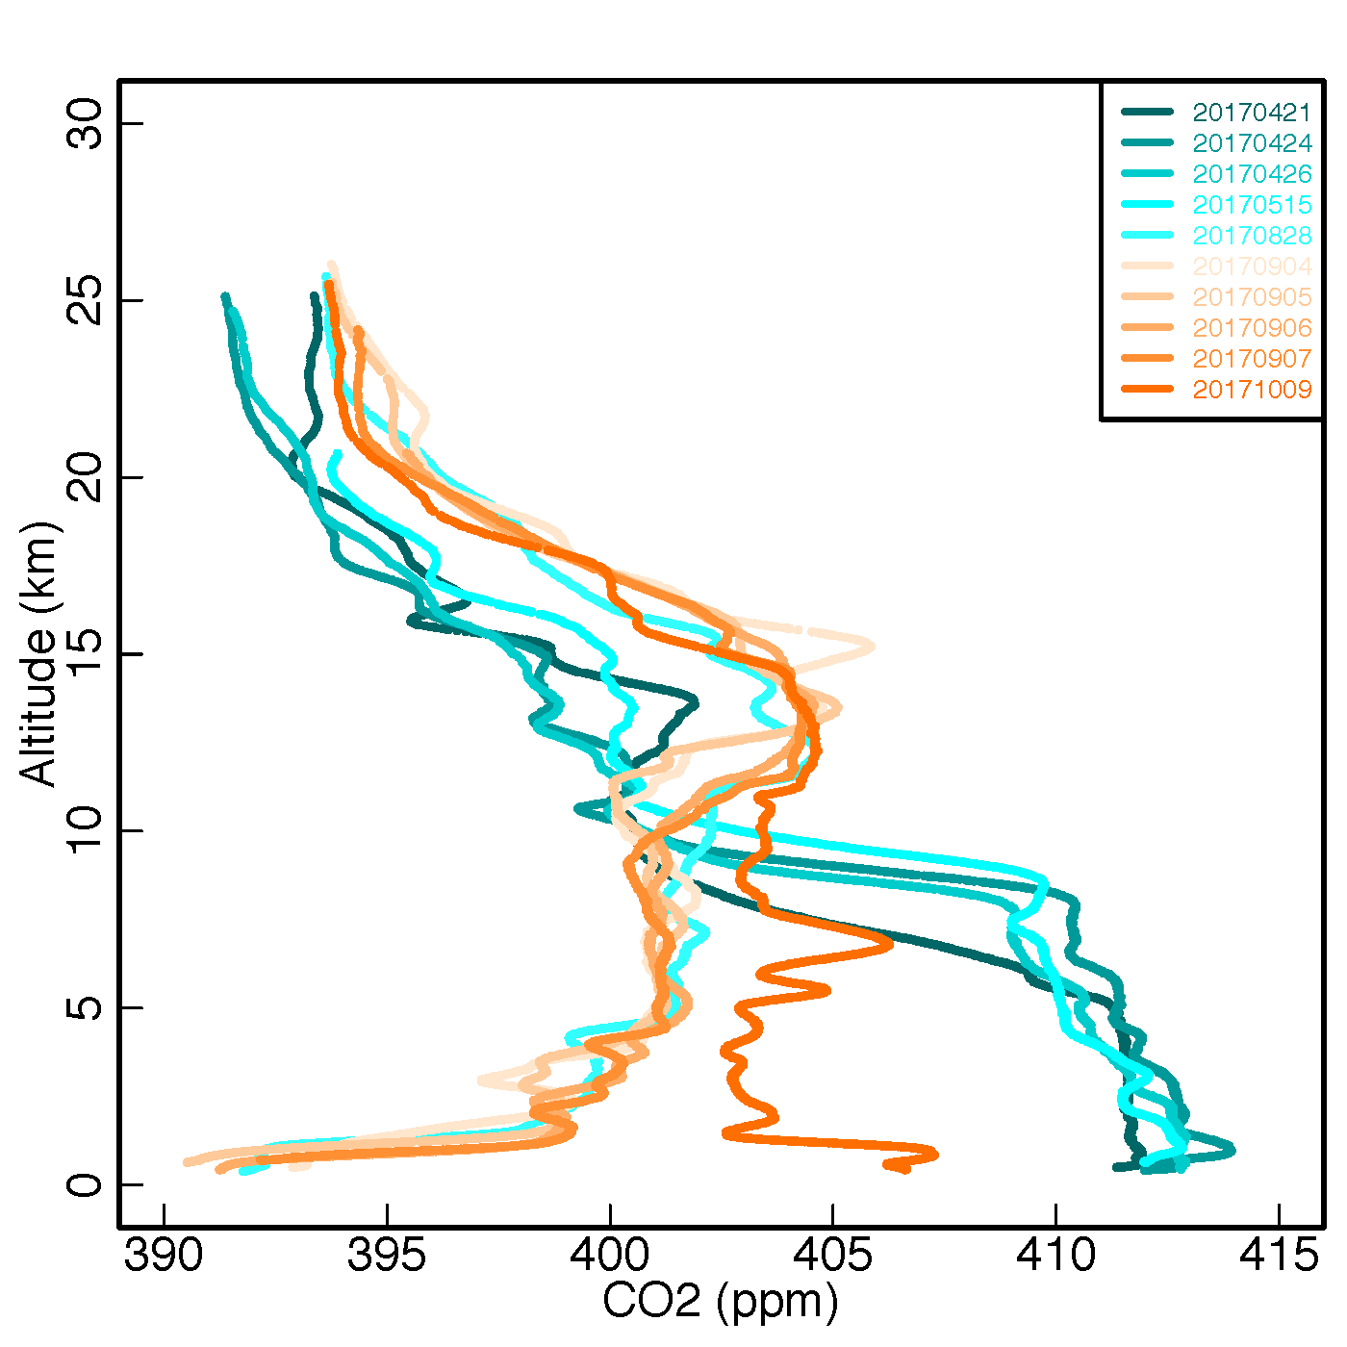
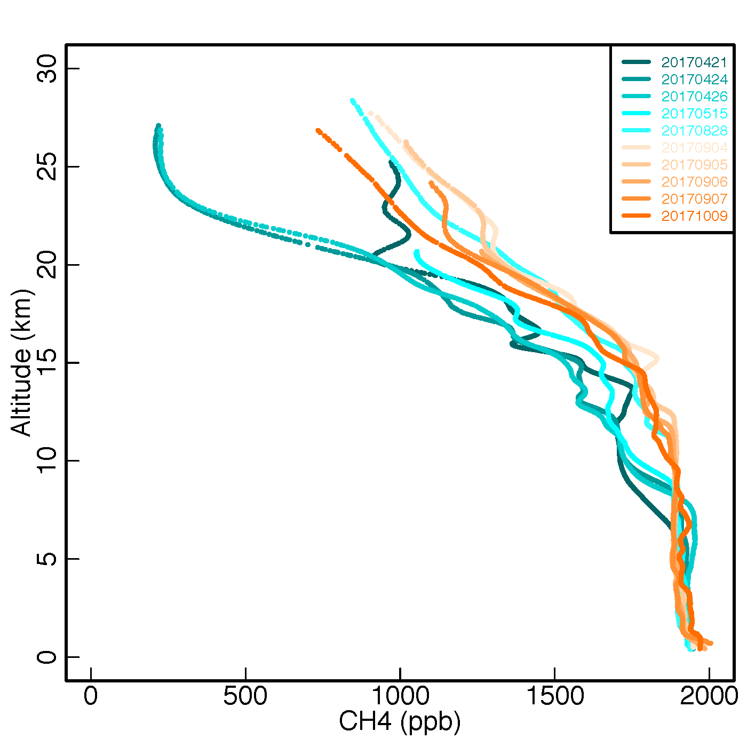
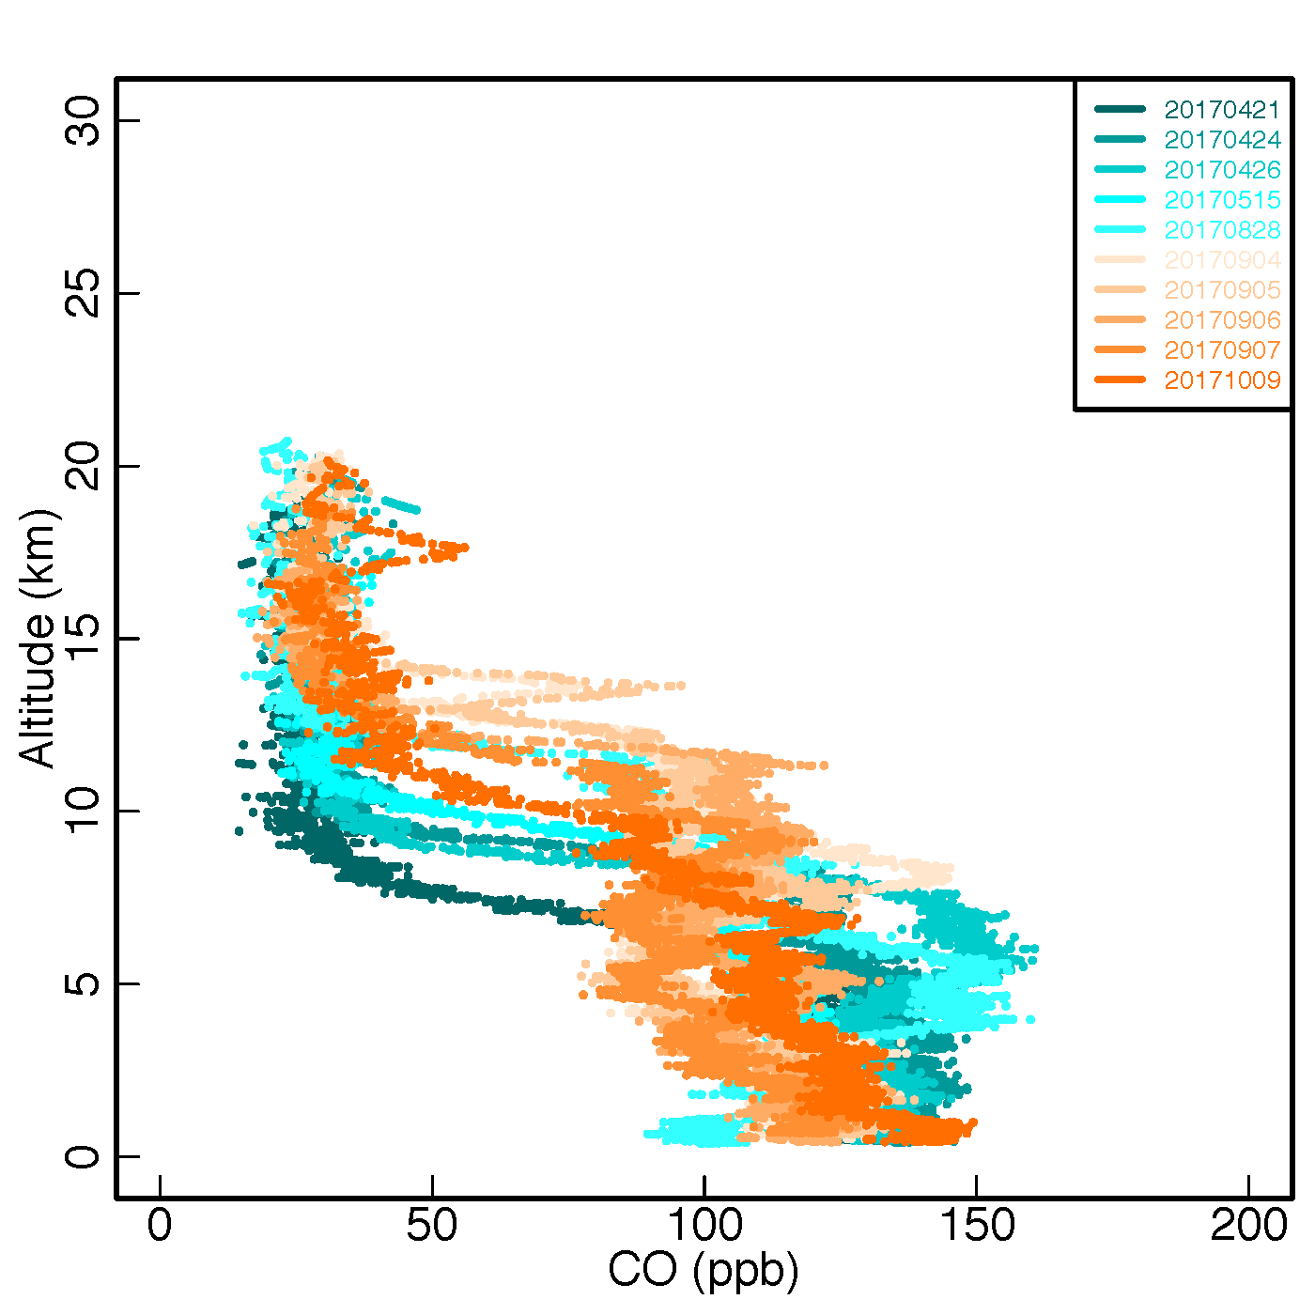
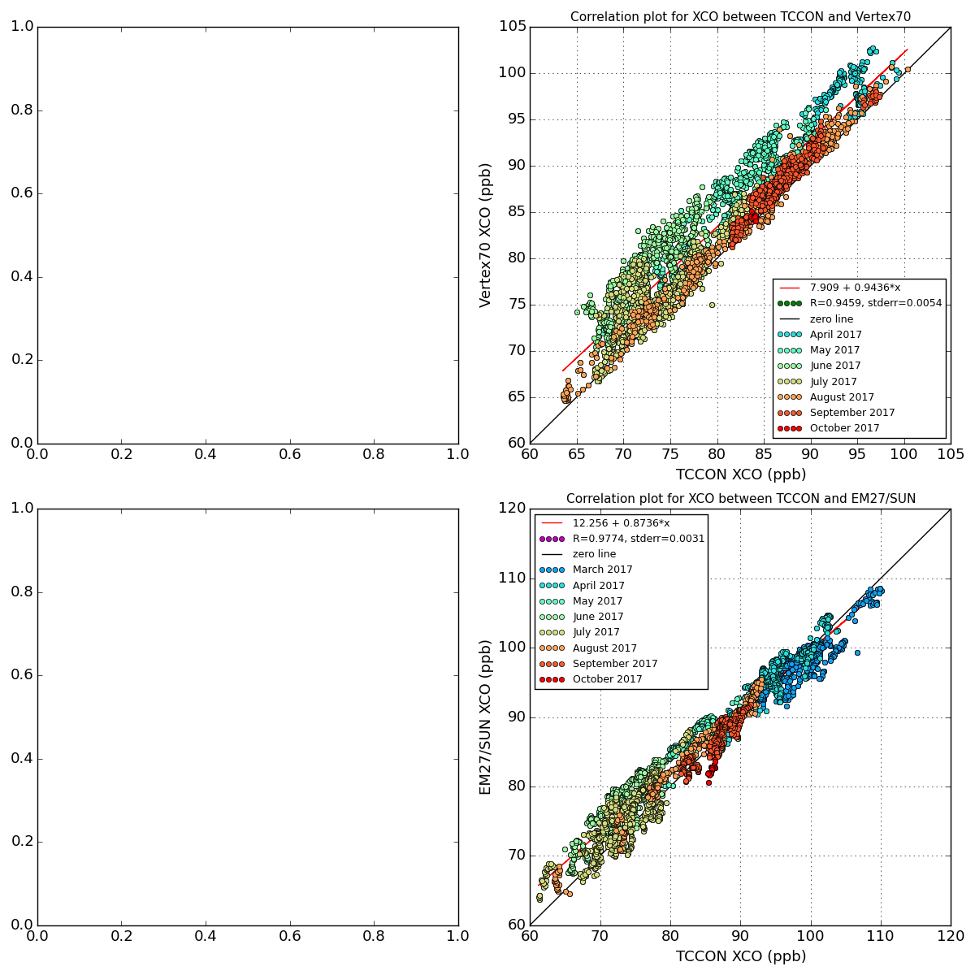
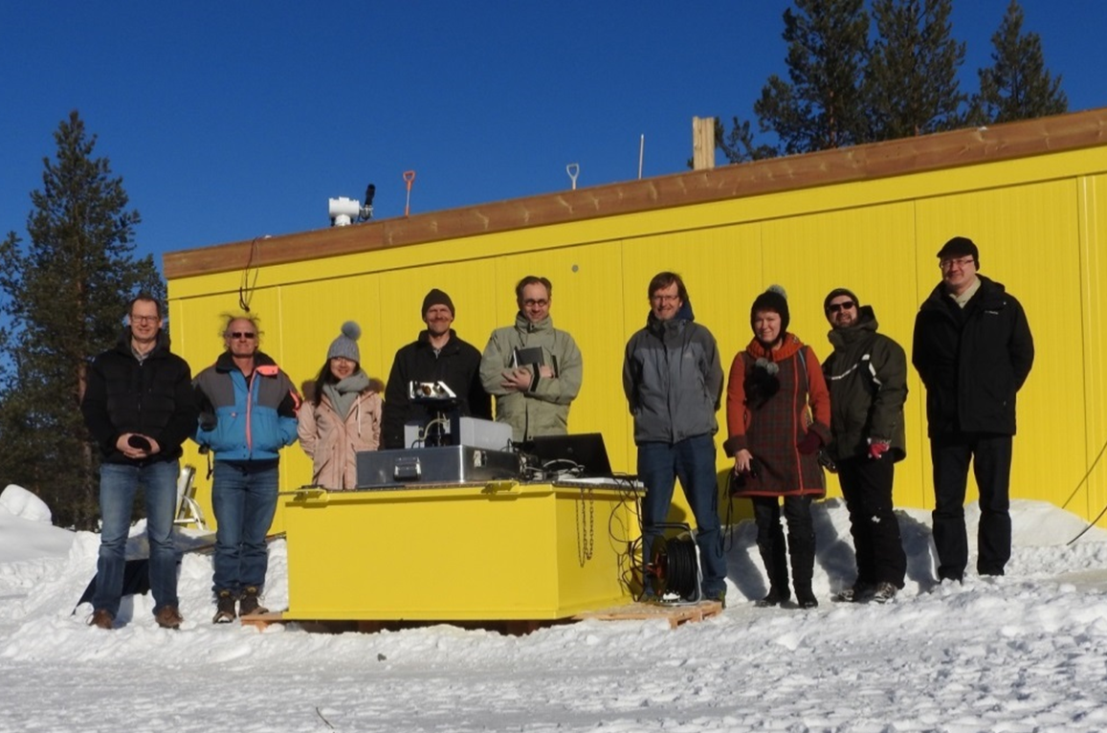







First year results of the Fiducial Reference Measurements for GreenHouse Gases (FRM4GHG) intercomparison campaign performed at the Sodankylä TCCON site
Mahesh Kumar Sha¹, Martine De Mazière¹, Justus Notholt², Thomas Blumenstock³, Huilin Chen⁴, Angelika Dehn⁵, David Griffith⁶, Frank Hase³, Pauli Heikkinen⁷, Christian Hermans¹, Alex Hoffmann⁸, Joram Hoogheim⁴, Marko Huebner⁸, Nicholas Jones⁶, Rigel Kivi⁷, Christof Petri², Francis Scolas¹, Qiansi Tu³, Damien Weidmann⁸
1: Royal Belgian Institute for Space Aeronomy (BIRA-IASB), Brussels, Belgium, 2: University of Bremen, Bremen, Germany, 3: Karlsruhe Institute of Technology, IMK-ASF, Karlsruhe, Germany, 4: University of Groningen, Groningen, Netherlands, 5: European Space Agency (ESA), ESRIN, Frascati, Italy, 6: University of Wollongong, Wollongong, Australia, 7: Finnish Meteorological Institute, Sodankylä, Finland, 8: Rutherford Appleton Laboratory, United Kingdom mahesh.sha@aeronomie.be
Koninklijk Belgisch Instituut voor Ruimte-Aeronomie (BIRA) Institut royal d’Aéronomie Spatiale de Belgique (IASB) Royal Belgian Institute for Space Aeronomy (BIRA-IASB) Koninklijk Belgisch Instituut voor Ruimte-Aeronomie (BIRA) Institut royal d’Aéronomie Spatiale de Belgique (IASB) Royal Belgian Institute for Space Aeronomy (BIRA-IASB) Koninklijk Belgisch Instituut voor Ruimte-Aeronomie (BIRA) Institut royal d’Aéronomie Spatiale de Belgique IASB) Koninklijk Belgisch Instituut voor Ruimte-Aeronomie (BIRA) Institut royal d’Aéronomie Spatiale de Belgique (IASB) Royal Belgian Institute for Space Aeronomy (BIRA-IASB) Koninklijk Belgisch Instituut voor Ruimte-Aeronomie (BIRA) Institut royal d’Aéronomie Spatiale
Project objective: Perform an intercomparison of simultaneously measured total column amounts of carbon dioxide (CO2), methane (CH4) and carbon monoxide (CO) using several different portable low-cost spectrometric instruments under different atmospheric conditions in comparison to the (TCCON) instrument.
Campaign implementation: Sodankylä TCCON site (67.37 N, 26.63 E, 188 m.a.s.l) has been selected as the campaign base. First campaign: measurements performed between March – October 2017. Campaign extended for another year of measurements in 2018.
Instrument | Institute | Spectral range | Resolution | Main GHGs
Bruker IFS 125HR Fig. 1b-right | FMI | 1800 — 15000 cm⁻¹ | 0.004 cm⁻¹ | XCO₂, XCH₄, XCO @ 0.02 cm⁻¹
Bruker Vertex 70 Fig. 1c-left | Uni Bremen BIRA | 2500 — 15000 cm⁻¹ | 0.16 cm⁻¹ | XCO₂, XCH₄, XCO
Bruker EM27/SUN Fig. 1b-left | KIT | 4000 — 9000 cm⁻¹ | 0.5 cm⁻¹ | XCO₂, XCH₄, XCO
Bruker IR Cube Fig. 1d | Uni Wollongong | 4500—15000 cm⁻¹ | 0.5 cm⁻¹ | XCO₂, XCH₄
LHR (Laser Heterodyne Radiometer) Fig. 1c-right | RAL | 954—960 cm⁻¹ | 0.002 and 0.02 cm⁻¹ | CO₂, H₂O
AirCore Fig. 1g | Uni Groningen FMI | In-situ sampling | 13.4 mbar (Amb.P. > 232 mbar) 3.9 mbar (Amb.P. < 232 mbar) | CO₂, CH₄, CO vertical profiles, calibrated to WMO standards
b
a
g
c
f
d
e
Fig. 1: (a) TCCON sites, (b) FRM4GHG container and EM27/SUN in front, (c-left) Vertex70 and (c-right) LHR,
(d) IRCube, (e) suntracker for IRCube, (f) suntracker for Vertex70 and LHR, (g) Aircore launch at Sodankylä site.
Results:
Period covered: March 2017 – October 2017
XAir: an indicator for instrument performance and analysis code performance
XAir
XCO2
XAir
XAir
XCH4
XCO
AirCore: in-situ sampling of targeted species to get vertical profiles calibrated to WMO standards
CO2
CO
CH4
Discussions:
➔ Most instruments operated well during the first year of campaign except for two technical interventions. The IRCube had its broken optical fiber cable replaced in April and the Vertex70 had an instrumental modification in July thereby improving the instrumental line shape significantly.
➔ All instruments showed stable ILS before and during the campaign. EM27/SUN was operated under ambient conditions covering temperatures of -25 °C to 25 °C while the other instruments were operated from inside the dedicated FRM4GHG container.
➔ XAir: all instruments have similar scatter for any airmass. XAir for Vertex70 and IRCube show the same airmass dependence i.e., decreasing value with increasing SZA as TCCON. The XAir for EM27/SUN is rather constant and doesn’t show this feature. This is probably due to the different retrieval code used; e.g., GFIT used by: TCCON, Vertex70 and IRCube and PROFFIT used by: EM27/SUN. All instruments show no dependencies to the H2O variation during the year.
➔ XCO2: EM27/SUN has the longest coverage without any technical intervention. The overall bias relative to the TCCON is very small however a small seasonal dependency is seen. Vertex70 shows a better match w.r.t the TCCON for measurements done with improved ILS. IRCube shows a change of bias (high bias) after the instrumental intervention. Seasonal dependency is also seen for the IRCube data. LHR which is a new homemade instrument shows large discrepancies (very high bias) with diurnal variability relative to the TCCON.
➔ XCH4: EM27/SUN and IRCube both pick-up nicely the annual cycle except for the period between March – May. Part of this difference is due to the TCCON a priori not matching with the actual profile shape (e.g. seen from AirCore profiles) and the differing sensitivities between TCCON and the low-resolution spectrometers. Vertex70 also has a small bias.
➔ XCO: EM27/SUN has a clear increase in bias for the March – May season, the annual cycle is produced very well but there is an overall curvature in the difference related to the SZA dependence. Vertex70 bias since the instrument modification is similar to the EM27/SUN.
➔ Most instruments have demonstrated good stability and consistency with very good correlation w.r.t TCCON reference during the whole year.
Next steps and outlook: • Continue testing with the current configuration of instruments during the extension of the campaign in 2018, add new species (e.g. HCHO, N2O) • Comparison of retrieval results for the two years of campaign measurements and determination of calibration factors w.r.t the TCCON. Verify calibration of remote sensing instruments w.r.t the AirCore • Provide a significant dataset of CO2, CH4 and CO measurements which can be used for satellite validation purposes (e.g. Sentinel-5 Precursor) • Provide a guideline for further development of new observation sites to complement the TCCON network and provide better support for the validation of existing and future satellite missions.
Acknowledgements: The FRM4GHG campaign is funded by ESA under contract number ESA-IPL-POE-LG-cl-LE-2015-1129.
The author thanks other FRM4GHG team members for their contribution and Paulo Castracane from ESA.
Website: http://frm4ghg.aeronomie.be
Notes:
Impact of profile is small compared to station-to-station variability
Same global picture for all satellites and products; small differences
Largest differences for polluted stations → problem of representativity?

